Slide 1
NEW BEDFORD, Massachusetts

Slide 2
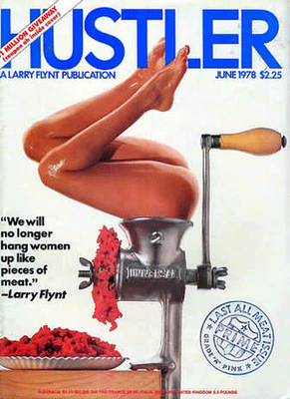
Hustler magazine

Slide 3
In January, 1983, Hustler ran an cover photo featuring a woman having sex with multiple men on a pool table.
In March, 1983, a woman in New Bedford, MA was gang-raped in a bar, on a pool table.

Slide 4
After the rape in New Bedford, Hustler published a “postcard” in their next issue.
The postcard depicted a naked woman on a pool table.
The caption read, “Greetings from New Bedford, Mass. The Portuguese Gang-Rape Capital of America.”

Slide 5
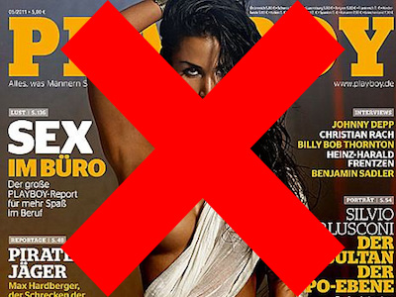
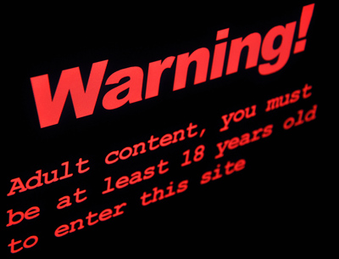
Pornography and Free Speech

Slide 6
Debate Propositions
"Everyone who can live healthfully on a vegetarian diet should do so."
"We have no direct moral duties to non-human animals."

Slide 7
How big is pornography?
7 pornography sites among top 100 most-visited websites in US:
#33 – xhamster
#43 – PornHub
#47 – LiveJasmin
#55 – xvideos
#76 – RedTube
#78 – XNXX
#84 – YouPorn
Compared with 11 news sites:
#15 – MSN
#21 – CNN
#22 – Huffington Post
#35 – NYTimes
#41 – Fox News
#51 – NBC News
#79 – Washington Post
#87 – Drudge Report
#89 – BBC Online
#96 – Wall Street Journal
#97 – USA Today

Slide 8
Genres
Age
Size/Anatomy
Race/Ethnicity
BDSM
Transsexuals
Strange Object Insertion
Pissing, etc.
And so on. . .

Slide 9
Attitudes & Behavior
Conscious vs. Non-conscious attitudes/processes
Forgetful
Old
Wise
Lonely
Florida
Wrinkle

Slide 10
Attitudes & Behavior
Conscious vs. Non-conscious attitudes/processes
Forgetful
Old
Wise
Lonely
Florida
Wrinkle

Slide 11
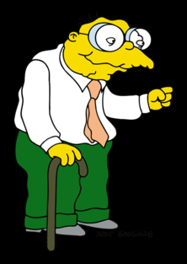
Attitudes & Behavior
1996 experiment:
Some subjects “primed” with elderly-stereotype words (subliminal presentation).
These subjects walked 15% slower on their way to the elevator after the experiment.

Slide 12
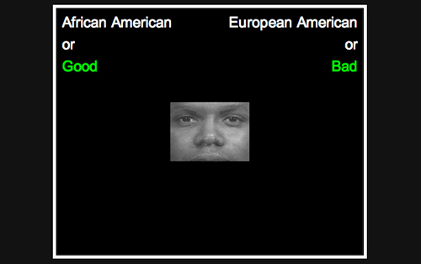
Attitudes & Behavior
Stereotypes, non-conscious attitudes, & behavior:
Project Implicit: https://implicit.harvard.edu/implicit/demo/
“an analysis of more than 900,000 completed Implicit Association Tests suggested that more than 70% of test takers associated White people with good and Black people with bad more strongly than the reverse.”
These measures of implicit attitudes show little or no correlation with explicitly-reported attitudes.

Slide 13
Attitudes & Behavior
Weapons IAT
Most Americans show moderate to strong tendency to associate Black Americans with weapons and White Americans with harmless objects.

Slide 14
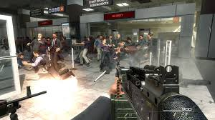
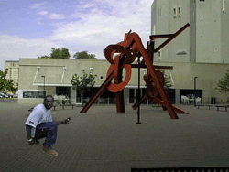
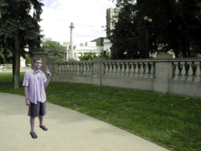
Attitudes & Behavior
2002 Study

Slide 15
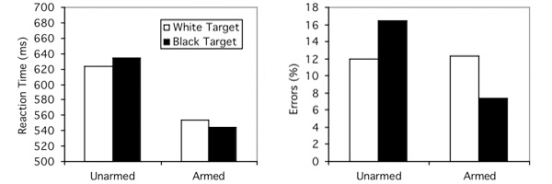
Attitudes & Behavior
2002 Study

Slide 16
Attitudes & Behavior
2002 Study
“It is important to recognize that the proposed process does not require a participant to dislike African Americans, or to hold any explicit prejudice against them, nor does it require that the participant endorse the stereotype; it simply requires that, at some level, the participant associates the two concepts “African American” and “violent.”

Slide 17
Putting it Together: Attitudes & Behavior
Psychological research tells us:
Our unconscious minds are constantly picking up cues from our environments.
We develop associations based on these cues that affect how we process incoming information.
These associations can affect how we behave, in subtle ways.
These processes work even when we are not aware of them.
We can exert influence on these processes by choosing the environments we’re exposed to.

Slide 18
Approaches to Morality of Pornography
Moralistic Approaches:
Sex should be for procreation.
Sex is “dirty” (inherently immoral).
Sex should be private.

Slide 19
Approaches to Morality of Pornography
Harm-Based Arguments:
People are harmed in the production & consumption of pornography.
Women are harmed in societies where pornography flourishes.
Pornography contributes to the oppression of women.
Hence, to the social, economic and political inequality of women.

Slide 20
Approaches to Morality of Pornography
Sex discrimination argument:
Pornography is a practice that subordinates and silences women.
See Catherine MacKinnon, Only Words (1993).
1983: Anti-Pornography Civil Rights Ordinance signed into law in Indianapolis.
Ruled unconstitutional in American Booksellers v Hudnut, 771 F.2d 323 (7th Cir., 1985).

Slide 21
Approaches to Morality of Pornography
Character-Based Critiques:
People choose to consume pornography and choose to maintain their sexual fantasies.
Deliberately fantasizing about demeaning, degrading, or humiliating others corrodes one’s character.
(See Dwyer, “Enter Here: The Moral Dangers of Cyberporn”)

Slide 22
Language Matters
We use definitions and characterizations to do (at least) two things:
1. Help us identify things in the world by finding things that fit those definitions or characterizations. (Identification function of language.)
2. Help us formulate arguments, by making clear what things we are talking about. (Strategic function of language.)

Slide 23
2 types of characterization
1. Descriptive characterization: does not contain any evaluation:
“Sally sang a song”
“Charles is 8 feet tall”
2. Normative characterization: contains evaluation:
“Sally screeched and howled her way through 3 minutes worth of acoustic assault”
“Charles is a freak”

Slide 24
Defining Pornography
“Pornography is the undiluted essence of anti-female propaganda.” (Susan Brownmiller, Against Our Will, 1975, 394)
“Pornography is the purest expression of human sexual and spiritual liberation.”
Pornography is the explicit depiction of human beings engaged in sexual activity.

Slide 25
Descriptive Characterizations
It’s easy to find things that are explicit depictions of human beings engaged in sexual activity.
Not so easy to find things that are the undiluted essence of anti-female propaganda.

Slide 26
Normative characterizations are strategically useful:
If one wanted to argue that pornography is morally problematic, then one would use a characterization like Brownmiller’s. For who would deny that anti-female propaganda is a bad thing?

Slide 27
Normative characterizations are strategically useful:
Similarly, if one wanted to argue that there is nothing morally problematic about pornography, one would use a characterization like “Pornography is the purest expression of human sexual and spiritual liberation.” For, who would argue that kind of material was morally problematic?

Slide 28
A Patriarchal Society?
Wage gap: Most optimistic estimates: Women make 86¢ on the dollar compared to men for the same work.
Wealth gap: 57% of men negotiate their starting salary, 7% of women do.
This generates an average initial wage disparity of $4,000/yr. This adds up to $.5M over a career.
US Justice Department: 1 in 5 women will be sexually assaulted in their lifetime.
Women are 3 times as likely as men to be murdered by an intimate partner.

Slide 29
Helen Longino: Pornography, Oppression, and Freedom
Two types of argument:
Moral Argument: Tries to convince us that pornography, as she defines it, is morally problematic.
Policy Argument: Tries to convince us that pornography, as she defines it, ought to be restricted by the state.

Slide 30
Longno’s Defintion
“Pornography. . .is verbal or pictorial material which represents or describes sexual behavior that is degrading or abusive to one or more of the participants in such a way as to endorse the degradation [or abuse].” (43)

Slide 31
2 Things to note about this definition
Not all sexually explicit material is pornography—sexually explicit material that fails to endorse depicted degradation doesn’t count.
Pornography vs. erotica
It is a stipulative definition—i.e., this is what she will mean by “pornography.” You are free to provide a different definition, but in evaluating her arguments we will assume her definition.

Slide 32
Moral Argument
P1: Definition: “Pornography is “verbal or pictorial material which depicts or describes sexual behavior that is degrading or abusive to one or more of the participants in such a way as to endorse the degradation [or abuse].” (43)
P2: Overwhelmingly, the participants whose degradation and abuse are endorsed in pornography are women.

Slide 33
Moral Argument
= Empirical
P1: Definition: Pornography is “verbal or pictorial material which depicts or describes sexual behavior that is degrading or abusive to one or more of the participants in such a way as to endorse the degradation [or abuse].” (43)
P2: Overwhelmingly, the participants whose degradation and abuse are endorsed in pornography are women.

Slide 34
Moral Argument
P3. Because of this, pornography
(a) contributes to violence against women;
(b) lies about women’s sexuality; &
(c) reinforces the oppression of women.
P4. (a), (b) & (c) are harms to women.
P5. Anything that is harmful to persons is morally problematic.
C. Therefore, pornography is morally problematic.

Slide 35
Moral Argument
= Empirical
= Normative
P3. Because of this, pornography
(a) contributes to violence against women;
(b) lies about women’s sexuality; &
(c) reinforces the oppression of women.
P4. (a), (b) & (c) are harms to women.
P5. Anything that is harmful to persons is morally problematic.
C. Therefore, pornography is morally problematic.

Slide 36
Longino: Harms to Women
How could pornography “lie about women’s sexuality”?
Women’s sexual pleasure is subordinate to men’s.
Women obtain sexual fulfillment primarily through pleasing men.
All women are sexually available (they just need a little persuasion).

Slide 37
Quick Note
3 loci of moral criticism:
Consumers (direct)
Consumers (indirect)
Industry
Producers/distributors
Performers
Incitation of sexual violence
Corruption of character
Treatment of performers (exploitation)
Complicity in sexual violence
Women’s oppression
Attitudes abt. women’s sexuality

Slide 38
Longino: Harms to Women
How could pornography contribute to sexual violence against women?
Recall “Attitudes & Behavior” lessons.
Could repeated exposure to this sort of material affect one’s attitudes about women and sex? One’s behavior?

Slide 39
Longino: Harms to Women
How could pornography contribute to women’s oppression?
Very roughly, to be oppressed is to have one’s life go less well than it otherwise would were it not for certain avoidable, external factors that prevent one from being able to lead a flourishing life in accordance with one’s actual capacities.
Having people’s beliefs about you determine and (apparently) justify treating you in certain ways is one way to be oppressed.

Slide 40
Summing Up: Longino’s Moral Argument
Note that her moral conclusion is weak: she claims only that pornography is “morally problematic”
Two routes of attacking her conclusion:
It is not plausible that pornography as she defines it, has the effects she claims for it.
No material of the sort she describes exists.

Slide 41
Policy Argument
P1. The only justification for state interference with an individual’s liberty is if the exercise of that liberty causes demonstrable harm to others.
“Harm Principle”
P2. Pornography, as Longino defines it, does cause demonstrable harm.
C. Therefore, the state is justified in interfering with individuals’ liberty to produce, distribute & consume pornography.

Slide 42
Evaluating the policy argument
Let us concede the truth of the Harm Principle (P1)
Next, we need to discover whether pornography does cause demonstrable harm.
Finally, we need to ask whether the harms to women are sufficiently severe to justify state intervention. (Wicclair: NO.)

Slide 43
Free Speech
Congress shall make no law respecting an establishment of religion, or prohibiting the free exercise thereof; or abridging the freedom of speech, or of the press; or the right of the people peaceably to assemble, and to petition the Government for a redress of grievances.
Amendment 1. Constitution of the United States.

Slide 44
Why is Free Speech Important?
Democracy requires free speech.
Discovering the truth requires free speech.
A free marketplace of ideas contributes to human flourishing.

Slide 45
Role of Free Speech Arguments
The appeal to free speech plays 2 roles in defending the freedom of pornographers:
Consequences of restricting pornography are worse than the consequences of letting it be.
Slippery slope worries: if we ban pornography today, what will happen tomorrow?

Slide 46
Wicclair
Any law must be written in a way that judges & juries can understand, and in a way that minimizes the chances of multiple, conflicting interpretations of it.
Inevitably, there will be difficulties surrounding the notion of degradation, and the fact of endorsement.

Slide 47
Wicclair: Free Speech Argument
Wicclair concedes Harm Principle:
It is justifiable to restrict liberty when exercise of liberty would cause substantial and demonstrable harm.
How do we know when harm is sufficient to justify censorship?

Slide 48
Wicclair: Free Speech Argument
Wicclair: Restrictions justified “only if words or images present a ‘clear and present danger’ of harm or injury.”
“It is doubtful that pornography satisfies the ‘clear and present danger’ condition.”
-Pg. 53

Slide 49
Empirical Questions
There is psychological evidence that after viewing violent pornography, people are more likely to say that women both enjoy violence and seek it out.
Wicclair: “. . .this does not show that viewing violent pornography causes violent behavior.”

Slide 50
Wicclair: Reasons for Suspicion
The behavior shown in (most) pornography is not illegal. How can it be legal to ban depicting it?
Degrading depictions of women are widespread in movies, advertisements, etc. Why censor only degrading depictions in sexually explicit material?

Slide 51
Possible Bad Consequences of Banning Pornography
We may lose the valuable cathartic effects of pornography’s availability.
Slippery slope: The state will move to censor other things we don’t want censored.

Slide 52
Evaluating Slippery Slope Arguments
Concede the “instant case”
Provide credible reasons to believe that the steps you cite will follow from the instant case. Merely being anxious that they might is not enough

Slide 53
Challenge for Slippery Slope Arguments
Child pornography has been banned, and this has not led to widespread bans on pornography of all types.
Why should it be different for banning, say, the “Forced” or “Pissing” subgenres?

