Slide 1
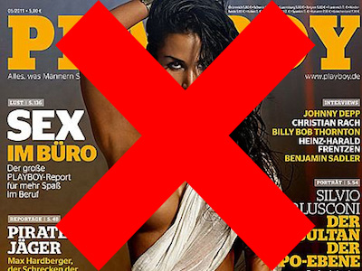
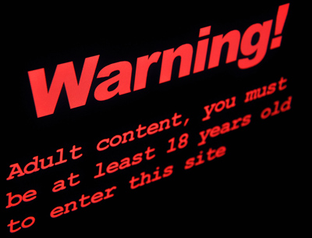
Pornography and Free Speech: Wrap-up

Slide 2
Cameron & Frazer: Main Points
1. Causal accounts of sexual violence—and human behavior generally—are both inadequate and miss the point.
2. But pornography is related to sexual violence: pornography makes sexual violence intelligible by making certain contributions to the space of reasons.

Slide 3
Explaining Human Behavior
Philosophers distinguish 2 ways of answering the question, ‘Why did Ted do X?’
Because neurons in region 5 of Ted’s brain were firing in such-and-such pattern. (Reductive, causal explanation.)
Because Ted wanted A and he believed that doing X was the best way to get A. (Reason explanation.)

Slide 5
Reasons
Reasons are a way of making sense of people’s actions—our own and those of others.
The set of available reasons does not exist in a vacuum—it is constantly shaped and re-formed by culture.
“When Ted Bundy tells us he was corrupted by pornography, we need to ask not whether he is lying but where he got the story.”
-Pg. 246

Slide 6
Cameron & Frazer reject 2 “causal” models
The “copycat” model of pornography’s effects: you see it, you do it.
Humans are not mere stimulus-response machines,
and
The “addiction” model of pornography’s effects: start with something mild, and then need more and more intense experiences, a need that results in actually acting.
A person needs to “interpret” representations in order to find them erotic.

Slide 7
Pornography’s Connection to Sexual Violence
Pornography does not cause sexual violence, but. . .
The presence of violent pornography does provide us with a “story” to use in interpreting and explaining, for example, Bundy’s actions.
What other “stories” might pornography give us about other facets of human sexuality?
Could it change our ideas about what kinds of sexuality are “normal”?
Could it shape our ideas about masculinity and femininity?

Slide 8
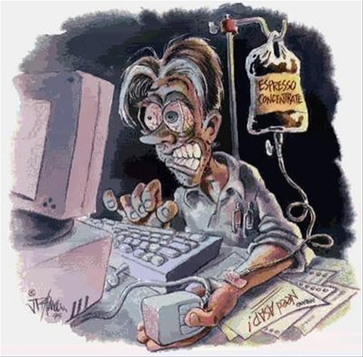
A note about pornography and addiction
Addiction, in general terms, is a condition of malfunctioning brain circuitry.
“Reward” and “motivation” centers/pathways.
Addiction is the “pathological pursuit of reward.”
Any activity that modifies the brain’s reward/motivation circuitry can be an addiction (drugs, gambling, internet).
So contrary to C&F, pornography addiction is perhaps not so different from drug addiction.

Slide 9
But. . .
But we do need to ask why it is we find certain materials erotic and arousing.
Why are these materials rewarding?
And we do need to ask what effect, if any, the “mainstream” nature of certain types of pornography is having on our ideas of sexuality.

Slide 10
Sex vs. Sexuality
Sex is indeed a biological phenomenon, in which instinct does play a role.
But sexuality—the ways we understand ourselves as sexual beings, and what we find erotic and sexual—is (at least partially) culturally constructed.

Slide 11
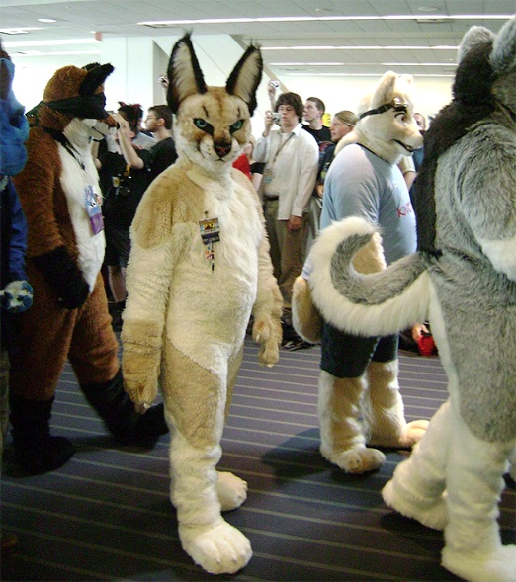
Sex vs. Sexuality
Looners
Furries
Literotica.com categories:
Erotic Couplings: 40,521
Incest: 29,888
Group Sex: 17,209
Exhibitionist & Voyeur: 13,534
Gay Male/Lesbian: ~11,000 each
Fetish (feet, panties, food): 9,499

Slide 12
Sex vs. Sexuality
Plausibly, expressions of sexuality in pornography both reflect and shape notions of sexuality in broader culture.
If aspects of our culture’s sexuality are problematic, perhaps pornography plays a role (along with many, many other things).
Sexual violence
Double standards
“Keeping up with the Jamesons”

Slide 13
Cameron & Frazer: Main Points
1. Causal accounts of sexual violence—and human behavior generally—are both inadequate and miss the point.
2. But pornography is related to sexual violence: pornography makes sexual violence intelligible by making certain contributions to the space of reasons.

Slide 14
Pornography and Free Speech: Wrap-up
Does pornography cause sexual violence?
Empirical Evidence? (Anecdotal, Criminological, Psychological)
Copycat behavior? Addictive behavior?
YES
NO
Should it be censored?
Should it still be censored?
YES
NO
YES
NO
Is it still harmful?
Moral deviancy?
Attitudes towards women?
How important is free speech? (Harm Principle)
Slippery Slope?
WRONG QUESTION!

Slide 15
Pornography and Free Speech: Final Questions
Apart from the question of whether pornography causes sexual violence, is it still morally problematic?
Even if pornography shouldn’t be censored, would it be good if we—as a society—chose to consume less of it (or less of certain kinds)?
(Vegetarianism)

