Slide 1
Tim and Angela are college juniors. They’ve been going out for 2½ years.
One Saturday night, Angela stays in because she’s not feeling well. Tim gets mildly intoxicated at a party and ends up sleeping with a friend visiting from out of town.

Slide 2
Global Poverty & International Aid
PHIL140

Slide 3
The Question:
What obligations do individual citizens of wealthy nations (for example, you and me) have to people suffering from poverty in faraway countries?

Slide 4
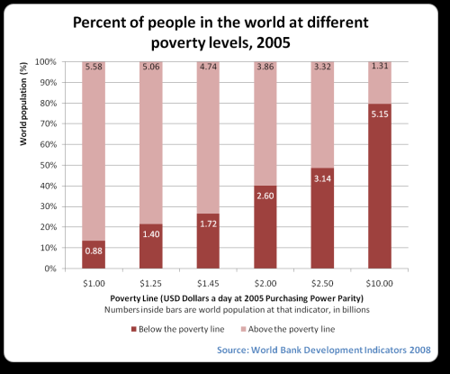
Some numbers: Global Poverty

Slide 5
Some Numbers: Global Poverty
Every year more than 6 million children under the age of five die from preventable causes (malaria, diarrhea, pneumonia).
More than 50% of Africans suffer from water-related diseases (cholera, infant diarrhea).
3 Million people per year die from malaria.
Of the 300 million children who go to bed hungry each night, more than 90% are suffering long-term malnutrition.
More than 2.6 billion do not have basic water sanitation; more than 1 billion use unsafe drinking water sources.
Women in Africa have a 1 in 16 chance of dying in pregnancy or childbirth. (1 in 3,700 in North America).
Source: United Nations Millennium Project

Slide 6
Peter Singer
Author of:
“Famine, Affluence, and Morality” (1972)
The Life You Can Save (2009)

Slide 7
Singer’s Argument:
P1: Suffering and death from lack of food, shelter, and medical care are bad.
P2: If it is in your power to prevent something bad from happening, without thereby sacrificing anything nearly as important, it is wrong not to do so.
P3: By donating to aid agencies, you can prevent suffering and death from lack of food, shelter, and medical care, without sacrificing anything nearly as important.
C: Therefore, if you do not donate to aid agencies, you are doing something wrong.

Slide 8
Singer’s Argument:
= Empirical
= Normative
P1: Suffering and death from lack of food, shelter, and medical care are bad.
P2: If it is in your power to prevent something bad from happening, without thereby sacrificing anything nearly as important, it is wrong not to do so.
P3: By donating to aid agencies, you can prevent suffering and death from lack of food, shelter, and medical care, without sacrificing anything nearly as important.
C: Therefore, if you do not donate to aid agencies, you are doing something wrong.

Slide 9
Singer’s Conclusion:
We have a moral duty to prevent suffering and death, even if it requires sacrificing “luxuries” for ourselves that we could afford to enjoy.

Slide 10
What does this conclusion mean?
It means that when we fail to give (or when we fail to give enough), we are doing something wrong.

Slide 11
Singer’s Key Analogy
You come across a young child drowning in a shallow pond. No one else is around. You can save the child by wading into the water, even though this will ruin your favorite shoes. Do you not have a moral obligation to save the child?
Singer uses this case to derive a general moral principle (Premise 2 of his argument).
If we wish to avoid Singer’s conclusion, the challenge is to find a morally relevant difference between this case and global poverty.

Slide 12
What is Singer saying?
That the distribution of wealth worldwide should be completely equal?
No.
That every citizen of wealthy nations has an obligation give substantial portions of her or his own income?
No.
That among those obligated to give, everyone must contribute some determinate percentage of her or his income?
No.
That the obligation to relieve desperate poverty falls entirely on individuals rather than governments?
No.

Slide 13
What is Singer saying?
That when you spend money on luxuries instead of using that money to prevent suffering, you violate your moral obligations?
Yes.
That the world would be a better place if wealthy people gave more in direct aid to people in developing countries?
Yes.
That even if you fail in the full extent of your moral duties, you can make the world a better place by doing something rather than nothing?
Yes.
That individual donations can sometimes be more effective than pushing for government action?
Yes.

