Slide 1

Singer’s Argument:
= Empirical
= Normative
P1: Suffering and death from lack of food, shelter, and medical care are bad.
P2: If it is in your power to prevent something bad from happening, without thereby sacrificing anything nearly as important, it is wrong not to do so.
P3: By donating to aid agencies, you can prevent suffering and death from lack of food, shelter, and medical care, without sacrificing anything nearly as important.
C: Therefore, if you do not donate to aid agencies, you are doing something wrong.

Slide 2
What is Singer saying?
That the distribution of wealth worldwide should be completely equal?
  No.
That every citizen of wealthy nations has an obligation to give substantial portions of her or his own income?
  No.
That among those obligated to give, everyone must contribute some determinate percentage of her or his income?
  No.
That the obligation to relieve desperate poverty falls entirely on individuals rather than governments?
  No.

Slide 3
What is Singer saying?
That when you spend money on luxuries instead of using that money to prevent suffering, you violate your moral obligations?
  Yes.
That the world would be a better place if wealthy people gave more in direct aid to people in developing countries?
  Yes.
That even if you fail in the full extent of your moral duties, you can make the world a better place by doing something rather than nothing?
  Yes.
That individual donations can sometimes be more effective than pushing for government action?
  Yes.

Slide 4
Singer’s Conclusion:
We have a moral duty to prevent suffering and death, even if it requires sacrificing “luxuries” for ourselves that we could afford to enjoy.

Slide 5
What does this conclusion mean?
It means that when we fail to give (or when we fail to give enough), we are doing something wrong.

Slide 6
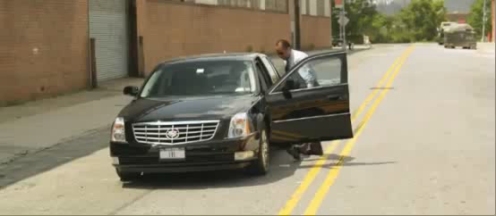

Slide 7
Singer’s Key Analogy
You come across a young child drowning in a shallow pond. No one else is around. You can save the child by wading into the water, even though this will ruin your favorite shoes. Do you not have a moral obligation to save the child?
  Singer uses this case to derive a general moral principle (Premise 2 of his argument).
  If we wish to avoid Singer’s conclusion, the challenge is to find a morally relevant difference between this case and global poverty.

Slide 8
Singer’s Argument:
= Empirical
= Normative
P1: Suffering and death from lack of food, shelter, and medical care are bad.
P2: If it is in your power to prevent something bad from happening, without thereby sacrificing anything nearly as important, it is wrong not to do so.
P3: By donating to aid agencies, you can prevent suffering and death from lack of food, shelter, and medical care, without sacrificing anything nearly as important.
C: Therefore, if you do not donate to aid agencies, you are doing something wrong.

Slide 9
Reservations - Empirical

Slide 10
How can I know that my donation will help?
What if the charity wastes the money?
  Incompetence
  Corruption
Couldn’t there be unforeseen consequences?

Slide 11
Resources for finding effective charities:
www.givewell.org
Oxford Center for Effective Altruism
The Life You Can Save (the website):
  www.thelifeyoucansave.org

Slide 12
Isn’t giving people money just treating their “symptoms”?
Don’t we need fundamental, lasting change (“treat the disease”)?

Slide 13
Response 1:
Consider the following. . .
Should we give pain medication to bone cancer patients?
  No. Treating patients’ pain only treats the symptoms. We need to treat the disease.
  If you are a doctor with a bone cancer patient in terrible pain, it is better not to give them pain medication.
    What will really help this person is if you sell the medication and donate the proceeds to bone cancer research.

Slide 14
Response 2:
Lasting change might require direct aid (temporarily).
Sachs: “It is no good to lecture the dying that they should have done better with their lot in life. Rather, it is our task to help them onto the ladder of development, at least to gain a foothold on the bottom rung, from which they can then proceed to climb on their own.”
  The End of Poverty (2005), p. 2

Slide 15
Isn’t overpopulation rampant in developing countries?
Won’t saving lives just lead to more population growth?
That will make it even harder to feed everyone.

Slide 16
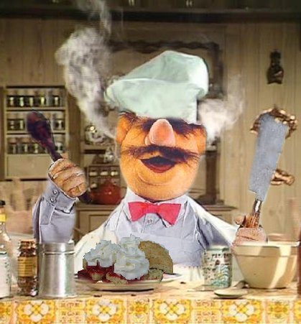
Response

Slide 17
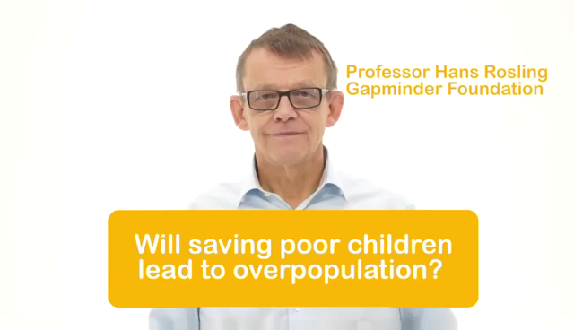
Response

Slide 18
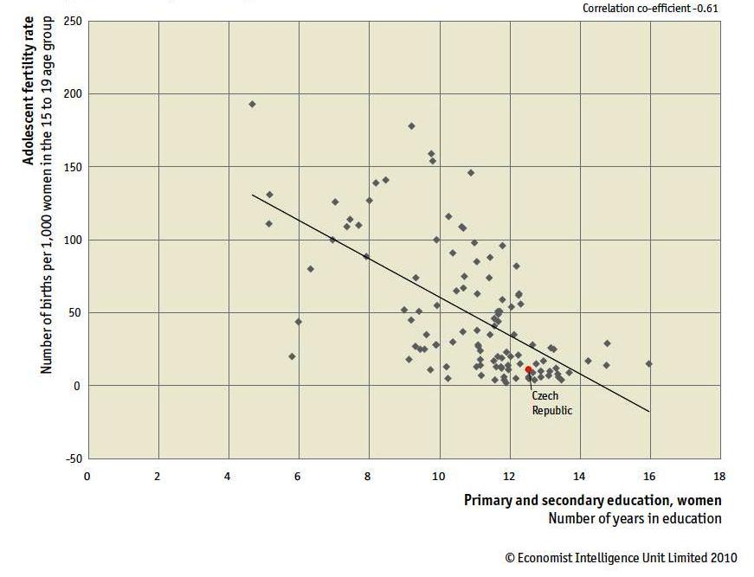
Girls’ education & fertility

Slide 19
Wait, what if everyone with disposable income gave as much as they could to poverty relief?
Wouldn’t that collapse the economy and make everyone worse off?

Slide 20
Response:
Short answer: Yes. But. . .
If you know (with virtual certainty) that everyone will not give away most of their income at once, then this isn’t a genuine concern.

