Slide 1
Global Poverty & International Aid
PHIL140

Slide 2
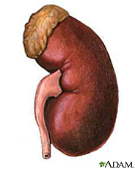
“Brother, can you spare a kidney?”
Singer’s principle:
If I can prevent something bad from happening [someone’s death from kidney failure] without sacrificing something nearly as important [I live with one kidney], it is wrong not to do so.

Slide 3
Singer’s 3 Options
Bite the bullet – Concede that yes, by applying a sound moral principle, we are morally obligated to give our kidneys to strangers.
Endorse a weaker version of the general moral principle.
Find some other morally relevant difference between the cases.

Slide 4
2 Separate Questions
Is it wrong not to donate your kidney to a stranger?
Is it good to donate your kidney to a stranger?
Might it be bad?
Categories: prohibited, permitted {obligatory, neutral, supererogatory}.

Slide 5
Arthur: Closing Thought
“It seems…that a reasonable code would require people to help when there is no substantial cost to themselves…when what they are sacrificing would not mean significant reduction in their own or their families’ level of happiness.”
Arthur -pg. 145
“If it is in your power to prevent something bad from happening, without thereby sacrificing anything nearly as important, it is wrong not to do so.”
Singer -pg. 15

Slide 6
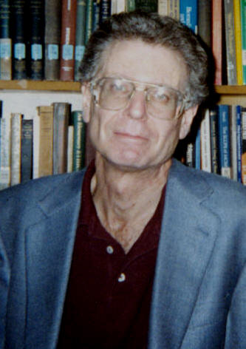
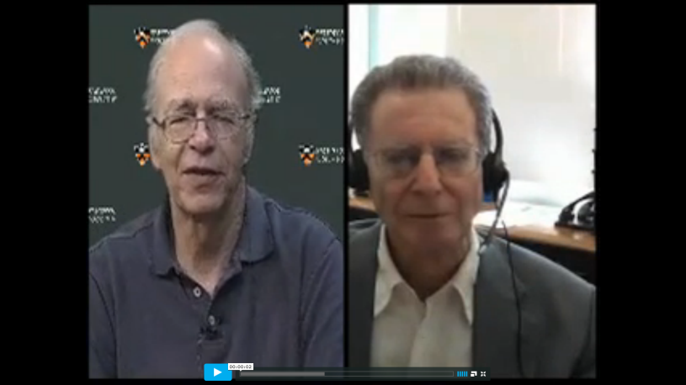
Michael Slote: Caring and Empathy
Responds to Singer with an alternative moral theory.
This theory revolves around empathy, and specifically normal human empathy.

Slide 7
Slote’s virtue ethics
Central moral question: To what extent does an act reflect a virtuous, empathetic character?
Does this act exhibit a deficiency of normal human empathy?
Compare:
Consequentialist/Utilitarian: Does this act produce the best all-around state of affairs?
Deontologist: Does this act conform to moral rules?

Slide 8
Slote
Central moral question: How well does this act reflect a virtuous, empathetic character?
Does this act exhibit a deficiency of normal human empathy?
Failing to save the drowning child: YES
Failing to save a starving child in India: NO
Or at least. . .PROBABLY NOT
This is why it’s wrong not to save the drowning child, but it isn’t wrong not to save a starving distant child.

Slide 9
Slote
“An ethics of caring will hold that it is virtuous to be more concerned about near and dear than about strangers.”
-Pg. 146
Not only are we allowed to care more for those near and dear to us, but we should do so (better expression of empathy).

Slide 10
Slote: Outstanding Questions
How far can an act stray from exhibiting normal human empathy before it becomes wrong?
What is “normal human empathy?”
How much empathy is it possible for a human to exhibit? How do situation and upbringing influence one’s level of empathy?
These are empirical questions.

Slide 11
Theoretical Interlude
How demanding should our moral theory be? How hard should it be to do the right thing?
In what way should our moral theory take account of how humans actually tend to act? Of how they’re capable of acting?
Immanuel Kant: “Ought implies can.”

Slide 12
Human Nature

Slide 13
Theoretical Interlude
Less
Demanding
More
Demanding
Obligatory
Supererogatory
Singer

Slide 14
Theoretical Interlude
Why would we want a less demanding moral theory? What happens if our theory is too demanding?
People may stop caring about morality altogether.
We may lose important distinctions among moral agents.
Depraved Sociopaths
Moral Saints

Slide 15
Theoretical Interlude
Why would we want a moral theory that’s more demanding? What happens if our moral theory is too weak?
Well, if the best arguments support a demanding moral theory. . .
People tend to rise (and fall) to the expectations that are set for them.

Slide 16
Theoretical Interlude
Less
Demanding
More
Demanding
Obligatory
Supererogatory
Singer
Kant spins in his grave
Spineless Accommodation

Slide 17
Back to Slote
Is it risky to tie our moral obligations to facts about how empathetic most humans happen to be?
Isn’t being a good person supposed to be hard?
Possible response (Slote pg. 153): Standard of measurement = How much empathy most people can develop, not just how much they have.
This seems to lead back towards Singer’s position (i.e. we should all be giving a lot more than we currently do).

Slide 18
Is a utilitarian framework necessary to derive Singer’s conclusions?
(Let’s set aside Singer’s strongest conclusions, and focus on the modest conclusion that you should be giving more to international relief than you currently are—let’s say $10/month.)

Slide 19
“It seems to me, then, that a reasonable code would require people to help when there is no substantial cost to themselves, that is, when what they are sacrificing would not mean significant reduction in their own or their families’ level of happiness.”
-John Arthur, pg. 145

Slide 20
“At the very least, then, even if Singer exaggerates what morality demands of us, it may nonetheless be true that many of us should give a good deal more for the relief of famine or disease around the world than we actually do.”
-Michael Slote, pg. 153

Slide 21
“At the very least, then, even if Singer exaggerates what morality demands of us, it may nonetheless be true that many of us should give a good deal more for the relief of famine or disease around the world than we actually do.”
-Michael Slote, pg. 153
It would be wrong not to give when giving would exhibit normal human empathy (or an amount of empathy most people could be led to develop).
You could probably develop sufficient empathy to donate $10/month to feed starving children.
Assumption: Giving $10/month is not onerous given your current standard of living.

Slide 22
“It seems to me, then, that a reasonable code would require people to help when there is no substantial cost to themselves, that is, when what they are sacrificing would not mean significant reduction in their own or their families’ level of happiness.”
-John Arthur, pg. 145
Giving $10/month would probably not result in a significant reduction of your or your family’s level of happiness.

Slide 23
THE CHALLENGE
Why shouldn’t you give $10/month to an international aid organization?

