Slide 1
Violinists and People Seeds
Thomson on Abortion

Slide 2
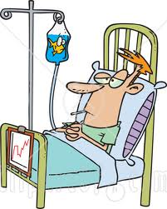
Imagine This. . .

Slide 3
Thomson
Main Points:
Some abortions are morally permissible, even if the fetus is a person—with a right to life—from the “moment” of conception.
The moral status of the fetus does not settle the moral issue of abortion.

Slide 4
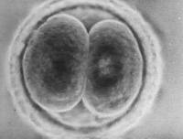
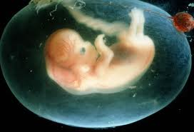
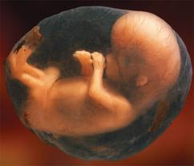

Slide 5
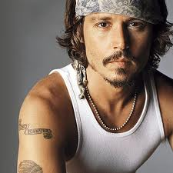
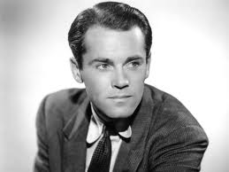
What is the Right to Life?
The right not to be killed? (Arthur)
The right to be given whatever one needs to continue living?
I have no right against
Johnny that he place his
cool hand upon my brow.

Slide 6
The Right to Life
Violinists are persons, so they have a right to life.
But if you unhook yourself from the violinist, you do not violate his right to life.
The right to life is not the right to be given whatever one needs to continue living.

Slide 7
The Right to Life
Therefore:
Even if a fetus is a person with a right to life,
This does not entail that it has a right to use a woman’s body for 9 months.
Thus, it is (usually) morally permissible for a woman to choose not to allow a fetus to use her body for 9 months (i.e., have an abortion).

Slide 8
The Responsibility Objection
What if you had joined the Society for Music Lovers, knowing that there was a possibility you would be called upon to allow the violinist use of your kidneys?
Women who are raped (or people kidnapped by the Society for Music lovers) may kill the fetus (or violinist), but. . .

Slide 9
The Responsibility Objection
But women who have engaged in voluntary intercourse:
Have tacitly consented to allowing the fetus the use of their bodies
Are (causally) responsible for the existence of the fetus, and so (morally) responsible for its well-being.
Have been negligent in permitting a state of affairs in which a person is dependent upon them; they have failed to exercise due caution in preventing this state of affairs.

Slide 11
The Responsibility Objection
But women who have engaged in voluntary intercourse:
Have tacitly consented to allowing the fetus the use of their bodies
Are (causally) responsible for the existence of the fetus, and so (morally) responsible for its well-being.
Have been negligent in permitting a state of affairs in which a person is dependent upon them; they have failed to exercise due caution in preventing this state of affairs.

Slide 12
The Responsibility Objection
How should we interpret due caution?
General strategy: “But she could have. . .”
Example: “She used contraception, but she could have abstained”
Implication: She is still responsible for the current state of affairs, and so bears responsibility for providing the fetus with what it needs to survive.

Slide 13
The Responsibility Objection
Less plausible example:
“The woman was raped, but she could have had her uterus removed.
So the question we must ask is not
“Is there anything the woman could have done to prevent pregnancy?” (the answer will always be yes)
But rather
“Is there anything the woman could have reasonably done to prevent pregnancy?”

Slide 14
Possible Views
Abortion is permissible except when the woman engages in voluntary intercourse.
But what if she uses 3 contraceptive methods in conjunction and restricts sex to “safe” days?
Is it reasonable to insist that she has tacitly consented, or that she has been negligent?

Slide 15
Consider this. . .
A person is driving on a busy road in an urban area.
A child runs into the street to pick up a quarter lying on the ground, and the car hits the child.
The child survives, but suffers severe injuries and has a large hospital bill.
Should the driver be responsible for paying the hospital bill?

Slide 16
Possible Views
Abortion is permissible except when the woman:
engages in voluntary intercourse, and
uses a contraceptive method less effective than the most effective one available to her.
Withdrawal?
Spermicidal foam but not condoms or pills?
Pills, but not pills + condoms
Pills + condoms, but fails to take pills at same time every day.
What if the woman has false beliefs about intercourse, contraception, and pregnancy?

Slide 17
Possible Views
Abortion is permissible except when the woman:
engages in voluntary intercourse without adequate contraception, but through no fault of her own
is ignorant of facts about intercourse and pregnancy.
(Differences in access to sex education)
What if she believes she cannot get pregnant. . .
During her period?
If the man withdraws prior to ejaculating?
If she does not have an orgasm?
If she has intercourse on a weeknight?
If she does not love her partner?

Slide 18
Responsibility Objection
Insisting that women are “responsible” for being pregnant so long as they choose not to have their uteruses removed is unreasonable. But is it reasonable to insist that. . .
Women must abstain from intercourse altogether in order to avoid responsibility for a fetus?
Women must educate themselves about intercourse and pregnancy before having intercourse?
Women must use reliable contraception if they plan to have intercourse?

Slide 19
Moral Implications
Intuitions on these questions will surely differ.
Even if we think a pregnant woman’s “responsibility” for her being pregnant (and for the fetus) is relevant:
There will be no quick and easy answers as to whether abortion is generally permissible or impermissible.
Especially when we consider inequalities in access to sex ed and contraception, non-rape coercive sex, etc.
Then again, responsibility might not be relevant at all (e.g., if the fetus is not a person).

Slide 20
Legal Implications
Assumption: Given a woman’s right to bodily integrity, if abortion is not morally impermissible, it should not be illegal.
Suppose we decide that abortion is immoral when a woman has not exercised due caution.
Could the legal system possibly settle the questions about responsibility and reasonableness we considered a few slides ago?
Would we want it to?

Slide 21
Thomson: Take Home Points
Insert argument
here
P1: The fetus is a person
C: Abortion is morally impermissible

