Slide 1
CAMPUSWIRE
a novel platform for interacting with students

Slide 2
ISSUES WITH PIAzza
We have all been using Piazza for many years
  CSDEPT group on Piazza

Slide 3
ISSUES WITH PIAzza
We have all been using Piazza for many years
  CSDEPT group on Piazza
There are several issues that seem to not have been addressed

Slide 4
ISSUES WITH PIAzza
We have all been using Piazza for many years
  CSDEPT group on Piazza
There are several issues that seem to not have been addressed
  Ageing interface (more like an old-style PHPBB forum than a modern responsive framework

Slide 5
ISSUES WITH PIAzza
We have all been using Piazza for many years
  CSDEPT group on Piazza
There are several issues that seem to not have been addressed
  Ageing interface (more like an old-style PHPBB forum than a modern responsive framework
  No duplicate post detection (very unnerving)

Slide 6
ISSUES WITH PIAzza
We have all been using Piazza for many years
  CSDEPT group on Piazza
There are several issues that seem to not have been addressed
  Ageing interface (more like an old-style PHPBB forum than a modern responsive framework
  No duplicate post detection (very unnerving)
  No file link consistency (this was only recently fixed, but nobody announced it)

Slide 7
ISSUES WITH PIAzza
We have all been using Piazza for many years
  CSDEPT group on Piazza
There are several issues that seem to not have been addressed
  Ageing interface (more like an old-style PHPBB forum than a modern responsive framework
  No duplicate post detection (very unnerving)
  No file link consistency (this was only recently fixed, but nobody announced it)
  Piazza Careers??? Why? Is this still happening? Do the students need another recruitment platform?

Slide 8
ISSUES WITH PIAzza
We have all been using Piazza for many years
  CSDEPT group on Piazza
There are several issues that seem to not have been addressed
  Ageing interface (more like an old-style PHPBB forum than a modern responsive framework
  No duplicate post detection (very unnerving)
  No file link consistency (this was only recently fixed, but nobody announced it)
  Piazza Careers??? Why? Is this still happening? Do the students need another recruitment platform?
  Cleartext e-mail exchange with help@piazza.com to password-protect classes (also recently fixed, also nobody announced)

Slide 9
ISSUES WITH PIAzza
We have all been using Piazza for many years
  CSDEPT group on Piazza
There are several issues that seem to not have been addressed
  Ageing interface (more like an old-style PHPBB forum than a modern responsive framework
  No duplicate post detection (very unnerving)
  No file link consistency (this was only recently fixed, but nobody announced it)
  Piazza Careers??? Why? Is this still happening? Do the students need another recruitment platform?
  Cleartext e-mail exchange with help@piazza.com to password-protect classes (also recently fixed, also nobody announced)
  Atrocious app (significantly altered over the last few months)

Slide 10
ISSUES WITH PIAzza
For a deeper analysis of some issues with Piazza all the way back to 2017, check out this blog post.
We have all been using Piazza for many years
  CSDEPT group on Piazza
There are several issues that seem to not have been addressed
  Ageing interface (more like an old-style PHPBB forum than a modern responsive framework
  No duplicate post detection (very unnerving)
  No file link consistency (this was only recently fixed, but nobody announced it)
  Piazza Careers??? Why? Is this still happening? Do the students need another recruitment platform?
  Cleartext e-mail exchange with help@piazza.com to password-protect classes (also recently fixed, also nobody announced)
  Atrocious app (significantly altered over the last few months)

Slide 11
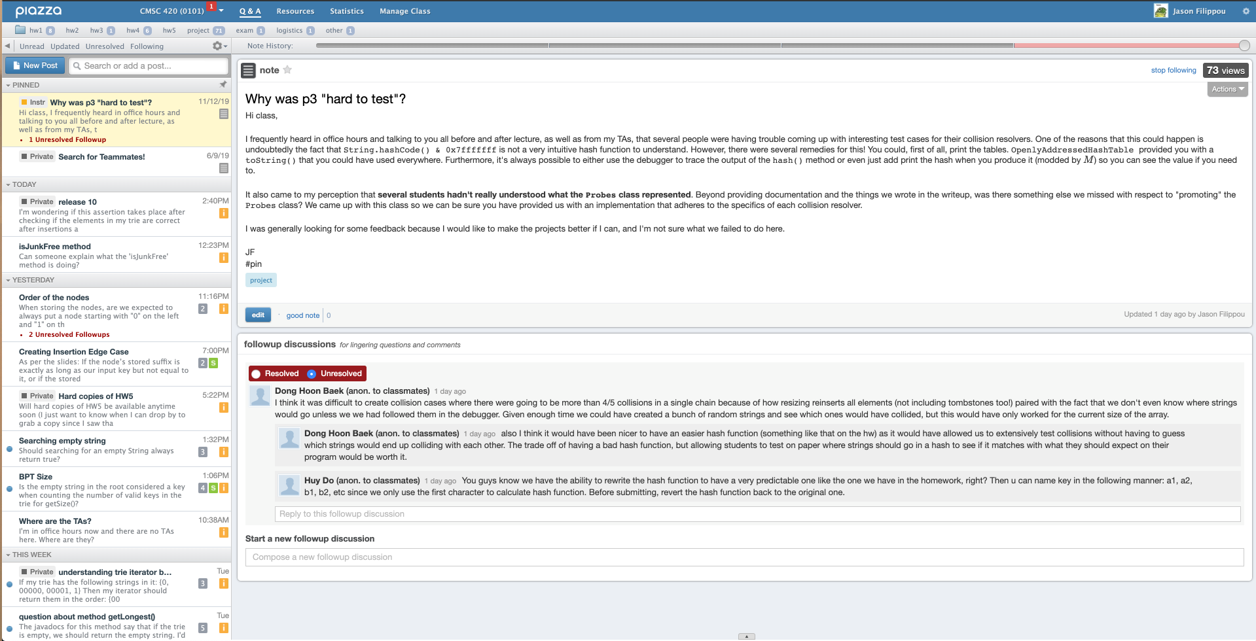
Q & A VIEW

Slide 12
Q & A VIEW
Clicking here does not take you to piazza.com
Nobody ever resolves followups

Slide 13
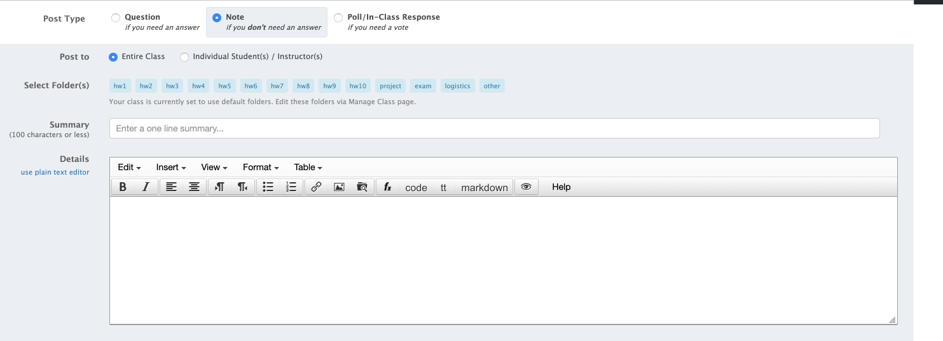
Making a post

Slide 14
Making a post
These options need to be a bit more prominent (posts that should be questions are posted as notes and vice versa)
Unless you click at around this level in the text box, you are not focused on the answer’s text box
The folder system is borderline infuriating. Meesh is the only person who I know has used it a lot and well.
Clicking here does not focus on the text box.

Slide 15
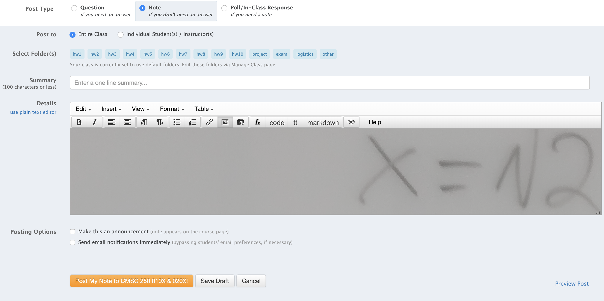
RESIZING AN IMAGE

Slide 16
RESIZING AN IMAGE
Resizing a large image is virtually impossible, unless….

Slide 17
RESIZING AN IMAGE
Resizing a large image is virtually impossible, unless….

Slide 18
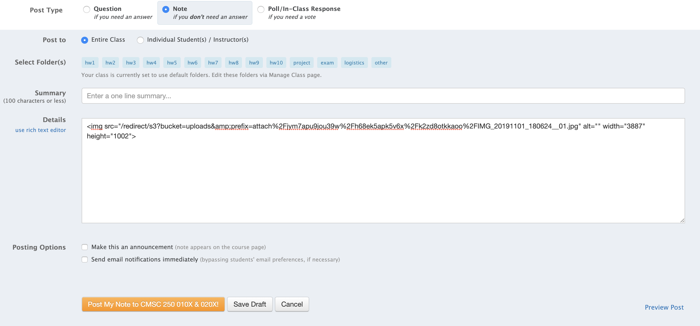
RESIZING AN IMAGE

Slide 19
RESIZING AN IMAGE

Slide 20
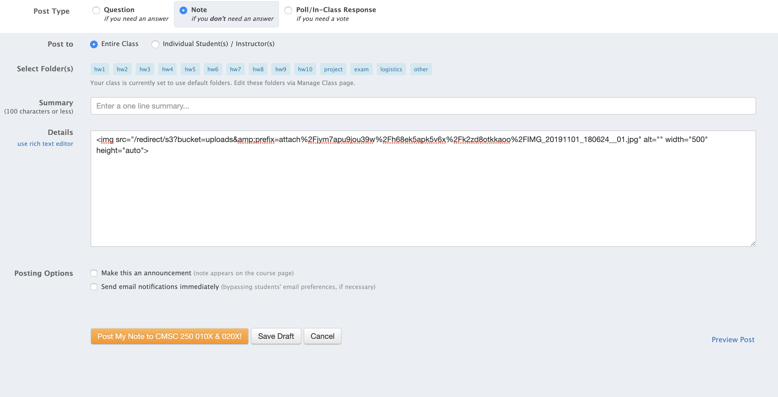
RESIZING AN IMAGE

Slide 21
RESIZING AN IMAGE
Preview a bunch of times to make sure you have it right…

Slide 22
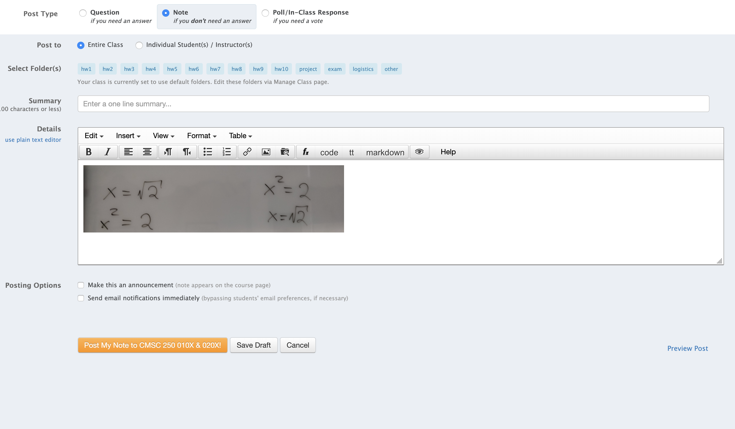
RESIZING AN IMAGE
Done.

Slide 23
Biggest problem: no communication

Slide 24
Biggest problem: no communication
In a series of recent phonecalls, devs and Pooja admitted as much.

Slide 25
Biggest problem: no communication
In a series of recent phonecalls, devs and Pooja admitted as much.
Even when there are updates (e.g app, filesystem consistency), they have not been (well?) communicated

Slide 26
Biggest problem: no communication
In a series of recent phonecalls, devs and Pooja admitted as much.
Even when there are updates (e.g app, filesystem consistency), they have not been (well?) communicated
Software gave the (false) impression of abandonware for many years

Slide 27
Biggest problem: no communication
In a series of recent phonecalls, devs and Pooja admitted as much.
Even when there are updates (e.g app, filesystem consistency), they have not been (well?) communicated
Software gave the (false) impression of abandonware for many years
Problems with prototyping – deployment pipeline?

Slide 28
good things about piazza

Slide 29
good things about piazza
Lightweight (very important)

Slide 30
good things about piazza
Lightweight (very important)
Free (also very important)

Slide 31
good things about piazza
Lightweight (very important)
Free (also very important)
FERPA compliant (whatever that means anyway)

Slide 32
good things about piazza
Lightweight (very important)
Free (also very important)
FERPA compliant (whatever that means anyway)
Close to 100% uptime (only time in recent memory it was down was when AWS was down a few years ago and half the internet did not work)

Slide 33
Piazza *does* have a future

Slide 34
Piazza *does* have a future
There are still updates in the background

Slide 35
Piazza *does* have a future
There are still updates in the background
  Password protection of a page is now possible Under Manage Class->Access Code.

Slide 36
Piazza *does* have a future
There are still updates in the background
  Password protection of a page is now possible Under Manage Class->Access Code.
  Duplicate post detection in the works (see next slide)

Slide 37
Duplicate post detection prototype

Slide 38
Duplicate post detection prototype

Slide 39
Piazza *does* have a future…. but
There are still updates in the background
  Password protection of a page is now possible Under Manage Class->Access Code.
  Duplicate post detection (see next slide)
  The timing is unfortunate, given competitors that are already there (Campswire, others?)

Slide 40
Piazza *does* have a future…. but
There are still updates in the background
  Password protection of a page is now possible Under Manage Class->Access Code.
  Duplicate post detection (see next slide)
  The timing is unfortunate, given competitors that are already there (Campswire, others?)
  Prototyping -> deployment pipeline historically slow

Slide 41
Piazza *does* have a future…. but
There are still updates in the background
  Password protection of a page is now possible Under Manage Class->Access Code.
  Duplicate post detection (see next slide)
  The timing is unfortunate, given competitors that are already there (Campswire, others?)
  Prototyping -> deployment pipeline historically slow
  Communication means need to be formalized, communicated.

Slide 42
Piazza *does* have a future…. but
There are still updates in the background
  Password protection of a page is now possible Under Manage Class->Access Code.
  Duplicate post detection (see next slide)
  The timing is unfortunate, given competitors that are already there (Campswire, others?)
  Prototyping -> deployment pipeline historically slow
  Communication means need to be formalized, communicated.
  It looks to be a bit behind, in spite of being very robust, free, easy to join

Slide 43
Campuswire
A more modern, responsive, JS-based communication framework that combines:

Slide 44
Campuswire
A more modern, responsive, JS-based communication framework that combines:
  Stack Overflow – style duplicate post detection

Slide 45
Campuswire
A more modern, responsive, JS-based communication framework that combines:
  Stack Overflow – style duplicate post detection
  Reddit – Style upvoting / downvoting and community promoting (badges, emojis, )

Slide 46
Campuswire
A more modern, responsive, JS-based communication framework that combines:
  Stack Overflow – style duplicate post detection
  Reddit – Style upvoting / downvoting and community promoting (badges, emojis, )
  Slack-style communication, including opportunity for private ”workspaces”

Slide 47
Campuswire
A more modern, responsive, JS-based communication framework that combines:
  Stack Overflow – style duplicate post detection
  Reddit – Style upvoting / downvoting and community promoting (badges, emojis, )
  Slack-style communication, including opportunity for private ”workspaces”
  Piazza – style polls, questions, notes.

Slide 48
Campuswire
A more modern, responsive, JS-based communication framework that combines:
  Stack Overflow – style duplicate post detection
  Reddit – Style upvoting / downvoting and community promoting (badges, emojis, )
  Slack-style communication, including opportunity for private ”workspaces”
  Piazza – style polls, questions, notes.
  Markdown and LaTeX support (Piazza doesn’t do Markdown right now)

Slide 49
Campuswire
A more modern, responsive, JS-based communication framework that combines:
  Stack Overflow – style duplicate post detection
  Reddit – Style upvoting / downvoting and community promoting (badges, emojis, )
  Slack-style communication, including opportunity for private ”workspaces”
  Piazza – style polls, questions, notes.
  Markdown and LaTeX support (Piazza doesn’t do Markdown right now)
  Opportunity to make a “group” or a ”class”
    “Class” has the Piazza features students are used to.

Slide 50
Campuswire
A more modern, responsive, JS-based communication framework that combines:
  Stack Overflow – style duplicate post detection
  Reddit – Style upvoting / downvoting and community promoting (badges, emojis, )
  Slack-style communication, including opportunity for private ”workspaces”
  Piazza – style polls, questions, notes.
  Markdown and LaTeX support (Piazza doesn’t do Markdown right now)
  Opportunity to make a “group” or a ”class”
    “Class” has the Piazza features students are used to.
Both “Free” and “Pro” versions available.
  Currently team wants to promote the “Pro” version after “free” has gotten traction with faculty.

Slide 51
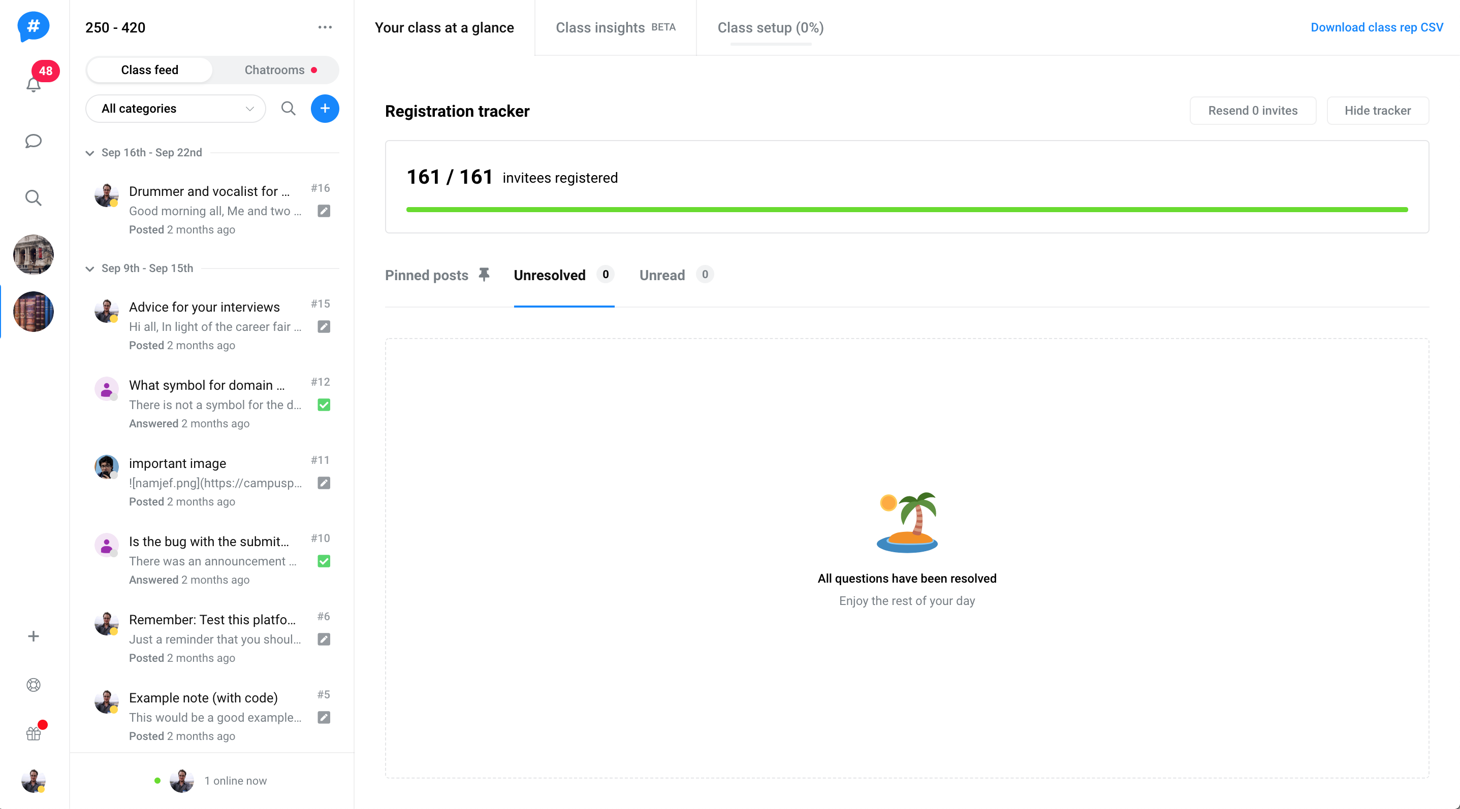
INTERFACE EXAMPLES

Slide 52
INTERFACE EXAMPLES

Slide 53
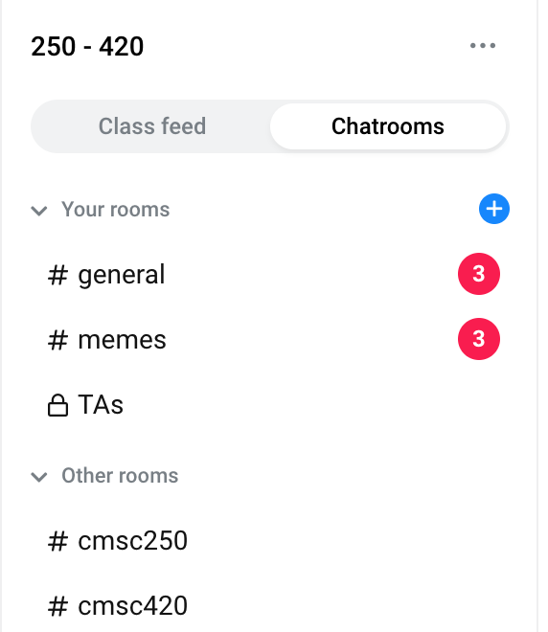
INTERFACE EXAMPLES

Slide 54
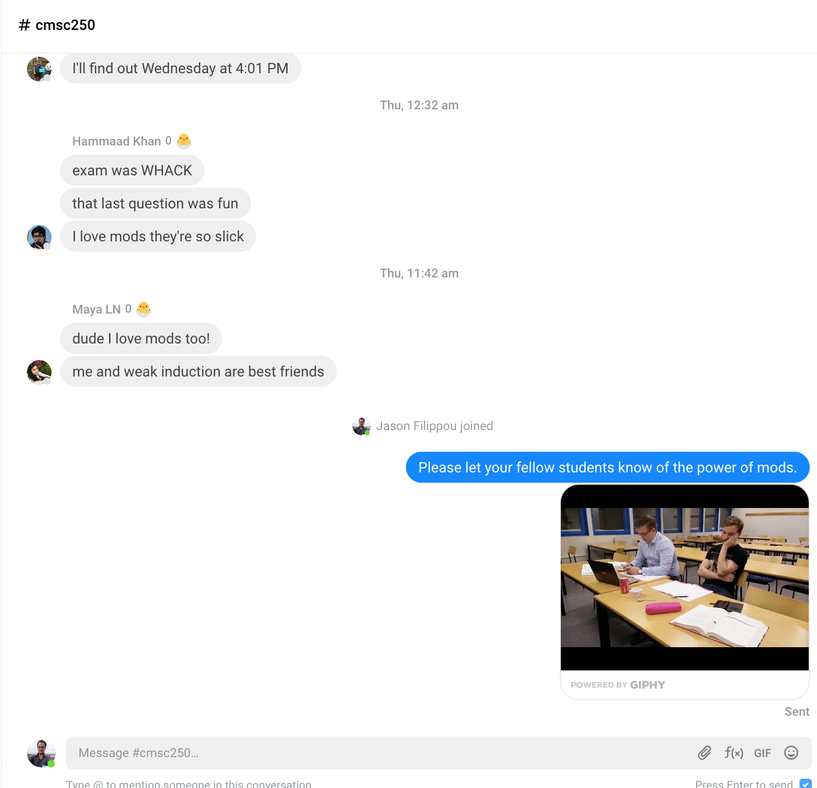
INTERFACE EXAMPLES

Slide 55
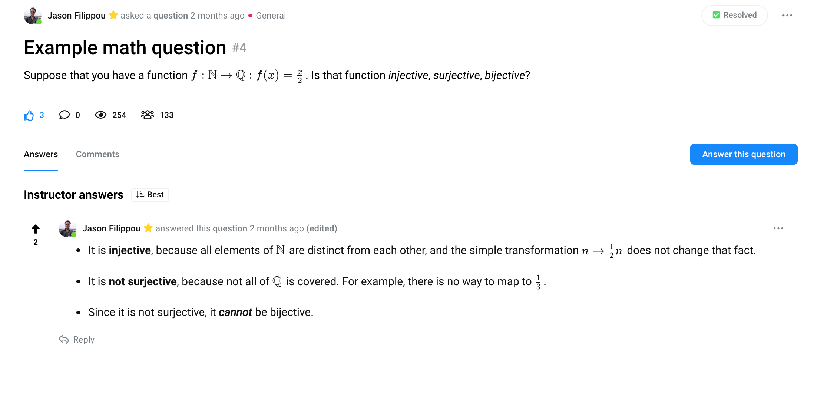
INTERFACE EXAMPLES

Slide 56
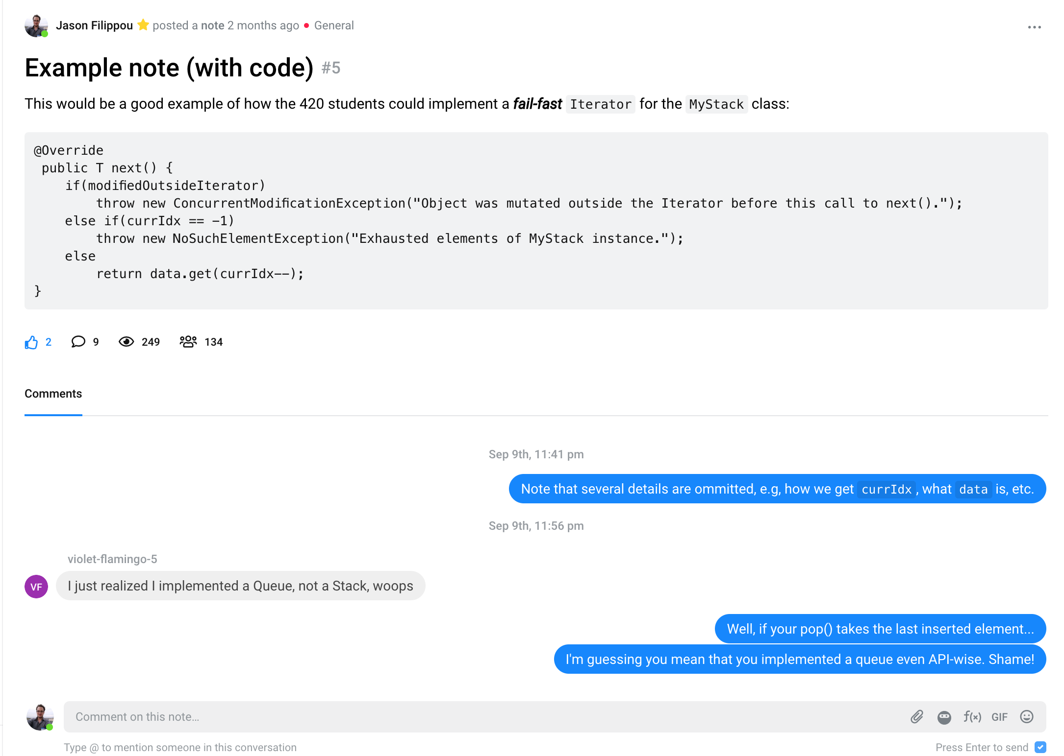
INTERFACE EXAMPLES

Slide 57
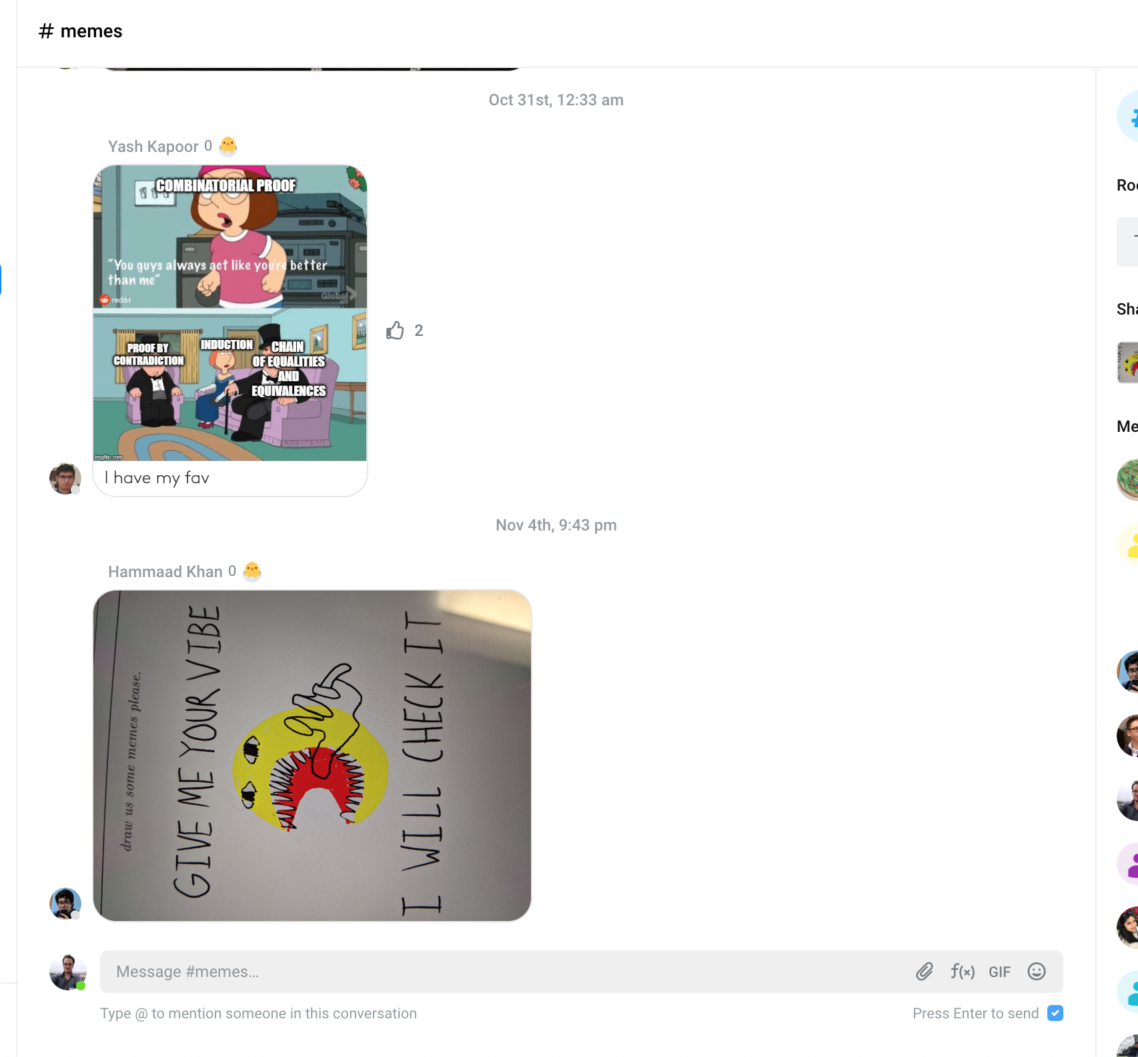
INTERFACE EXAMPLES

Slide 58
Personal action

Slide 59
Personal action
Intend to replace Piazza with CW at least for Spring 2019’s CMSC250 (order of 800 students)

Slide 60
Personal action
Intend to replace Piazza with CW at least for Spring 2019’s CMSC250 (order of 800 students)
Would also use it for comms with TAs, so that we avoid having separate Slack workspace.

Slide 61
Personal action
Intend to replace Piazza with CW at least for Spring 2019’s CMSC250 (order of 800 students)
Would also use it for comms with TAs, so that we avoid having separate Slack workspace.
Can report on findings.

Slide 62
Personal action
Intend to replace Piazza with CW at least for Spring 2019’s CMSC250 (order of 800 students)
Would also use it for comms with TAs, so that we avoid having separate Slack workspace.
Can report on findings.
Ideas of things to look out for?

Slide 63
You can try cw outside class RIGHT NOW!

Slide 64
You can try cw outside class RIGHT NOW!
Make a CW account (free)

Slide 65
You can try cw outside class RIGHT NOW!
Make a CW account (free)
Click here: https://campuswire.com/p/G7A4E1B54 and insert the “group join code” 8934 to join a “group” created for us (similar to CSDEPT in Piazza).

Slide 66
You can try cw outside class RIGHT NOW!
Make a CW account (free)
Click here: https://campuswire.com/p/G7A4E1B54 and insert the “group join code” 8934 to join a “group” created for us (similar to CSDEPT in Piazza).
Play around!

