Slide 1
Some applications of satellite remotely-sensed oceanographic data in the Central North Pacific Jeffrey Polovina Affiliate Faculty UH Marine Biology Program
Staugler
Staugler
Notes:
Welcome to the online course on oceanographic satellite data products, produced by NOAA’s CoastWatch Program.
In this module we will discuss how satellite data can be used for water quality applications. The information presented here builds on the concepts discussed in several of the course’s earlier modules, including Satellite 101, Sea Surface Temperature, Ocean Color, and the one covering Wind, Salinity, and Sea Surface Height. You might want to review those modules first before viewing this module.
My name is Cara Wilson, I’m the node manager of the West Coast Node of NOAA’s CoastWatch Program. The materials I will be presenting here were produced from a collaboration from many members of NOAA’s CoastWatch Program including Dale Robinson, Melanie Abecassis, Ron Vogel, Shelly Tomlinson, Andrea VanderWoude, Betty Staugler, V Wegman and myself.

Slide 2
Topics I’ll discuss
Data presentation/visualization
Application to loggerhead sea turtle migration
Application to monk seal pup survival variation
Describing changes in subtropical gyre habitat
A review paper:
Chassot et al. 2011. Satellite remote sensing for an ecosystem approach to fisheries management. ICES68(4)
NOAA CoastWatch Satellite Course http://coastwatch.noaa.gov

Slide 3
Hawaii SST – typical monthly SST time series display
NOAA CoastWatch Satellite Course http://coastwatch.noaa.gov

Slide 4
Alternative display of daily SST with application to coral reef bleaching
From J. Gove, PIFSC, NOAA
NOAA CoastWatch Satellite Course http://coastwatch.noaa.gov

Slide 5
Color scales are widely used to display satellite data but the choice of the scale is important
NOAA CoastWatch Satellite Course http://coastwatch.noaa.gov

Slide 6
Same data, different scale shows different features
NOAA CoastWatch Satellite Course http://coastwatch.noaa.gov

Slide 7
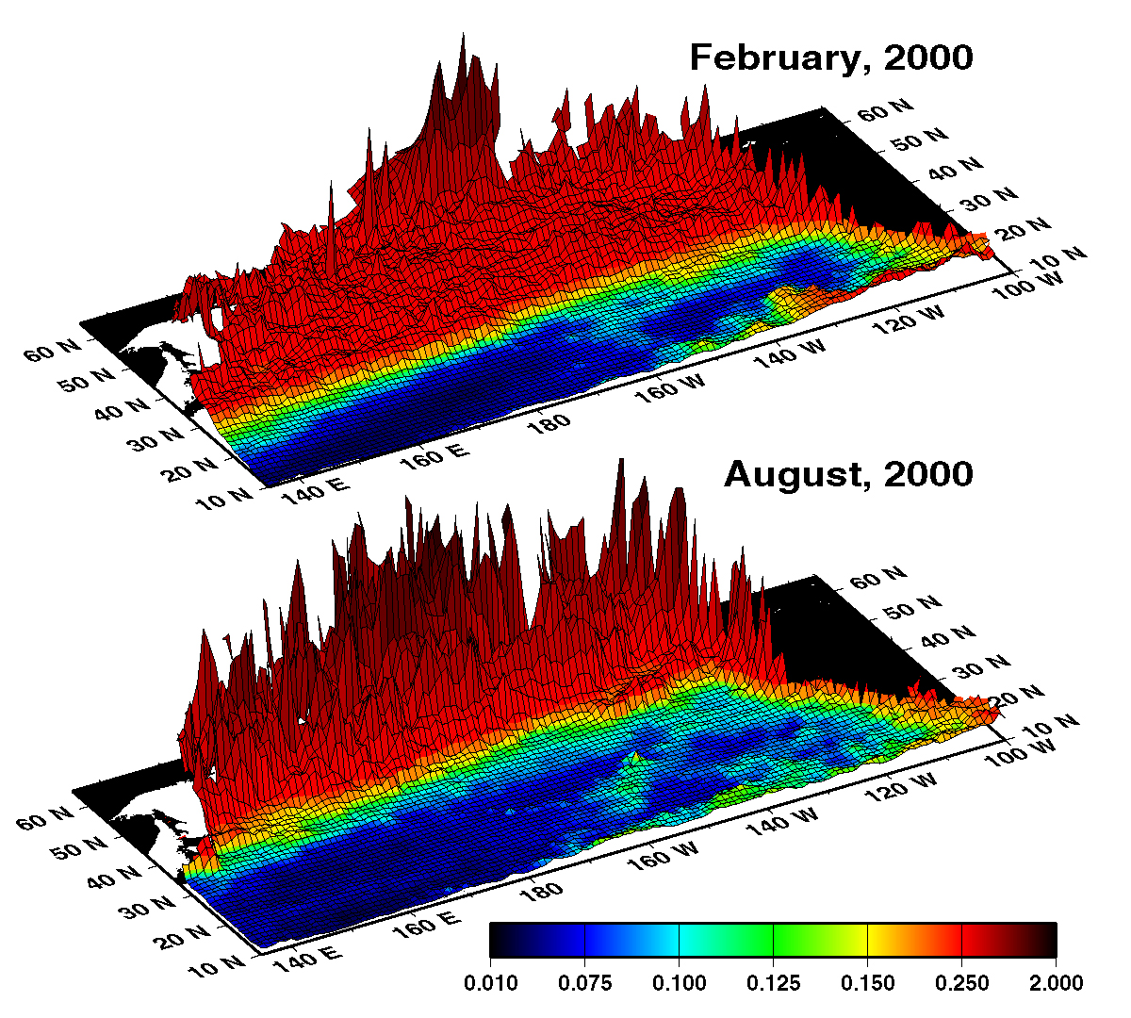
Combining color with a 3-D plot
Cover Illustration in Progress in oceanography, 49(1-4),
NOAA CoastWatch Satellite Course http://coastwatch.noaa.gov

Slide 8
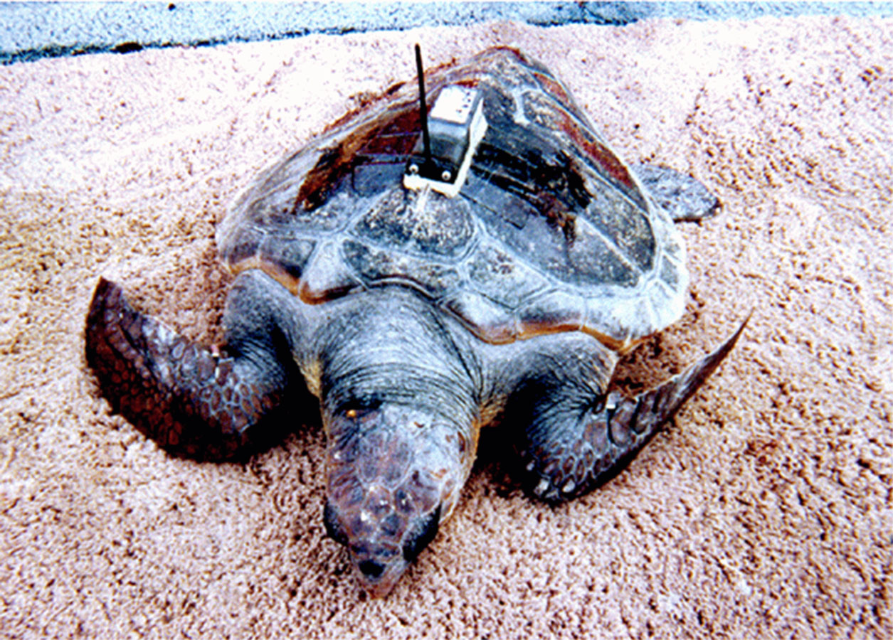
Loggerhead sea turtles daily positions with daily SST climatology
All tracks remapped to a single calendar year
Climatological SST field, contour at 18° C for reference
Animation From D. Kobayashi, PIFSC, NOAA
NOAA CoastWatch Satellite Course http://coastwatch.noaa.gov

Slide 9
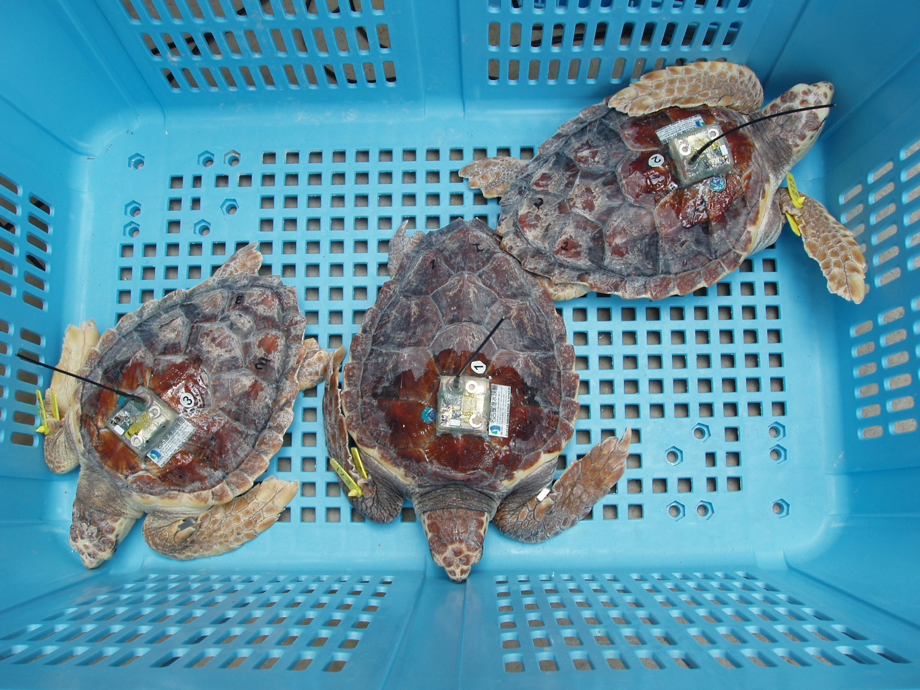
Satellite data with loggerhead sea turtle tagging data
Loggerhead sea turtle migration
NOAA CoastWatch Satellite Course http://coastwatch.noaa.gov

Slide 10
Loggerhead sea turtles daily positions with daily SST climatology
All tracks remapped to a single calendar year
Climatological SST field, contour at 18°C for reference
Animation From D. Kobayashi, PIFSC, NOAA
NOAA CoastWatch Satellite Course http://coastwatch.noaa.gov

Slide 11
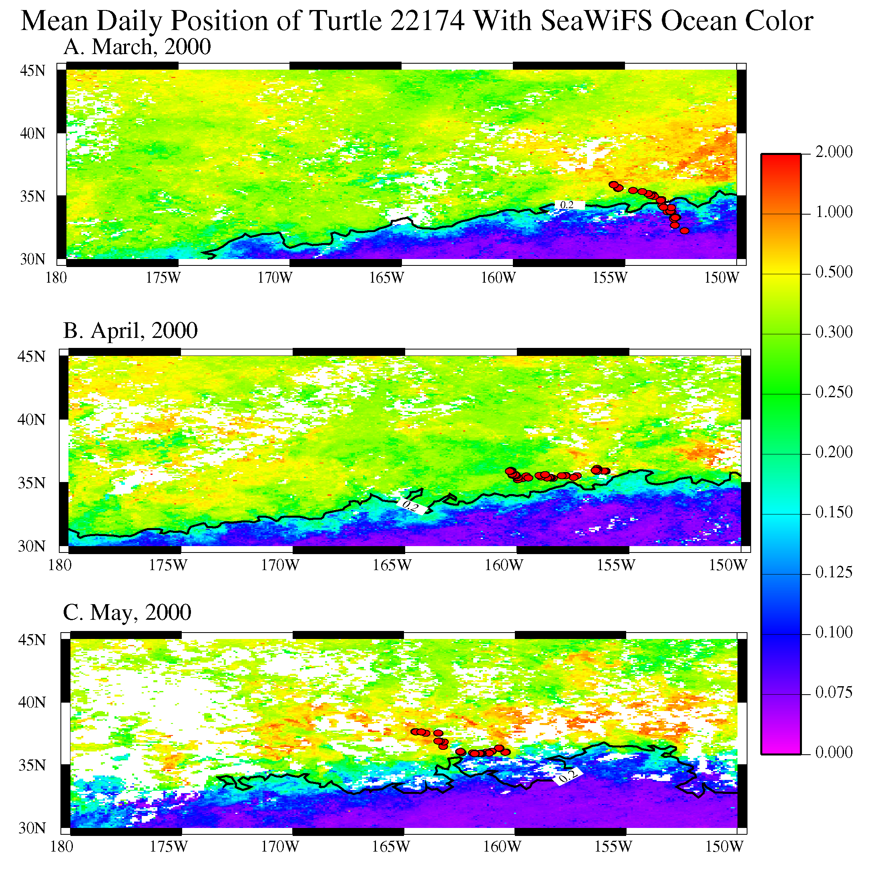
mg m⁻³
NOAA CoastWatch Satellite Course http://coastwatch.noaa.gov

Slide 12
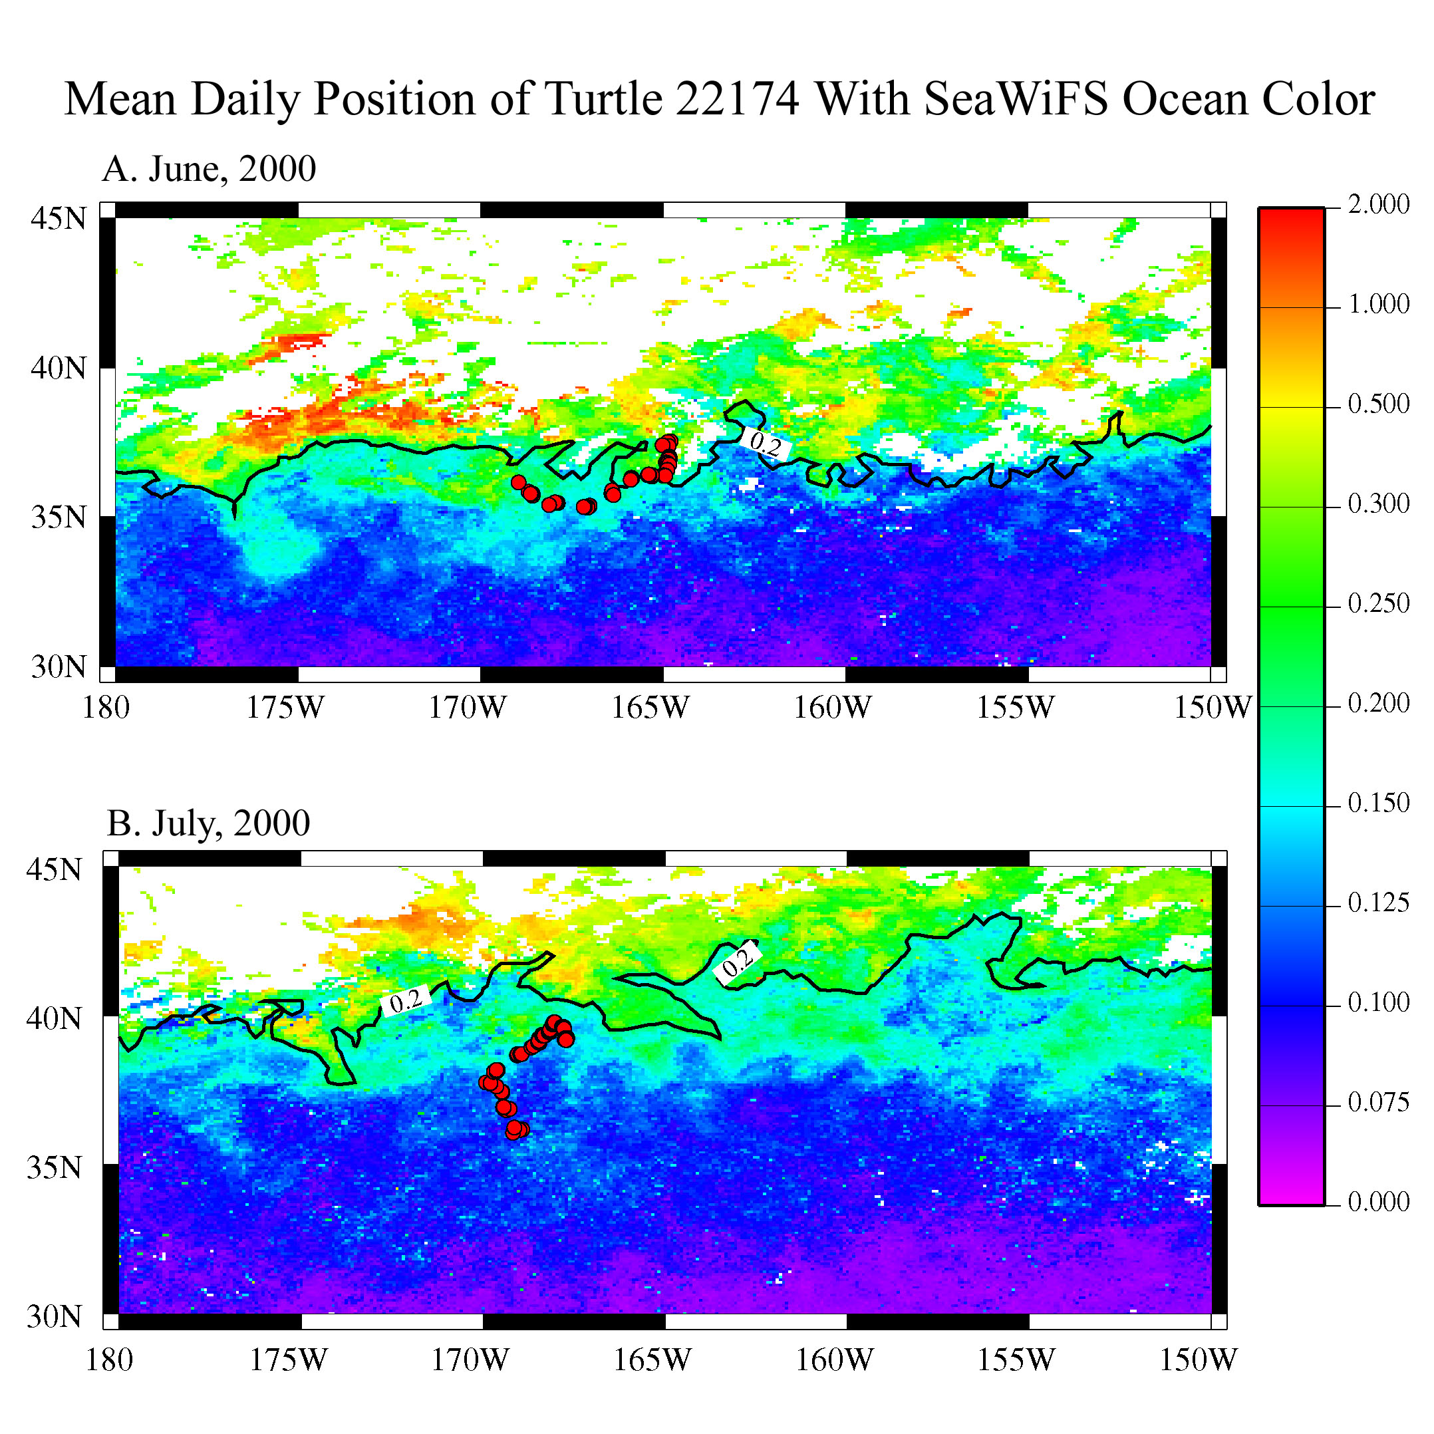
mg m⁻³
NOAA CoastWatch Satellite Course http://coastwatch.noaa.gov

Slide 13
Surface Chlorophyll Climatology showing the forage habitat of loggerheads in the North Pacific as the boundary between the low chlorophyll region in blue and the higher chlorophyll region in green.
NOAA CoastWatch Satellite Course http://coastwatch.noaa.gov

Slide 14
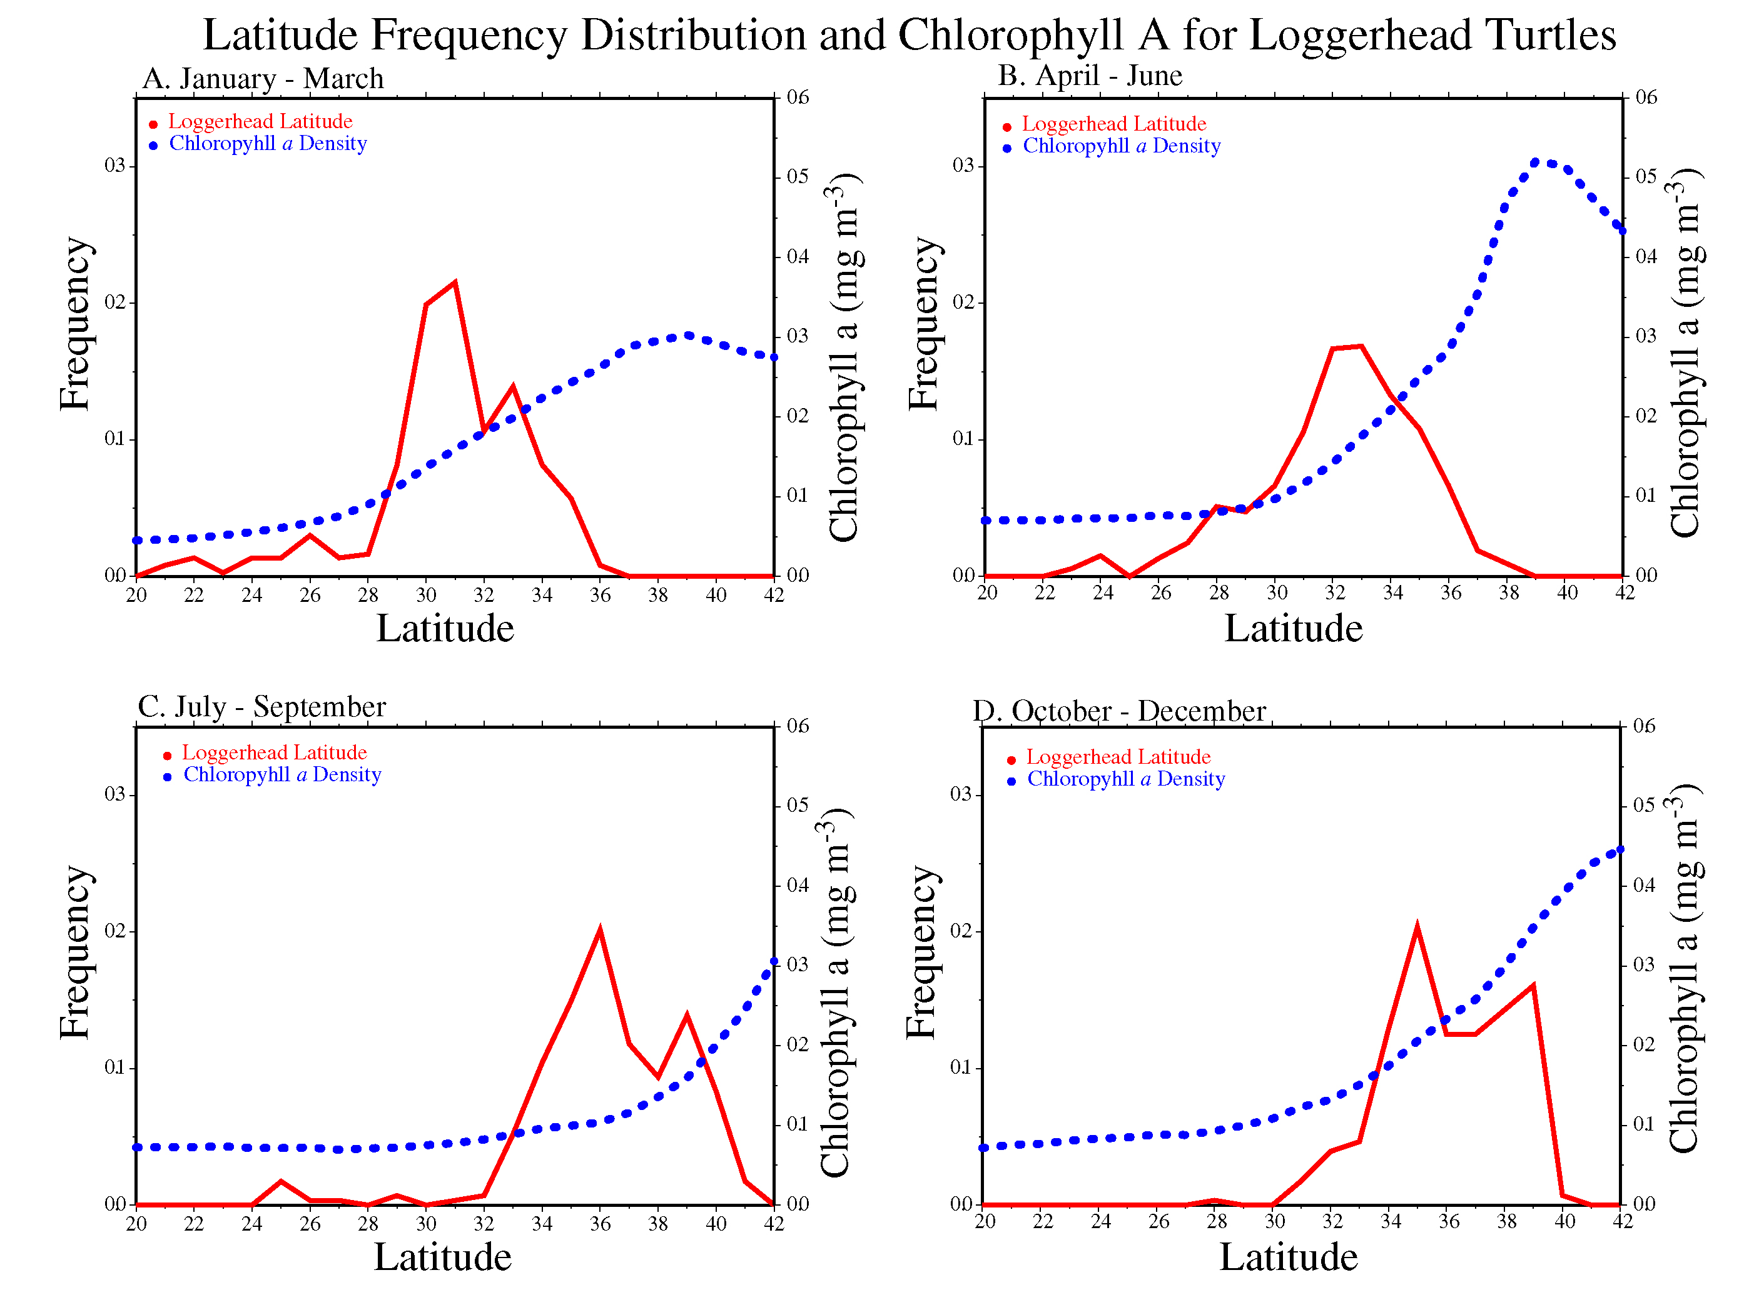
Polovina et al. 2000. Fish. Oceanogr. 9, 71-82
NOAA CoastWatch Satellite Course http://coastwatch.noaa.gov

Slide 15
Wind Stress Curl, Surface Chlorophyll a, and 18ºC SST for 180-160ºW longitude
Created by D. Foley
NOAA CoastWatch Satellite Course http://coastwatch.noaa.gov

Slide 16
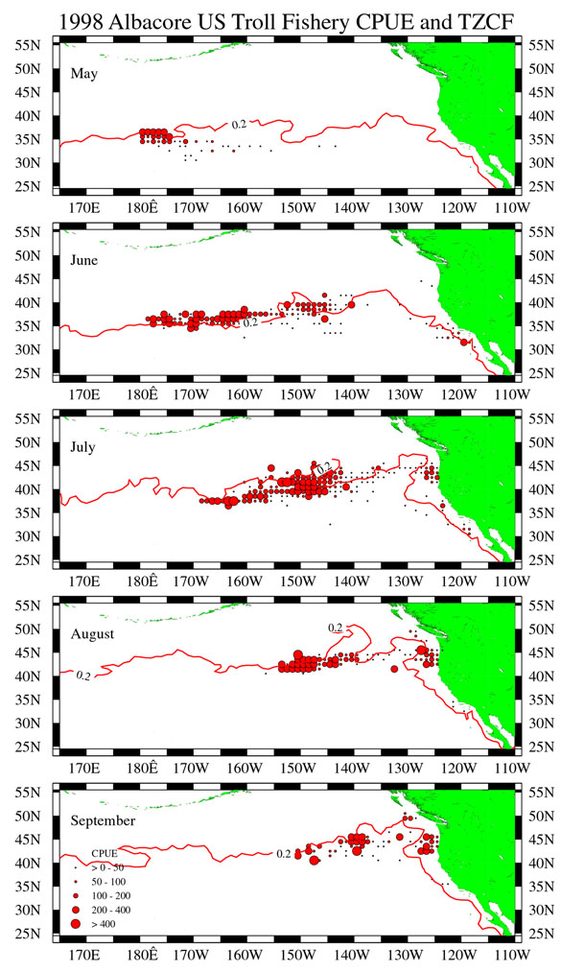
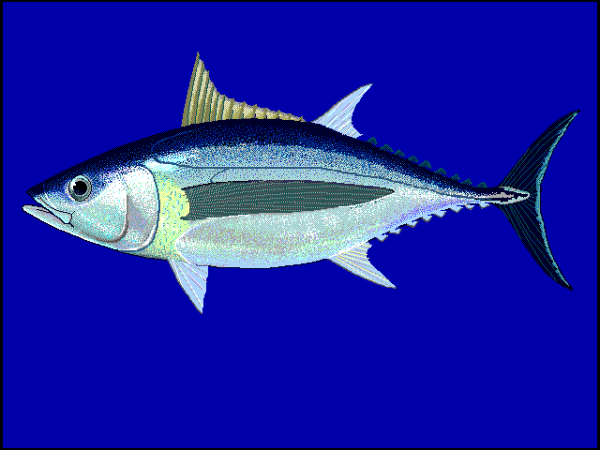
Albacore tuna catch data and the transition zone chlorophyll front(TZCF) (red line)
Polovina et al. 2001. Progress in oceanography, 49(1-4), pp.469-483.
NOAA CoastWatch Satellite Course http://coastwatch.noaa.gov

Slide 17
Based on loggerhead’s use of the TZCF we developed TurtleWatch to advise fishers of the zone of highest probability of interaction
Howell et al. 2008 Endangered Species Research, 5(2-3), pp.267-278.
NOAA CoastWatch Satellite Course http://coastwatch.noaa.gov

Slide 18
Schematic of the Kuroshio Extension Bifurcation region (A)
AVISO altimetry for March 2003
AVISO altimetry for September 2003
Polovina et a. 2006.Deep Sea Research Part II: Topical Studies in Oceanography, 53(3-4), pp.326-339.
NOAA CoastWatch Satellite Course http://coastwatch.noaa.gov

Slide 19
Loggerhead track over SSH and geostrophic currents in the Kuroshio Extension Current for October 2003 (A), November 2003 (B), December 2003 (C), and January 2004 (D)
Polovina et a. 2006.Deep Sea Research Part II: Topical Studies in Oceanography, 53(3-4), pp.326-339.
NOAA CoastWatch Satellite Course http://coastwatch.noaa.gov

Slide 20
Frequency distributions for loggerhead turtles west of the dateline with Chl a, and geostrophic velocity during quarters 1 (A), 2 (B), 3 (C), 4(D)
Polovina et a. 2006.Deep Sea Research Part II: Topical Studies in Oceanography, 53(3-4), pp.326-339.
NOAA CoastWatch Satellite Course http://coastwatch.noaa.gov

Slide 21
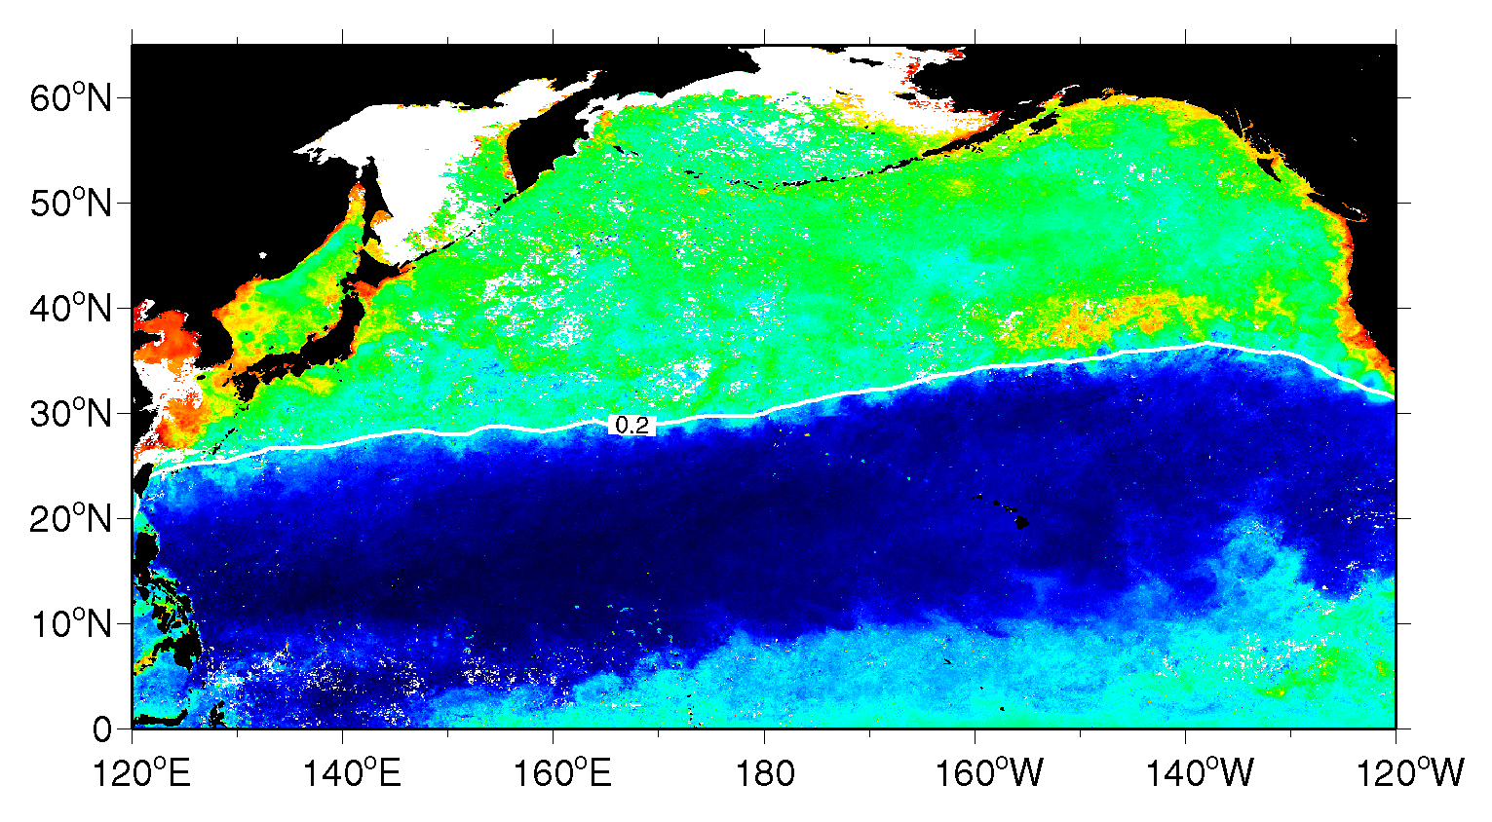
Transition Zone Chlorophyll Front (TZCF)
Vertical profiles
Net community maximum production (Juranek et al. 2012)
Polovina et al. 2001. Progress in oceanography, 49(1-4), pp.469-483.
NOAA CoastWatch Satellite Course http://coastwatch.noaa.gov

Slide 22
Impact of TZCF on NWHI
Satellite-derived winter Surface chlorophyll in March 2000 (La Nina) (top, middle) and March 2004 (El Nino) (bottom) provide an example of interannual variation in northward extent oligotrophic waters. (Baker et al. 2007 MEPS 346,277-283 )
NOAA CoastWatch Satellite Course http://coastwatch.noaa.gov

Slide 23
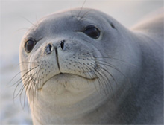
Generalized Additive Model (GAM):
Pup survival (t) = S(min lat TZCF (t-1))
Survival of Hawaiian Monk Seals at northern atolls as a function of the position of the 18º SST isotherm, a proxy for the TZCF, 1985-2003
A: 1&2 yr old pups
B: 3&4 yr old pups
(Baker et al. 2007 MEPS 346,277-283 )
NOAA CoastWatch Satellite Course http://coastwatch.noaa.gov

Slide 24
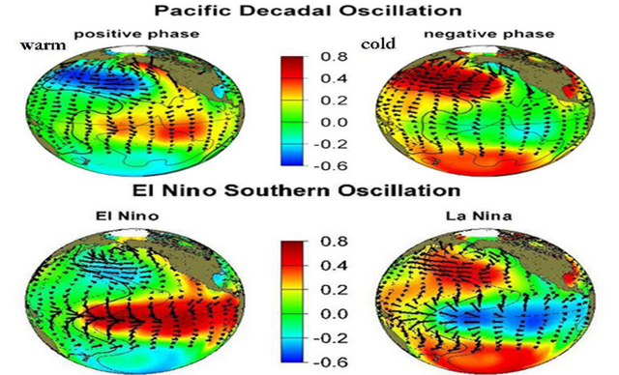
Two Modes of Oceanographic Variation in the Pacific
NOAA CoastWatch Satellite Course http://coastwatch.noaa.gov

Slide 25
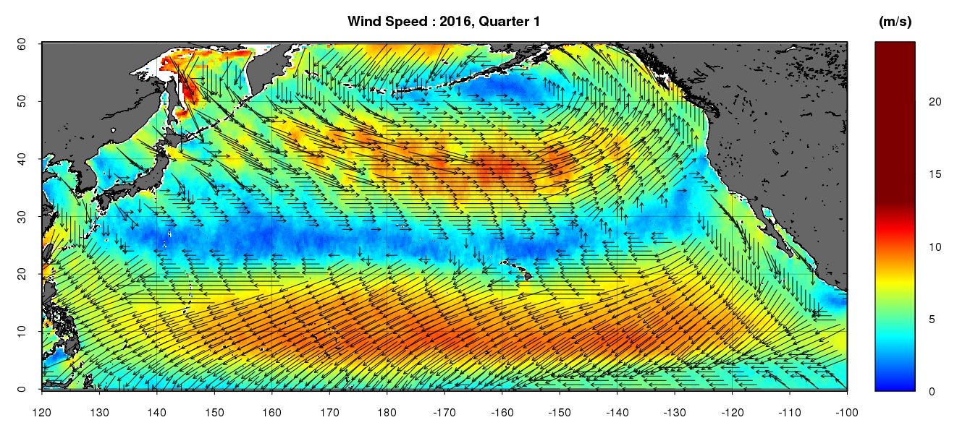
El Nino and positive PDO - 2016 Quarter 1
ASCAT winds
NOAA CoastWatch Satellite Course http://coastwatch.noaa.gov

Slide 26
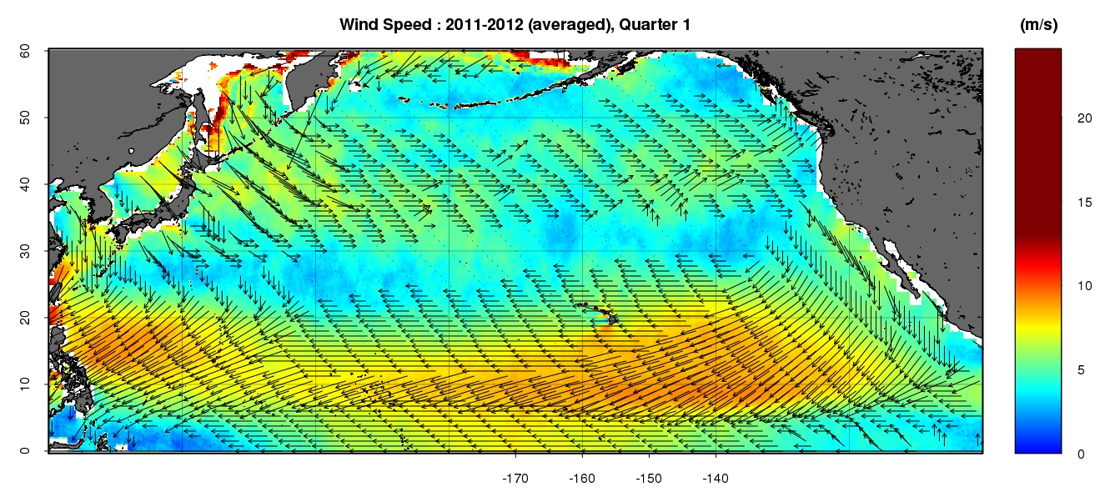
La Nina and negative PDO – Quarter 1 2011 and 2012 averaged
NOAA CoastWatch Satellite Course http://coastwatch.noaa.gov

Slide 27
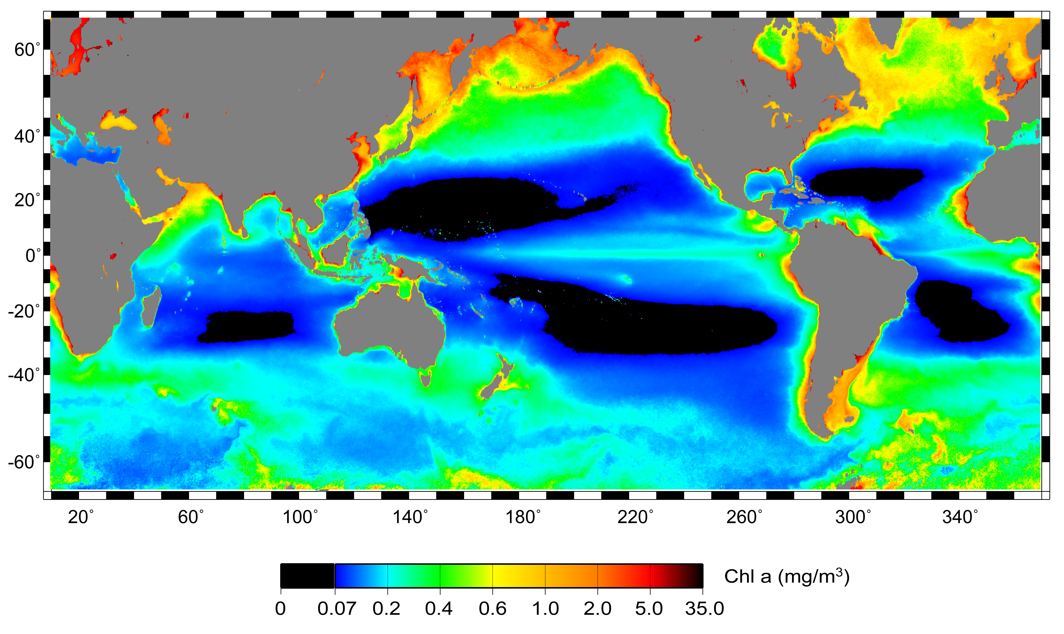
SeawiFS surface chlorophyll climatology with oligotrophic gyres in black
Monitoring changes in ocean habitat with satellite data
Polovina et al. 2008 Geophysical Research Letters, 35(3).
NOAA CoastWatch Satellite Course http://coastwatch.noaa.gov
Notes:
A SeaWiFS Aug 2003 surface chl image showing large subtropical gyre (blue and black) with the oligotrophic core chl <= 0.07 mgC/m3 in black. NP summer gyre is expanded, SP winter gyre contracted.

Slide 28
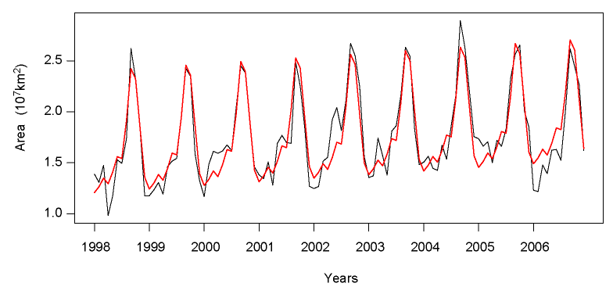
N Pacific Monthly Area with surface chlorophyll< =0.07 mg C/m³ 1998-2006 with GAM fit (red)
GAM: Monthly Area = A + B*month + S(seasonal) + error
Polovina et al. 2008 Geophysical Research Letters, 35(3).
NOAA CoastWatch Satellite Course http://coastwatch.noaa.gov

Slide 29
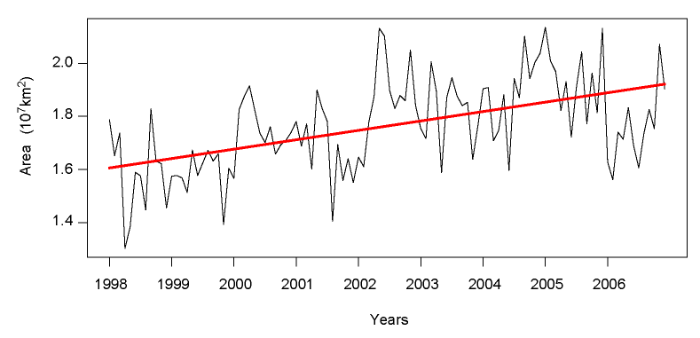
Pacific Monthly Area (seasonally adjusted)r, data and GAM linear term (red)
Polovina et al. 2008 Geophysical Research Letters, 35(3).
NOAA CoastWatch Satellite Course http://coastwatch.noaa.gov

Slide 30
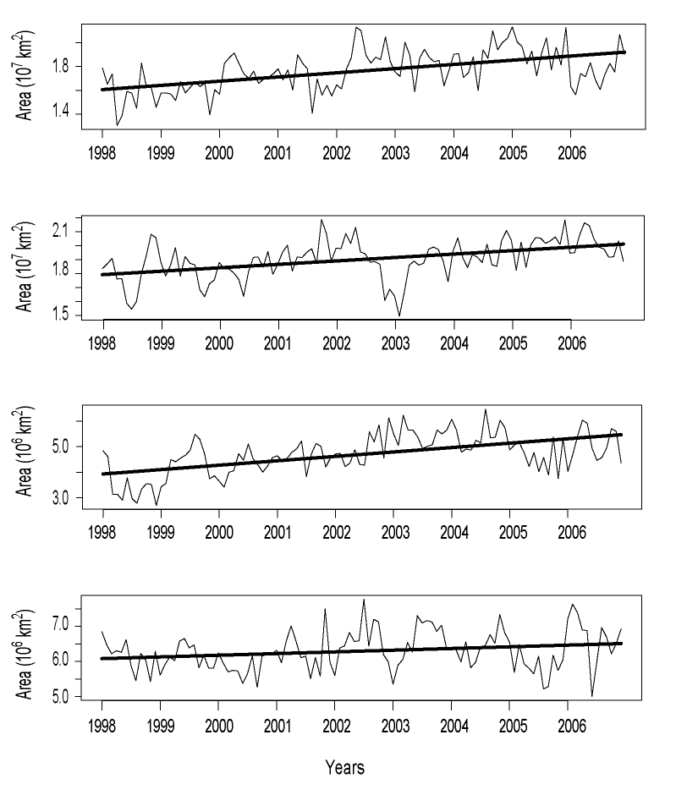
Linear term
N Pacific
S Pacific
N Atlantic
S Atlantic
Polovina et al. 2008 Geophysical Research Letters, 35(3).
NOAA CoastWatch Satellite Course http://coastwatch.noaa.gov
Notes:
Monthly areas with seasonal component removed and linear trend fit

Slide 31
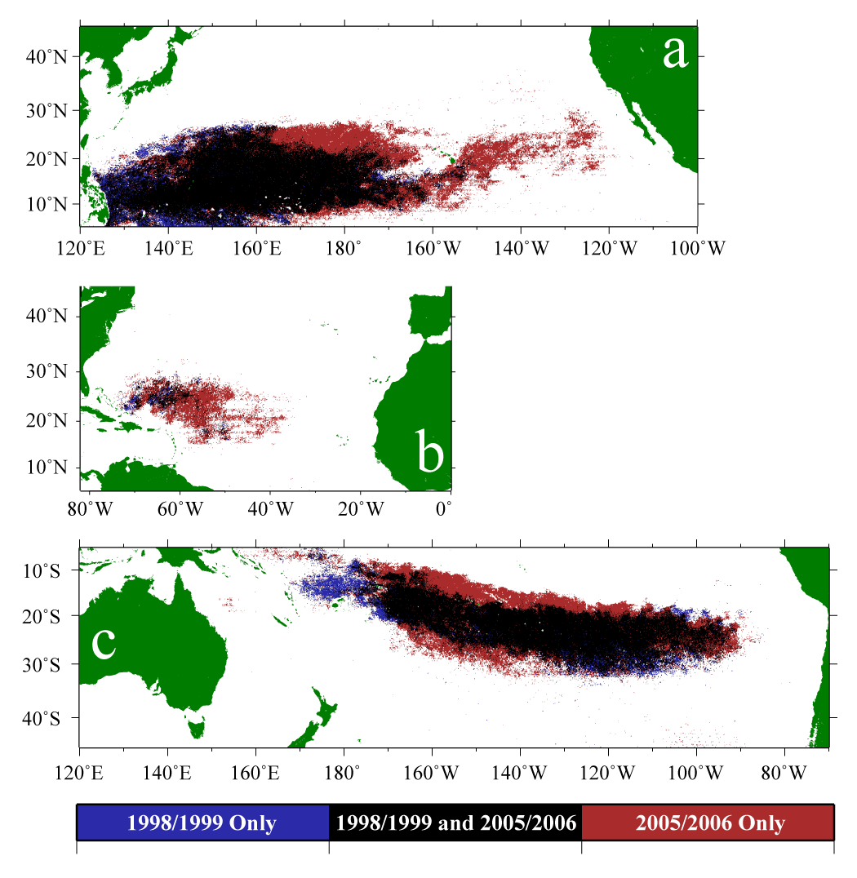
Changes in oligotrophic areas between 1998-1999 and 2005-2006 in
December:
North Pacific,
North Atlantic,
and August:
South Pacific
Polovina et al. 2008 Geophysical Research Letters, 35(3).
NOAA CoastWatch Satellite Course http://coastwatch.noaa.gov
Notes:
Core of gyre pretty stable over time. NP NA expansion eastward, SP expansion north and south. Within the STG high chl habitat is replaced by low chl habitat reducing productivity of STG. Likely ecosysem impacts for example in NP western warm pool has distinctive pelagic ecosystem, lots of skipjack for example. Will this ecosystem expand into the CNP or will CNP ecosystem change to to be functionally similar but with mahi instead of skipjack?

Slide 32
Some Final Thoughts
Satellite remotely-sensed data have wide applicability
Be creative about uses of data. Think about process and features
Applications may foster or require collaborations
NOAA CoastWatch Satellite Course http://coastwatch.noaa.gov

