Slide 1
Introduction to CoastWatch and the CoastWatch Satellite Course
https://umd.instructure.com/courses/1332077
coastwatch.info@noaa.gov
Notes:
Welcome to the online course on oceanographic satellite data products, produced by NOAA’s CoastWatch Program. In this module we will discuss the measurement of sea surface salinity, surface winds, and sea surface height using satellite remote sensing techniques. The information presented here builds on the concepts discussed in the Satellite 101 Part 1 and Part 2 modules of the online course. You might want to review those modules first before viewing this module.
My name is Cara Wilson, I’m the node manager of the West Coast Node of NOAA’s CoastWatch Program. The materials I will be presenting in this video were produced from a collaboration from many members of NOAA’s CoastWatch Program including Dale Robinson, Melanie Abecassis, Ron Vogel, Shelly Tomlinson, me and the late Dave Foley.

Slide 2
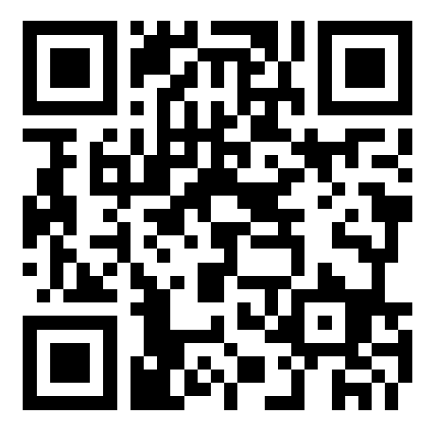
Slido
What country are you from?
What is your current time?
What is your affiliation?
How did you hear about this course?
What do you want to get out of this course?
How familiar are you with satellite data?
What software track are you planning to follow?
Have you set up the required software on your computer?
Have you started watching the presentations yet?
slido.com #SatCourse0422

Slide 3
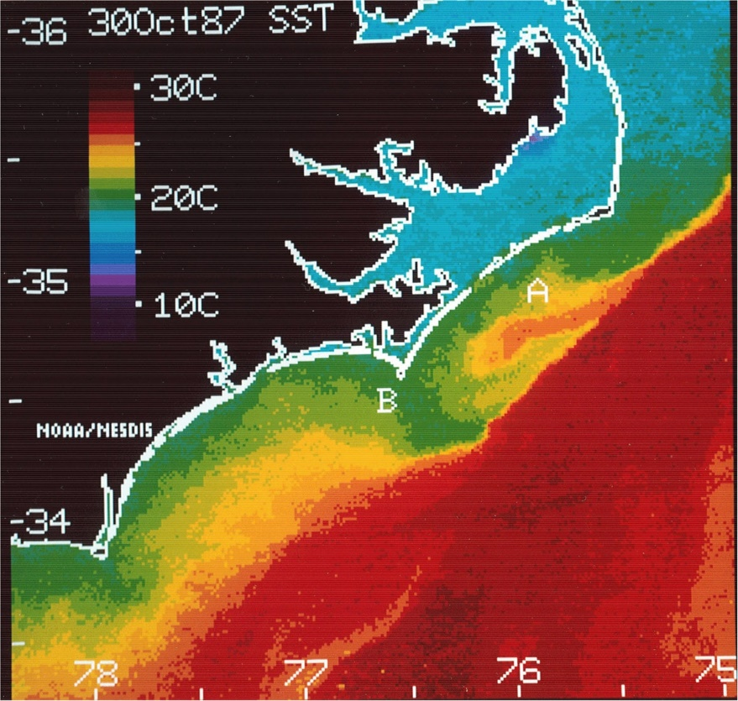
NOAA CoastWatch Program was established in 1987
NOAA CoastWatch was established in 1987 in response to two significant environmental events:
A Harmful Algal Bloom (HAB) event occurred off the coast of North Carolina transporting the toxic Karenia brevis (formerly known as Gymnodinium breve and Ptychodiscus brevis) cells from Florida via the Gulf Stream into the colder coastal waters near Cape Lookout.
A severe mammal die-off occurred, where more than 700 bottlenose dolphins died off the mid-Atlantic coast. Both instances prompted Federal and State officials to explore additional data sources for monitoring the coastal waters, such as near real-time satellite data.
First CoastWatch image

Slide 4
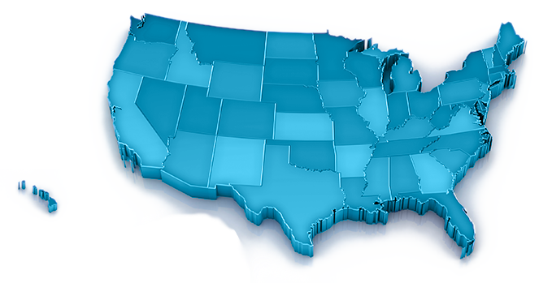
CoastWatch > National Program
NOAA CoastWatch is a national program funded by NESDIS¹
Mission: Provide access to and promote the use of ocean satellite data products
Great Lakes
Great Lakes
West Coast
& PolarWatch
East Coast
Central Office
Central Pacific
Caribbean
Gulf of Mexico
¹National Environmental Satellite, Data, and Information Service

Slide 5
West Coast Node (WCN) – NOAA Fisheries
Service area - US West Coast from California to Alaska
Personnel at NMFS/SWFSC
Dale Robinson – Coordinator
Cara Wilson – Manager
User Community
Users from Alaska to California
Extensive data holdings
Eastern Pacific and global coverage
One stop shopping with easy data access
1000's of datasets from NOAA, NASA and other sources
https://coastwatch.pfeg.noaa.gov

Slide 6
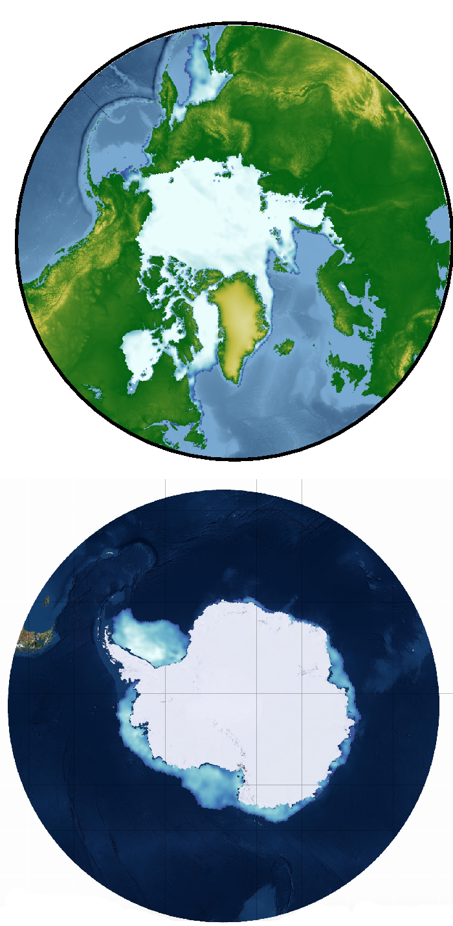
PolarWatch (PW) – NOAA Fisheries
Personnel
Cara Wilson – Manager
Dale Robinson – Deputy Manager
Jennifer Sevadjian- Coordinator
Node Highlights
Providing easier access to polar satellite data
Previewing data online with polar maps
Serving sea ice datasets
Serving polar projected datasets
Collaborators
National Ice Center
National Snow and Ice Data Center
STAR Science Teams (Sea Ice, SAR, LSA)
Location
Housed at SWFSC, CA
Focused on high latitude regions
https://polarwatch.noaa.gov/

Slide 7
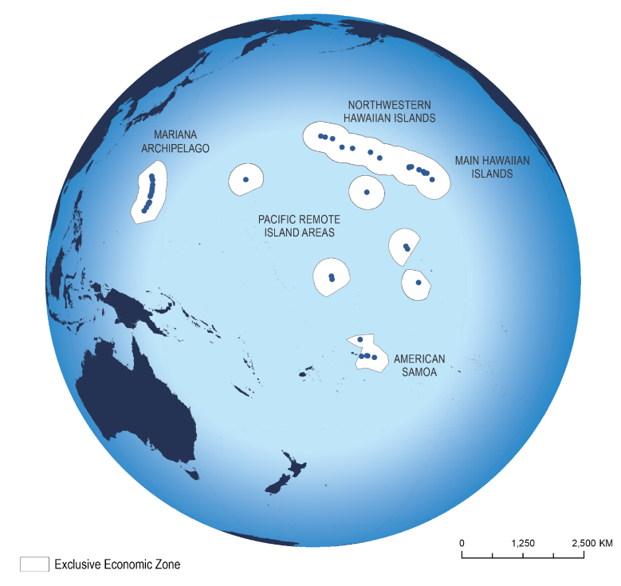
OceanWatch central Pacific (OWCP) – NOAA Fisheries
Personnel
Ryan Rykaczewski – Manager
Melanie Abecassis – Outgoing Ops Manager
Daisy Shi – Incoming Ops Manager (~ June)
Location
Housed at PIFSC, HI
Focused on the Pacific Islands Region
Node Highlights
Focused on user needs in the tropics and the subtropical gyre from island-scale to basin-scale. Providing easier access to satellite data across the dateline.
TurtleWatch
Oceanic and Climate indicators
Capacity Building
https://oceanwatch.pifsc.noaa.gov/

Slide 8
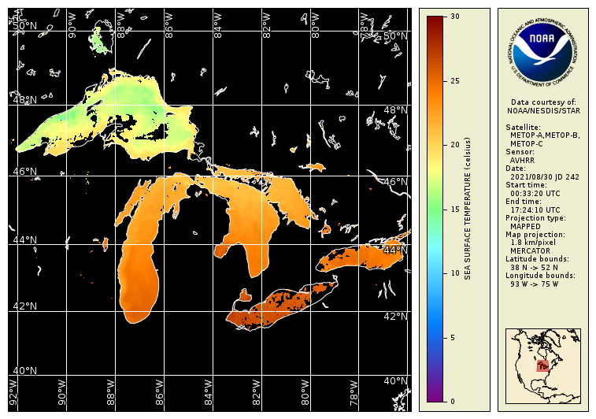
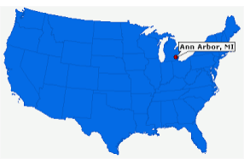
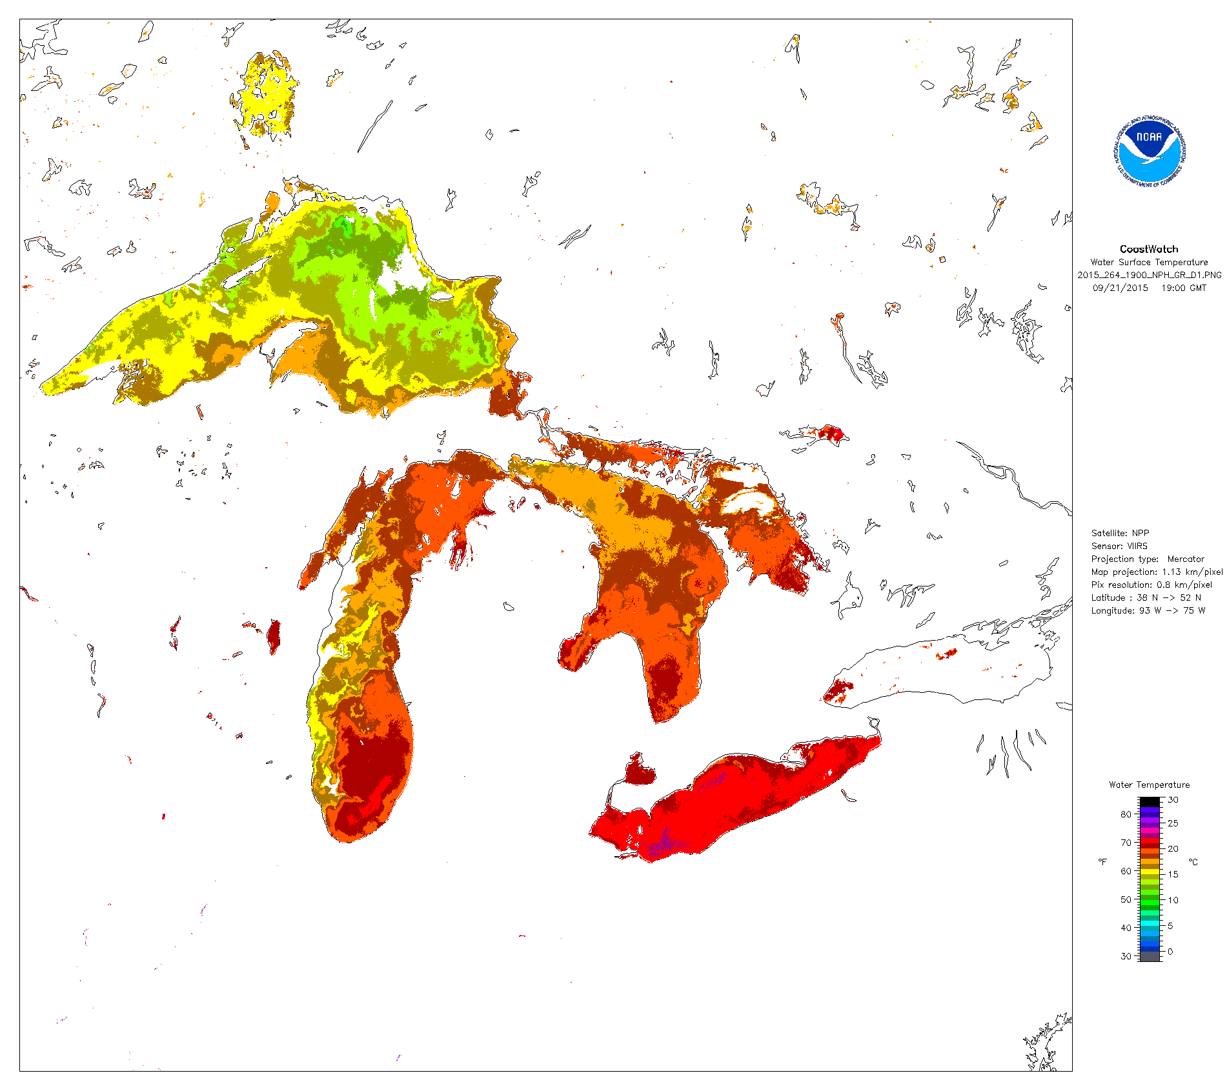
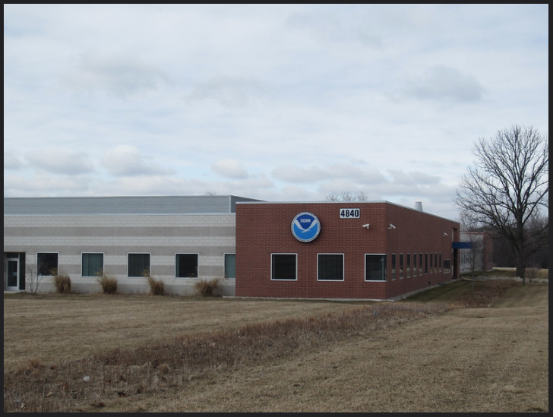
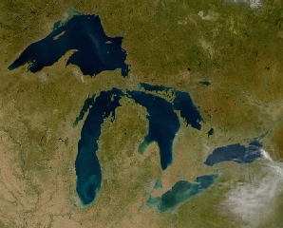
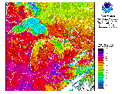
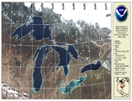
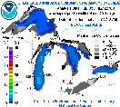
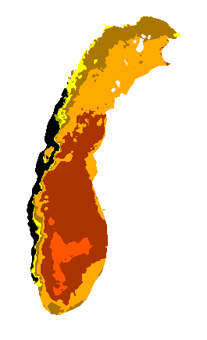
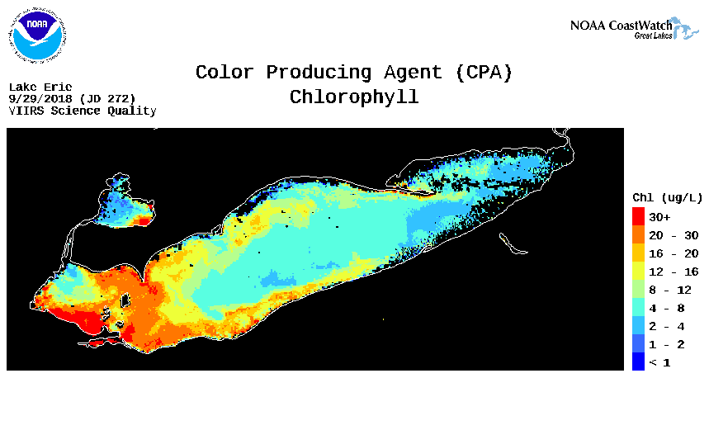
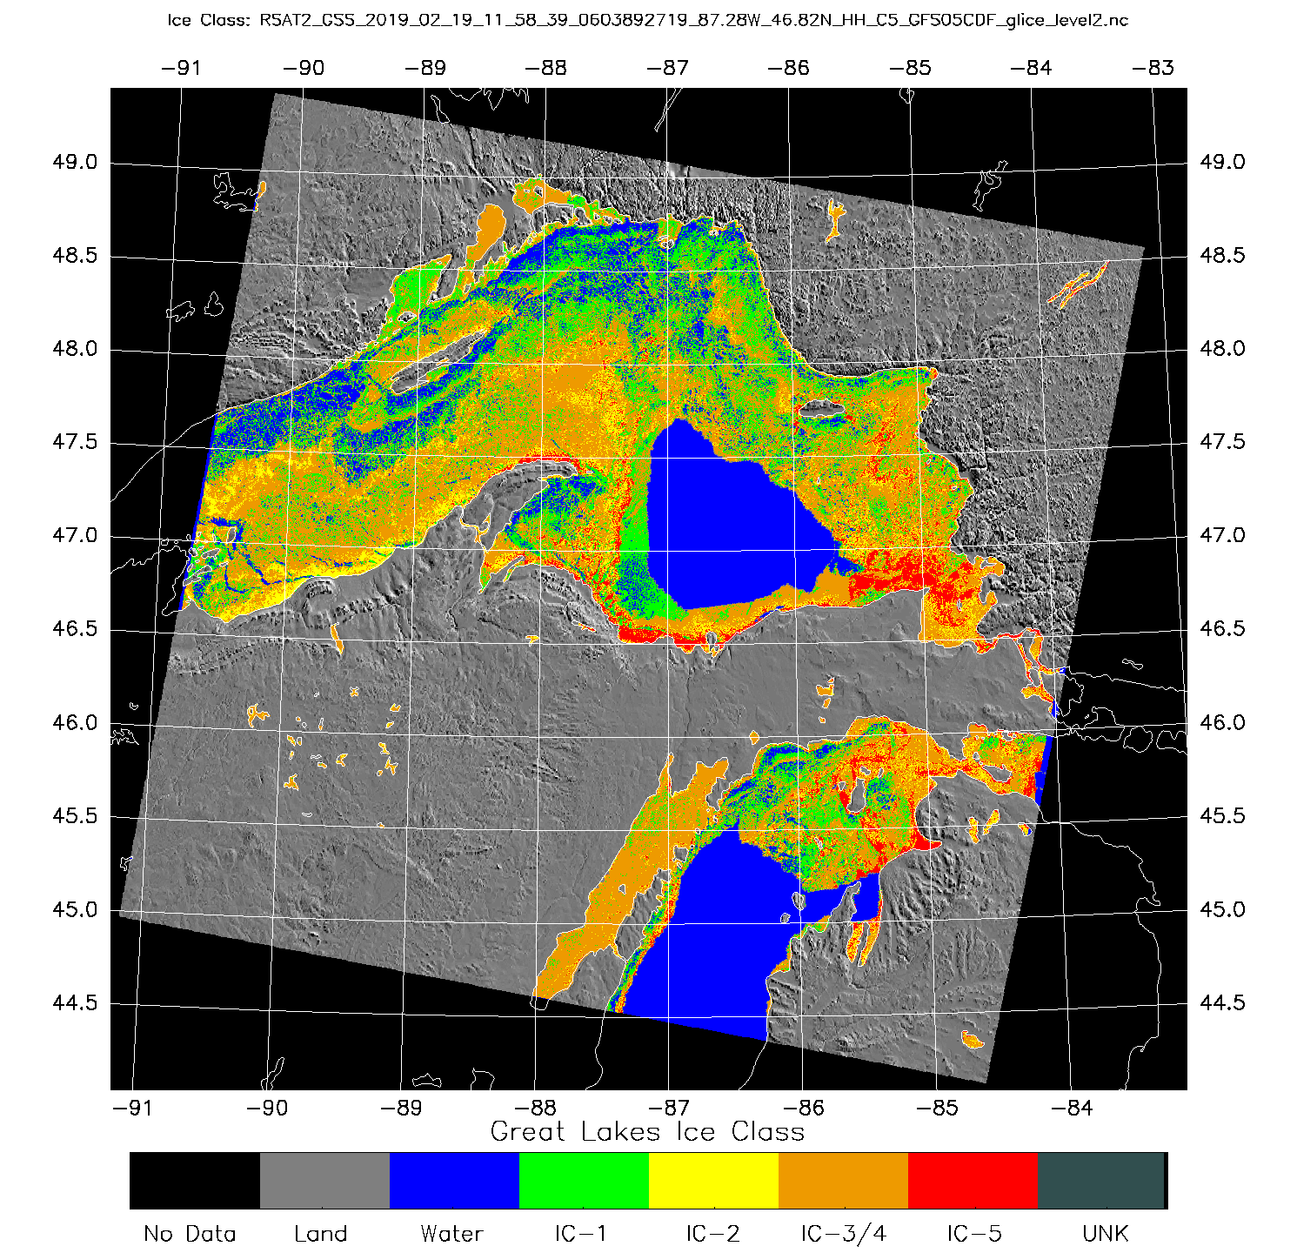
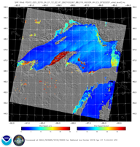
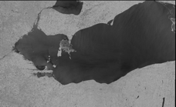
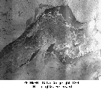
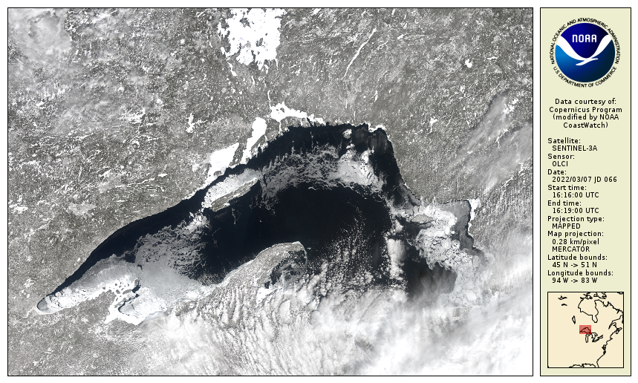
Great Lakes Node – NOAA Research (OAR)
Node Highlights
Established in 1990
Housed at NOAA Great Lakes Environmental Research Laboratory (GLERL),Ann Arbor, MI
The service area is the Great Lakes region
User Community
GLERL, NCEP, NWS, US Coast Guard, Local Government agencies, Universities, and Public Users
Satellite Data Products
Hundreds of datasets including water surface temperature, color producing agents, ice concentration and ice type classification
Personnel
Andrea Vander Woude – Manager
Songzhi Liu – Operations Manager
GOES SST
ACSPO SST
VIIRS SST
MODIS True Color
AVHRR SST
https://coastwatch.glerl.noaa.gov/
VIIRS True Color
GLSEA
CPA
Upwellings
ICECON
Winds
SENTINEL 1A/B
RADARSAT
GOES Visible
OLCI True Color

Slide 9
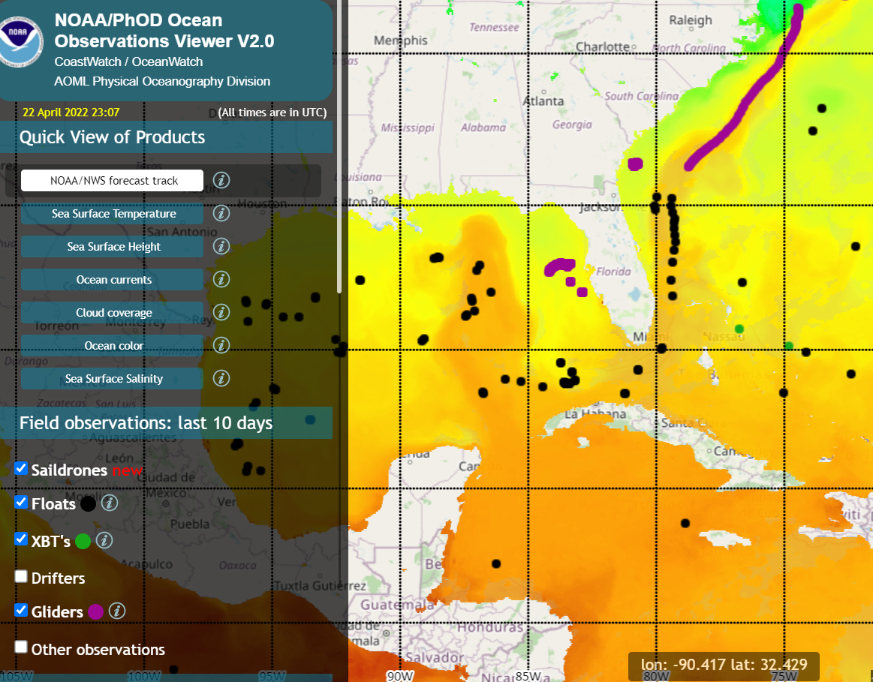
Gulf of Mexico Node – NOAA Research (OAR)
Personnel
Joaquín Trinanes – Ops Manager
Gustavo Goñi – Manager
User Community
Gulf of Mexico & Caribbean
Focus
Hurricanes, Sargassum, Vibrio, Seascapes
https://cwcaribbean.aoml.noaa.gov/

Slide 10
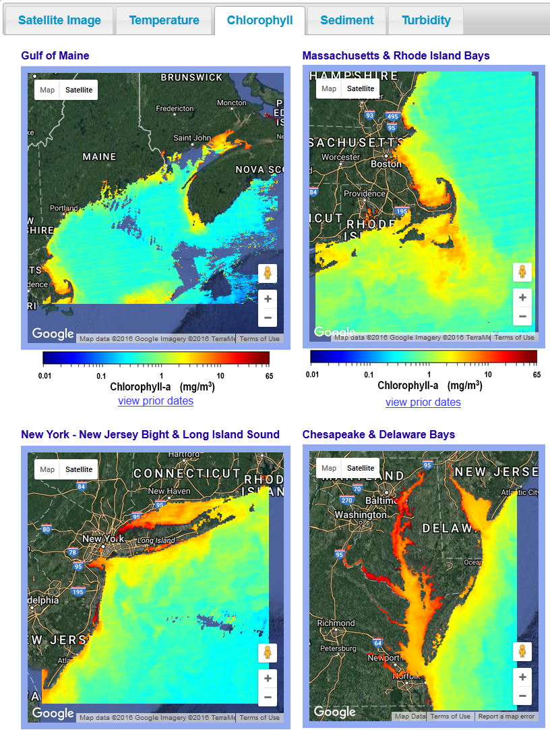
East Coast Node (ECN) – NOAA Ocean Service (NOS)
Service area - US East Coast from Maine to Florida
Personnel at National Ocean Service, NOAA Chesapeake Bay Office, and Center for Satellite Applications & Research
Shelly Tomlinson – Manager
Ron Vogel – Coordinator
User Community
Environmental decision-makers, researchers, commercial data providers & the general public from Maine to Florida
Providing Support
Making data usable for water quality, fisheries, aquaculture, algal bloom tracking, climate change, and more
Building tailored applications by engaging directly with stakeholders
Data holdings in temperature, water clarity, chlorophyll
https://eastcoast.coastwatch.noaa.gov

Slide 11
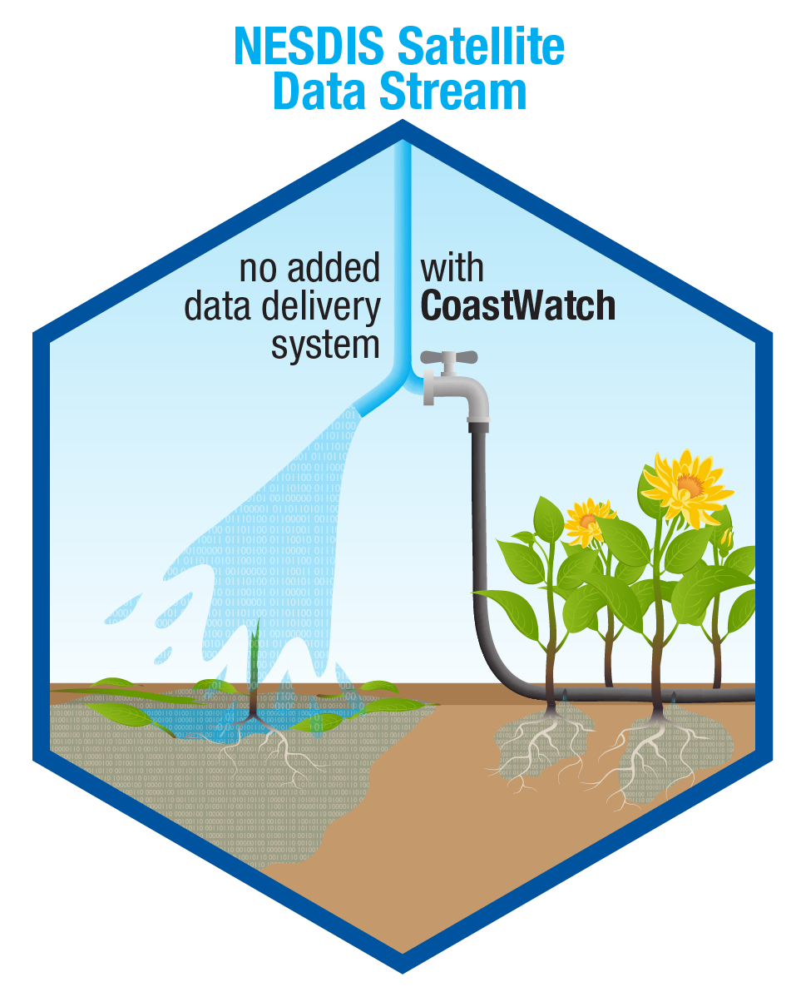
CoastWatch offers several levels of service to help users with satellite data
Provide access to datasets with data servers
Develop tools and tutorials to help users interact with the server and use the data
Provide training and hands-on assistance
Find or create products and tools to address users needs
Work directly with users on projects
Increasing Assistance to User
COASTWATCH IS A VALUE ADDED PROVIDER

Slide 12
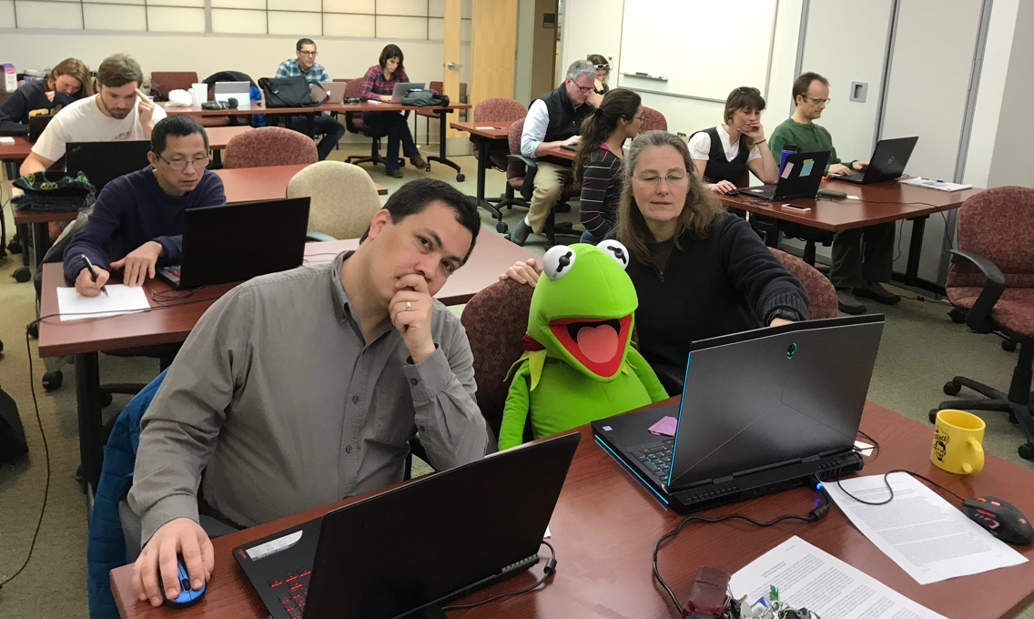
NOAA CoastWatch Satellite Courses
Developed in 2006 at the WCN
3-day course aimed at NOAA participants who want to learn how to access & use satellite data
Courses now conducted by all of the nodes
NOAA CoastWatch Satellite course at AFSC/ABL in Juneau, AK, March 2019

Slide 13
Why is satellite data is underutilized within the‘wet’part of NOAA?
Fisheries scientists and managers are often not familiar with the available datasets or how to access and manipulate them.
Satellite data can be difficult to access, manipulate and process, particularly for people who have never used it before.
Data is available from many sources, often poorly documented, each data access is different
Rigorous ‘data mining’ is needed to match up satellite data with survey or telemetry records.
Time-series of satellite data are relatively short compared to many fisheries datasets.

Slide 14
NOAA CoastWatch Satellite Course Philosophy
The objective of the course is to show people how to access satellite data and use it in the environment they are used to working in – a somewhat challenging task!
We focus on the software used the most widely by participants – primarily R, ArcGIS, and python, and to a lesser extent Matlab.
This is not a “GIS course”, nor a “R course” but it includes elements of both.
The course focuses on datasets available on CoastWatch ERDDAPs

Slide 15
What We Expect from You
One Summary Slide of your project
On Friday you will present one slide about your project or how you envision using satellite data in your future work.
These slides are important to NESDIS to demonstrate the utility and application of their products.

Slide 16
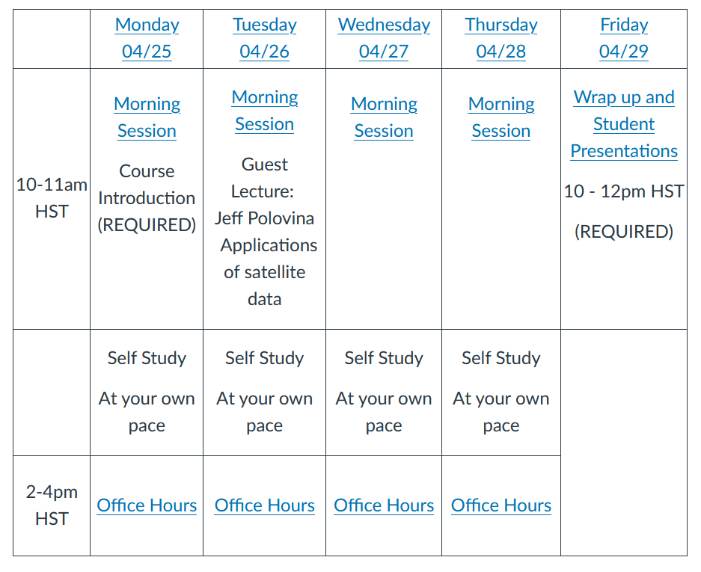
Course Structure
Notes:
ERDDAP is designed to make data access easier. There are a lot of different data sources out there, which gives rise to a plethora of different file formats and different methods for accessing and downloading data. Each institution that distributes data tends to favor a specific service and procedure, so if you need data from several sources, it can be a real headache to familiarize yourself will all of them, and then to figure out how to convert the data into a format you can use. ERDDAP works as a middleman, pulling data from a variety of different sources, and then distributing data in a wide variety of formats, as both data and graphs.
You now don’t have to learn how to use new protocols and formats, all you have to do is go to an ERDDAP webpage, select data you are interested in, and download it in your preferred format. ERDDAP is a RESTful service, which means that the entire data request is defined by a URL, which allows you to interact with ERDDAP from within your preferred software without having to go to the website. This is especially useful if you need to routinely download data and don’t want to make many different requests manually.

Slide 17
Discussion Forum
For questions/issues:
1. Click on this invite link to get access to the CoastWatch Slack workspace.
2. We will use this channel for the class. Click the "Join Channel" at the bottom center of the page the first time you access it.
All users should understand this is a public forum and anything submitted is open to public access.
For NOAA employees and affiliates:
Visit https://slack.com/ and establish an account.
1) Users should create an account using their NOAA email as the username and create a unique password.
(select the "continue with email" option)
2) Use the Slack web interface. Do not install the Slack App/program on your Government computer.
3) Don't share screen while using Slack (close/hide the tab)
Notes:
ERDDAP is designed to make data access easier. There are a lot of different data sources out there, which gives rise to a plethora of different file formats and different methods for accessing and downloading data. Each institution that distributes data tends to favor a specific service and procedure, so if you need data from several sources, it can be a real headache to familiarize yourself will all of them, and then to figure out how to convert the data into a format you can use. ERDDAP works as a middleman, pulling data from a variety of different sources, and then distributing data in a wide variety of formats, as both data and graphs.
You now don’t have to learn how to use new protocols and formats, all you have to do is go to an ERDDAP webpage, select data you are interested in, and download it in your preferred format. ERDDAP is a RESTful service, which means that the entire data request is defined by a URL, which allows you to interact with ERDDAP from within your preferred software without having to go to the website. This is especially useful if you need to routinely download data and don’t want to make many different requests manually.

Slide 18
Instructor Info
Name | Affiliation | Software | Research focus
Melanie Abecassis | CoastWatch | R ERDDAP Panoply | Pelagics Satellite data
Tom Oliver | NOAA PIFSC | R ERDDAP | Coral Reefs
Johanna Wren | NOAA PIFSC | R Python | Pelagics
Phoebe Woodworth-Jefcoats | NOAA PIFSC | R Matlab | Pelagics
Kisei Tanaka | NOAA PIFSC | R | Coral Reefs
Yvonne Barkley | NOAA PIFSC | R | Marine Mammals
Notes:
ERDDAP is designed to make data access easier. There are a lot of different data sources out there, which gives rise to a plethora of different file formats and different methods for accessing and downloading data. Each institution that distributes data tends to favor a specific service and procedure, so if you need data from several sources, it can be a real headache to familiarize yourself will all of them, and then to figure out how to convert the data into a format you can use. ERDDAP works as a middleman, pulling data from a variety of different sources, and then distributing data in a wide variety of formats, as both data and graphs.
You now don’t have to learn how to use new protocols and formats, all you have to do is go to an ERDDAP webpage, select data you are interested in, and download it in your preferred format. ERDDAP is a RESTful service, which means that the entire data request is defined by a URL, which allows you to interact with ERDDAP from within your preferred software without having to go to the website. This is especially useful if you need to routinely download data and don’t want to make many different requests manually.

Slide 19
Instructor Info - CoastWatch
Name | Affiliation | Software | Location
Michael Soracco | CoastWatch Central | ArcGIS | East Coast
Cara Wilson | CoastWatch West Coast Node | R ERDDAP | West Coast
Dale Robinson | CoastWatch West Coast Node | Python ERDDAP | West Coast
Jennifer Sevadjian | PolarWatch | Python ERDDAP | West Coast
Notes:
ERDDAP is designed to make data access easier. There are a lot of different data sources out there, which gives rise to a plethora of different file formats and different methods for accessing and downloading data. Each institution that distributes data tends to favor a specific service and procedure, so if you need data from several sources, it can be a real headache to familiarize yourself will all of them, and then to figure out how to convert the data into a format you can use. ERDDAP works as a middleman, pulling data from a variety of different sources, and then distributing data in a wide variety of formats, as both data and graphs.
You now don’t have to learn how to use new protocols and formats, all you have to do is go to an ERDDAP webpage, select data you are interested in, and download it in your preferred format. ERDDAP is a RESTful service, which means that the entire data request is defined by a URL, which allows you to interact with ERDDAP from within your preferred software without having to go to the website. This is especially useful if you need to routinely download data and don’t want to make many different requests manually.

Slide 20
Course Page
https://umd.instructure.com/courses/1332077
Notes:
ERDDAP is designed to make data access easier. There are a lot of different data sources out there, which gives rise to a plethora of different file formats and different methods for accessing and downloading data. Each institution that distributes data tends to favor a specific service and procedure, so if you need data from several sources, it can be a real headache to familiarize yourself will all of them, and then to figure out how to convert the data into a format you can use. ERDDAP works as a middleman, pulling data from a variety of different sources, and then distributing data in a wide variety of formats, as both data and graphs.
You now don’t have to learn how to use new protocols and formats, all you have to do is go to an ERDDAP webpage, select data you are interested in, and download it in your preferred format. ERDDAP is a RESTful service, which means that the entire data request is defined by a URL, which allows you to interact with ERDDAP from within your preferred software without having to go to the website. This is especially useful if you need to routinely download data and don’t want to make many different requests manually.

Slide 21
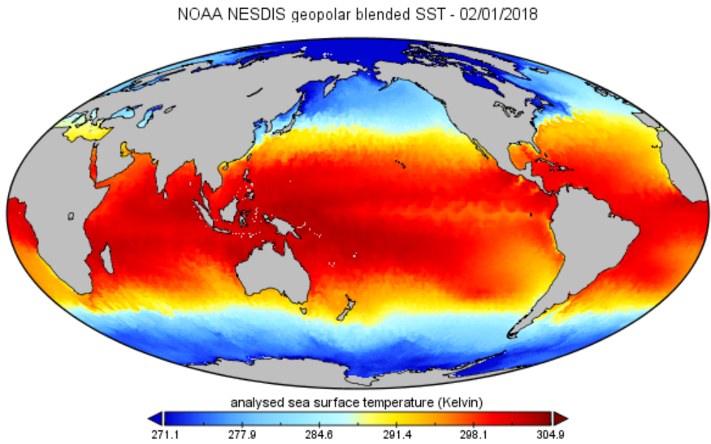
NetCDF/Panoply
Understand what NetCDF is and why it’s the standard firmat for satellite data
Use NASA Panoply to look at the structure of NetCDF files and make maps
https://umd.instructure.com/courses/1332077/pages/panoply-tutorial?module_item_id=11289443
Notes:
ERDDAP is designed to make data access easier. There are a lot of different data sources out there, which gives rise to a plethora of different file formats and different methods for accessing and downloading data. Each institution that distributes data tends to favor a specific service and procedure, so if you need data from several sources, it can be a real headache to familiarize yourself will all of them, and then to figure out how to convert the data into a format you can use. ERDDAP works as a middleman, pulling data from a variety of different sources, and then distributing data in a wide variety of formats, as both data and graphs.
You now don’t have to learn how to use new protocols and formats, all you have to do is go to an ERDDAP webpage, select data you are interested in, and download it in your preferred format. ERDDAP is a RESTful service, which means that the entire data request is defined by a URL, which allows you to interact with ERDDAP from within your preferred software without having to go to the website. This is especially useful if you need to routinely download data and don’t want to make many different requests manually.

Slide 22
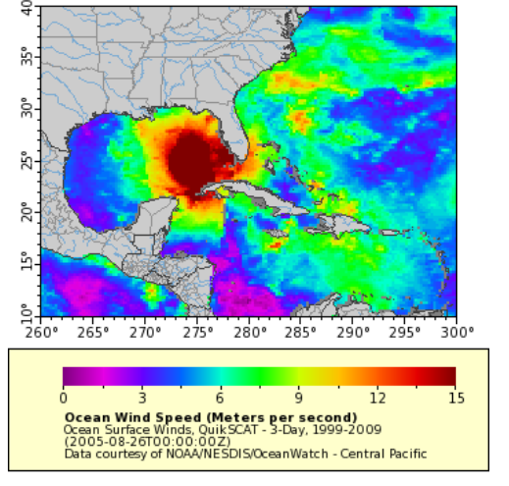
ERDDAP
Get familiar with ERDDAP web platform to visualize and download data
make basic graphs
Understand the structure of the ERDDAP URL/API
Use the Interpolate tool to match satellite data to in-situ points.
https://umd.instructure.com/courses/1332077/pages/erddap-tutorial?module_item_id=11289374
Notes:
ERDDAP is designed to make data access easier. There are a lot of different data sources out there, which gives rise to a plethora of different file formats and different methods for accessing and downloading data. Each institution that distributes data tends to favor a specific service and procedure, so if you need data from several sources, it can be a real headache to familiarize yourself will all of them, and then to figure out how to convert the data into a format you can use. ERDDAP works as a middleman, pulling data from a variety of different sources, and then distributing data in a wide variety of formats, as both data and graphs.
You now don’t have to learn how to use new protocols and formats, all you have to do is go to an ERDDAP webpage, select data you are interested in, and download it in your preferred format. ERDDAP is a RESTful service, which means that the entire data request is defined by a URL, which allows you to interact with ERDDAP from within your preferred software without having to go to the website. This is especially useful if you need to routinely download data and don’t want to make many different requests manually.

Slide 23
Questions?
Notes:
ERDDAP is designed to make data access easier. There are a lot of different data sources out there, which gives rise to a plethora of different file formats and different methods for accessing and downloading data. Each institution that distributes data tends to favor a specific service and procedure, so if you need data from several sources, it can be a real headache to familiarize yourself will all of them, and then to figure out how to convert the data into a format you can use. ERDDAP works as a middleman, pulling data from a variety of different sources, and then distributing data in a wide variety of formats, as both data and graphs.
You now don’t have to learn how to use new protocols and formats, all you have to do is go to an ERDDAP webpage, select data you are interested in, and download it in your preferred format. ERDDAP is a RESTful service, which means that the entire data request is defined by a URL, which allows you to interact with ERDDAP from within your preferred software without having to go to the website. This is especially useful if you need to routinely download data and don’t want to make many different requests manually.

Slide 24
Guest Lecture Dr. Jeff Polovina
Notes:
ERDDAP is designed to make data access easier. There are a lot of different data sources out there, which gives rise to a plethora of different file formats and different methods for accessing and downloading data. Each institution that distributes data tends to favor a specific service and procedure, so if you need data from several sources, it can be a real headache to familiarize yourself will all of them, and then to figure out how to convert the data into a format you can use. ERDDAP works as a middleman, pulling data from a variety of different sources, and then distributing data in a wide variety of formats, as both data and graphs.
You now don’t have to learn how to use new protocols and formats, all you have to do is go to an ERDDAP webpage, select data you are interested in, and download it in your preferred format. ERDDAP is a RESTful service, which means that the entire data request is defined by a URL, which allows you to interact with ERDDAP from within your preferred software without having to go to the website. This is especially useful if you need to routinely download data and don’t want to make many different requests manually.

Slide 25
Jeff Polovina
https://en.wikipedia.org/wiki/Jeffrey_Polovina
Highlights:
Director of the Ecosystem and Oceanography Division (now the pelagic program in ESD) at the NOAA Pacific Islands Fisheries Science Center (PIFSC)
Retired in 2016, now affiliated with Hawaii Institute of Marine Biology (HIMB)
Developed Ecopath: “named one of the ten biggest scientific breakthroughs in the first 200 years of NOAA”
Manager of the Hawaii node of CoastWatch for 20(?) years

Slide 26
Slido
How did you find the amount of material in yesterday’s module?
Which content did you finish?
How did the Panoply installation go for you?
Did you have any issues with the tutorials?
What do you think of ERDDAP?
Are you likely to use ERDDAP in the future?
Do you need help with your project? (check all that apply)
slido.com #SatCourse0422

Slide 27
Slido
How are you feeling about the course so far?
How did you find the amount of material in yesterday’s module?
Which content did you finish?
Do you still need help with your project?
Would it be useful if we gave live demos of any of these tools/software?
slido.com #SatCourse0422

Slide 28
R Tutorials
Notes:
ERDDAP is designed to make data access easier. There are a lot of different data sources out there, which gives rise to a plethora of different file formats and different methods for accessing and downloading data. Each institution that distributes data tends to favor a specific service and procedure, so if you need data from several sources, it can be a real headache to familiarize yourself will all of them, and then to figure out how to convert the data into a format you can use. ERDDAP works as a middleman, pulling data from a variety of different sources, and then distributing data in a wide variety of formats, as both data and graphs.
You now don’t have to learn how to use new protocols and formats, all you have to do is go to an ERDDAP webpage, select data you are interested in, and download it in your preferred format. ERDDAP is a RESTful service, which means that the entire data request is defined by a URL, which allows you to interact with ERDDAP from within your preferred software without having to go to the website. This is especially useful if you need to routinely download data and don’t want to make many different requests manually.

Slide 29
R – Contents
How to work with satellite data in R
Learn how to download data from ERDDAP and use the ncdf4 package to load the data, base plots to make a map of SST around Hawaii
Comparison of chlorophyll data from different sensors
Use the rerddap package to download data from ERDDAP for different ocean color sensors and plot time series of chl-a concentration around Hawaii.
Extract data within a shapefile using ERDDAP
Use the sf package to read a shapefile into R, and the rerddapXtracto package to extract data from ERDDAP within the shapefile boundaries, to plot a map of SST within the PMMN boundary.
Extract data along a turtle track
Learn 2 different ways to extract chl-a and SST from ERDDAP data along a turtle track.
Extract ocean color data in optically-shallow waters
Learn how to deal with ocean color data (chl-a) in shallow locations.
Notes:
ERDDAP is designed to make data access easier. There are a lot of different data sources out there, which gives rise to a plethora of different file formats and different methods for accessing and downloading data. Each institution that distributes data tends to favor a specific service and procedure, so if you need data from several sources, it can be a real headache to familiarize yourself will all of them, and then to figure out how to convert the data into a format you can use. ERDDAP works as a middleman, pulling data from a variety of different sources, and then distributing data in a wide variety of formats, as both data and graphs.
You now don’t have to learn how to use new protocols and formats, all you have to do is go to an ERDDAP webpage, select data you are interested in, and download it in your preferred format. ERDDAP is a RESTful service, which means that the entire data request is defined by a URL, which allows you to interact with ERDDAP from within your preferred software without having to go to the website. This is especially useful if you need to routinely download data and don’t want to make many different requests manually.

Slide 30
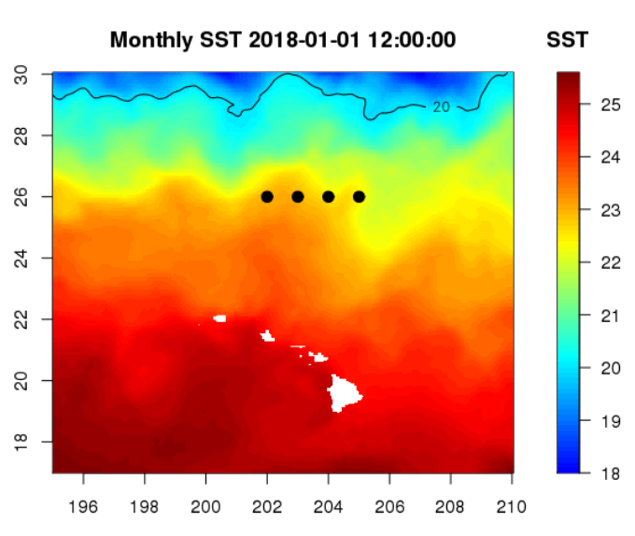
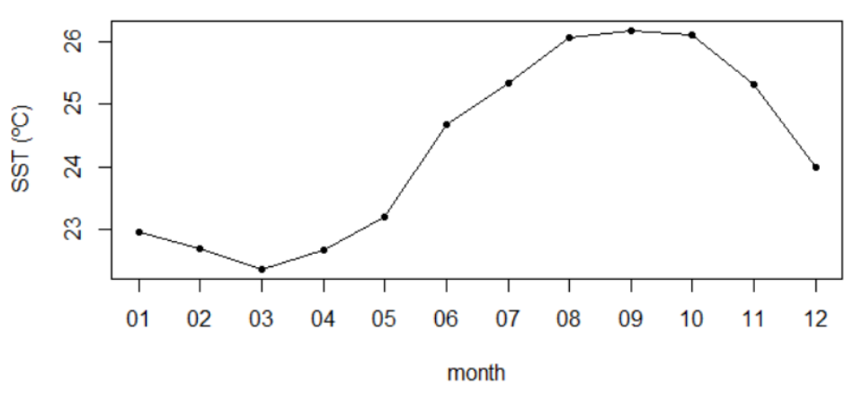
R – Tutorial 1
Find data on ERDDAP and generate download URL from ERDDAP webpage
Use ncdf4 package to load NetCDF data into R
Make a map and plot a time-series of SST around Hawaii
https://umd.instructure.com/courses/1332077/pages/r-tutorial-1-how-to-work-with-satellite-data-in-r?module_item_id=11294631
Notes:
ERDDAP is designed to make data access easier. There are a lot of different data sources out there, which gives rise to a plethora of different file formats and different methods for accessing and downloading data. Each institution that distributes data tends to favor a specific service and procedure, so if you need data from several sources, it can be a real headache to familiarize yourself will all of them, and then to figure out how to convert the data into a format you can use. ERDDAP works as a middleman, pulling data from a variety of different sources, and then distributing data in a wide variety of formats, as both data and graphs.
You now don’t have to learn how to use new protocols and formats, all you have to do is go to an ERDDAP webpage, select data you are interested in, and download it in your preferred format. ERDDAP is a RESTful service, which means that the entire data request is defined by a URL, which allows you to interact with ERDDAP from within your preferred software without having to go to the website. This is especially useful if you need to routinely download data and don’t want to make many different requests manually.

Slide 31
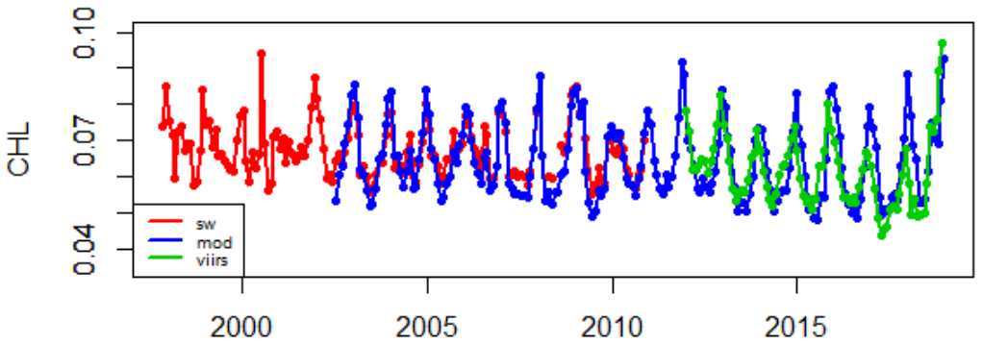
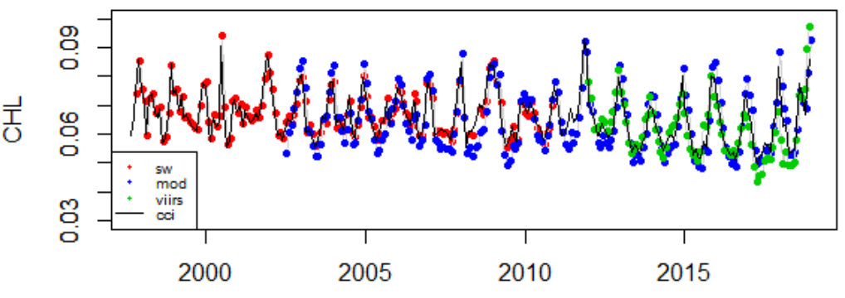
R – Tutorial 2
Use the rerddap package to download chl-a concentration data from ERDDAP for different sensors
Plot time series to compare data from different sensors
https://umd.instructure.com/courses/1332077/pages/r-tutorial-2-comparison-of-chlorophyll-data-from-different-sensors?module_item_id=11289580
Notes:
ERDDAP is designed to make data access easier. There are a lot of different data sources out there, which gives rise to a plethora of different file formats and different methods for accessing and downloading data. Each institution that distributes data tends to favor a specific service and procedure, so if you need data from several sources, it can be a real headache to familiarize yourself will all of them, and then to figure out how to convert the data into a format you can use. ERDDAP works as a middleman, pulling data from a variety of different sources, and then distributing data in a wide variety of formats, as both data and graphs.
You now don’t have to learn how to use new protocols and formats, all you have to do is go to an ERDDAP webpage, select data you are interested in, and download it in your preferred format. ERDDAP is a RESTful service, which means that the entire data request is defined by a URL, which allows you to interact with ERDDAP from within your preferred software without having to go to the website. This is especially useful if you need to routinely download data and don’t want to make many different requests manually.

Slide 32
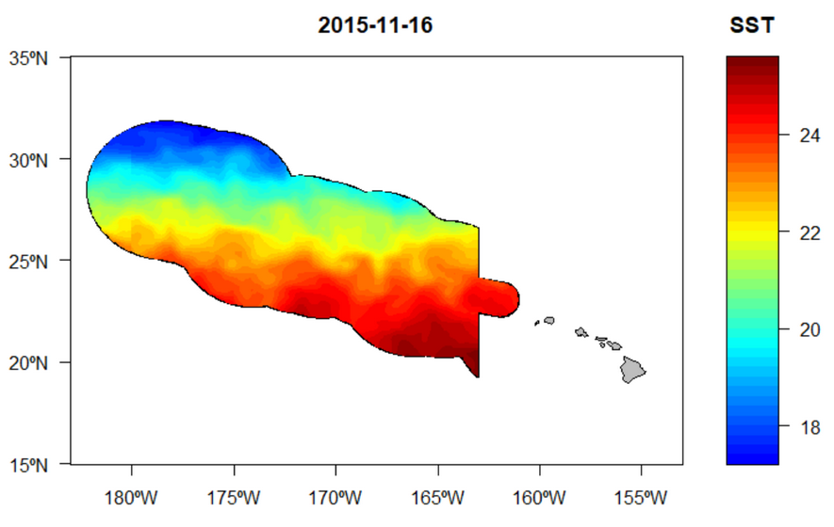
R – Tutorial 3
Use the sf package to load a shapefile into R
Use the rxtractogon function from the rerddapXtracto package to download data from ERDDAP within the boundaries of the shapefile
Make a map of SST within the boundaries of PMMN
https://umd.instructure.com/courses/1332077/pages/r-tutorial-3-extract-data-within-a-shapefile-using-erddap?module_item_id=11289586
Notes:
ERDDAP is designed to make data access easier. There are a lot of different data sources out there, which gives rise to a plethora of different file formats and different methods for accessing and downloading data. Each institution that distributes data tends to favor a specific service and procedure, so if you need data from several sources, it can be a real headache to familiarize yourself will all of them, and then to figure out how to convert the data into a format you can use. ERDDAP works as a middleman, pulling data from a variety of different sources, and then distributing data in a wide variety of formats, as both data and graphs.
You now don’t have to learn how to use new protocols and formats, all you have to do is go to an ERDDAP webpage, select data you are interested in, and download it in your preferred format. ERDDAP is a RESTful service, which means that the entire data request is defined by a URL, which allows you to interact with ERDDAP from within your preferred software without having to go to the website. This is especially useful if you need to routinely download data and don’t want to make many different requests manually.

Slide 33
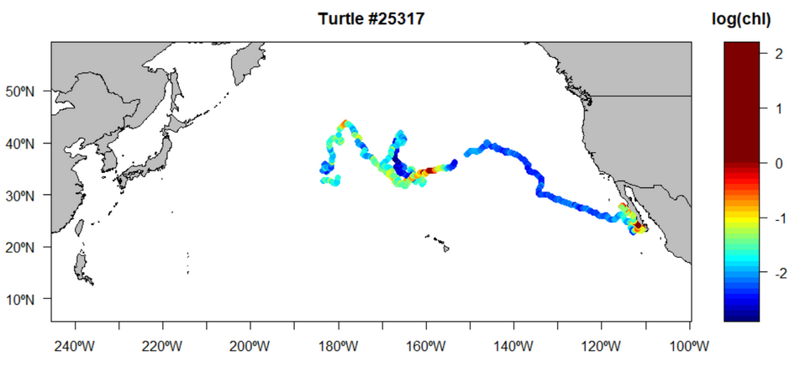
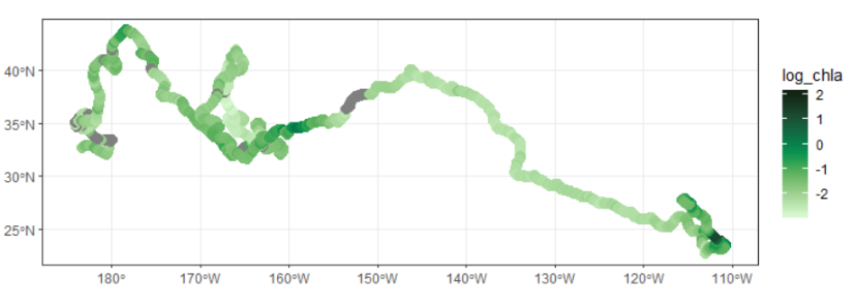
R – Tutorial 4
Use 2 different methods to download data for each point (location/date) along a turtle track.
Build an ERDDAP URL and extract data in a loop, and make map use base plots.
Use the rxtracto function of the rerddapXtracto package to extract data all at once and make a map using ggplot2.
https://umd.instructure.com/courses/1332077/pages/r-tutorial-4-extract-data-along-a-turtle-track?module_item_id=11289590
Notes:
ERDDAP is designed to make data access easier. There are a lot of different data sources out there, which gives rise to a plethora of different file formats and different methods for accessing and downloading data. Each institution that distributes data tends to favor a specific service and procedure, so if you need data from several sources, it can be a real headache to familiarize yourself will all of them, and then to figure out how to convert the data into a format you can use. ERDDAP works as a middleman, pulling data from a variety of different sources, and then distributing data in a wide variety of formats, as both data and graphs.
You now don’t have to learn how to use new protocols and formats, all you have to do is go to an ERDDAP webpage, select data you are interested in, and download it in your preferred format. ERDDAP is a RESTful service, which means that the entire data request is defined by a URL, which allows you to interact with ERDDAP from within your preferred software without having to go to the website. This is especially useful if you need to routinely download data and don’t want to make many different requests manually.

Slide 34
Python Tutorials
Notes:
ERDDAP is designed to make data access easier. There are a lot of different data sources out there, which gives rise to a plethora of different file formats and different methods for accessing and downloading data. Each institution that distributes data tends to favor a specific service and procedure, so if you need data from several sources, it can be a real headache to familiarize yourself will all of them, and then to figure out how to convert the data into a format you can use. ERDDAP works as a middleman, pulling data from a variety of different sources, and then distributing data in a wide variety of formats, as both data and graphs.
You now don’t have to learn how to use new protocols and formats, all you have to do is go to an ERDDAP webpage, select data you are interested in, and download it in your preferred format. ERDDAP is a RESTful service, which means that the entire data request is defined by a URL, which allows you to interact with ERDDAP from within your preferred software without having to go to the website. This is especially useful if you need to routinely download data and don’t want to make many different requests manually.

Slide 35
Python – Contents
How to work with satellite data in Python
Learn how to download data from ERDDAP and use the urllib and xarray packages to load the data, matplotlib to make a map of SST around Hawaii
Comparison of chlorophyll data from different sensors
Use the urllib and xarray packages to download data from ERDDAP for different ocean color sensors and plot time series of chl-a concentration around Hawaii.
Extract data within a shapefile using ERDDAP
Use the shapely and geopandas packages to read in a shapefile, and extract data from ERDDAP within the shapefile boundaries, to plot a map of SST within the PMMN boundary.
Extract data along a turtle track
Extract chl-a and SST from ERDDAP data along a turtle track.
Notes:
ERDDAP is designed to make data access easier. There are a lot of different data sources out there, which gives rise to a plethora of different file formats and different methods for accessing and downloading data. Each institution that distributes data tends to favor a specific service and procedure, so if you need data from several sources, it can be a real headache to familiarize yourself will all of them, and then to figure out how to convert the data into a format you can use. ERDDAP works as a middleman, pulling data from a variety of different sources, and then distributing data in a wide variety of formats, as both data and graphs.
You now don’t have to learn how to use new protocols and formats, all you have to do is go to an ERDDAP webpage, select data you are interested in, and download it in your preferred format. ERDDAP is a RESTful service, which means that the entire data request is defined by a URL, which allows you to interact with ERDDAP from within your preferred software without having to go to the website. This is especially useful if you need to routinely download data and don’t want to make many different requests manually.

Slide 36
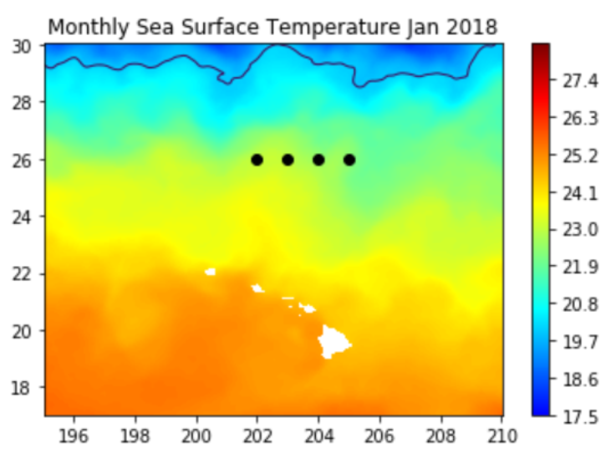
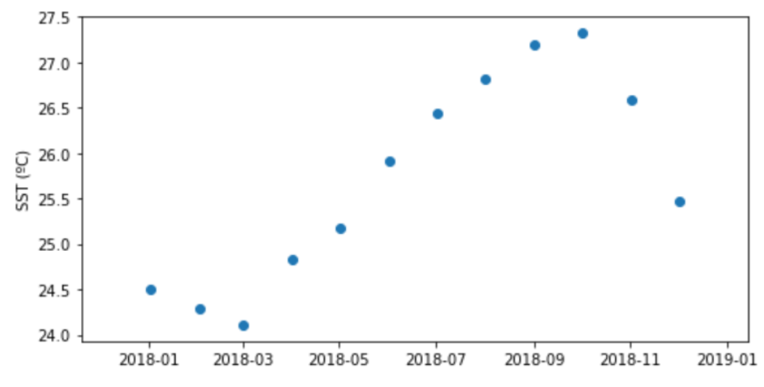
Python – Tutorial 1
Find data on ERDDAP and generate download URL from ERDDAP webpage
Use urllib and xarray packages to load NetCDF data into R
Make a map and plot a time-series of SST around Hawaii
https://umd.instructure.com/courses/1332077/pages/python-tutorial-1-how-to-work-with-satellite-data-in-python?module_item_id=11294632
Notes:
ERDDAP is designed to make data access easier. There are a lot of different data sources out there, which gives rise to a plethora of different file formats and different methods for accessing and downloading data. Each institution that distributes data tends to favor a specific service and procedure, so if you need data from several sources, it can be a real headache to familiarize yourself will all of them, and then to figure out how to convert the data into a format you can use. ERDDAP works as a middleman, pulling data from a variety of different sources, and then distributing data in a wide variety of formats, as both data and graphs.
You now don’t have to learn how to use new protocols and formats, all you have to do is go to an ERDDAP webpage, select data you are interested in, and download it in your preferred format. ERDDAP is a RESTful service, which means that the entire data request is defined by a URL, which allows you to interact with ERDDAP from within your preferred software without having to go to the website. This is especially useful if you need to routinely download data and don’t want to make many different requests manually.

Slide 37
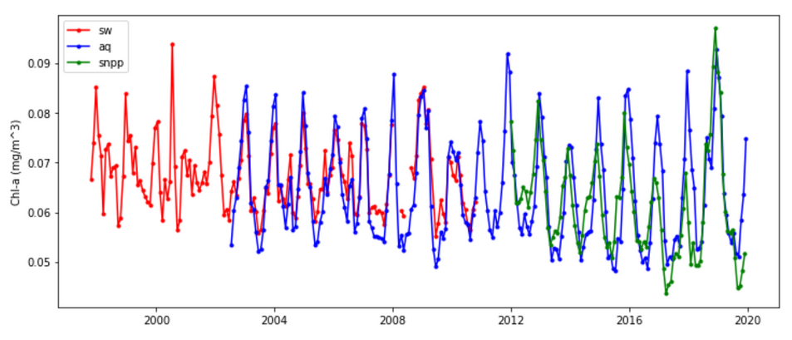
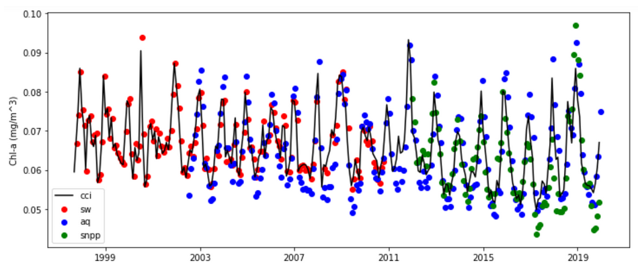
Python – Tutorial 2
Use the urllib and xarray packages to download chl-a concentration data from ERDDAP for different sensors
Plot time series to compare data from different sensors
https://umd.instructure.com/courses/1332077/pages/python-tutorial-2-comparison-of-chlorophyll-data-from-different-sensors?module_item_id=11289598
Notes:
ERDDAP is designed to make data access easier. There are a lot of different data sources out there, which gives rise to a plethora of different file formats and different methods for accessing and downloading data. Each institution that distributes data tends to favor a specific service and procedure, so if you need data from several sources, it can be a real headache to familiarize yourself will all of them, and then to figure out how to convert the data into a format you can use. ERDDAP works as a middleman, pulling data from a variety of different sources, and then distributing data in a wide variety of formats, as both data and graphs.
You now don’t have to learn how to use new protocols and formats, all you have to do is go to an ERDDAP webpage, select data you are interested in, and download it in your preferred format. ERDDAP is a RESTful service, which means that the entire data request is defined by a URL, which allows you to interact with ERDDAP from within your preferred software without having to go to the website. This is especially useful if you need to routinely download data and don’t want to make many different requests manually.

Slide 38
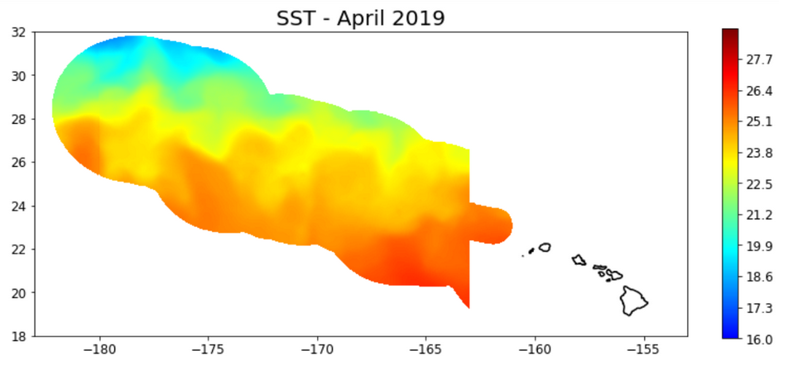
Python – Tutorial 3
Use the shapely and geopandas packages to read in a shapefile, and download data from ERDDAP within the boundaries of the shapefile
Make a map of SST within the boundaries of PMMN
https://umd.instructure.com/courses/1332077/pages/python-tutorial-3-extract-data-within-a-shapefile-using-erddap?module_item_id=11289599
Notes:
ERDDAP is designed to make data access easier. There are a lot of different data sources out there, which gives rise to a plethora of different file formats and different methods for accessing and downloading data. Each institution that distributes data tends to favor a specific service and procedure, so if you need data from several sources, it can be a real headache to familiarize yourself will all of them, and then to figure out how to convert the data into a format you can use. ERDDAP works as a middleman, pulling data from a variety of different sources, and then distributing data in a wide variety of formats, as both data and graphs.
You now don’t have to learn how to use new protocols and formats, all you have to do is go to an ERDDAP webpage, select data you are interested in, and download it in your preferred format. ERDDAP is a RESTful service, which means that the entire data request is defined by a URL, which allows you to interact with ERDDAP from within your preferred software without having to go to the website. This is especially useful if you need to routinely download data and don’t want to make many different requests manually.

Slide 39
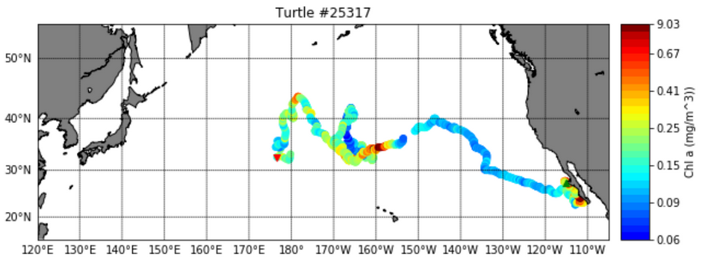
Python – Tutorial 4
Extract chl-a and SST from ERDDAP data for each point (location/date) along a turtle track.
Make a map using Basemap.
https://umd.instructure.com/courses/1332077/pages/python-tutorial-4-extract-data-along-a-turtle-track?module_item_id=11289600
Notes:
ERDDAP is designed to make data access easier. There are a lot of different data sources out there, which gives rise to a plethora of different file formats and different methods for accessing and downloading data. Each institution that distributes data tends to favor a specific service and procedure, so if you need data from several sources, it can be a real headache to familiarize yourself will all of them, and then to figure out how to convert the data into a format you can use. ERDDAP works as a middleman, pulling data from a variety of different sources, and then distributing data in a wide variety of formats, as both data and graphs.
You now don’t have to learn how to use new protocols and formats, all you have to do is go to an ERDDAP webpage, select data you are interested in, and download it in your preferred format. ERDDAP is a RESTful service, which means that the entire data request is defined by a URL, which allows you to interact with ERDDAP from within your preferred software without having to go to the website. This is especially useful if you need to routinely download data and don’t want to make many different requests manually.

Slide 40
ArcGIS Tutorials
Notes:
ERDDAP is designed to make data access easier. There are a lot of different data sources out there, which gives rise to a plethora of different file formats and different methods for accessing and downloading data. Each institution that distributes data tends to favor a specific service and procedure, so if you need data from several sources, it can be a real headache to familiarize yourself will all of them, and then to figure out how to convert the data into a format you can use. ERDDAP works as a middleman, pulling data from a variety of different sources, and then distributing data in a wide variety of formats, as both data and graphs.
You now don’t have to learn how to use new protocols and formats, all you have to do is go to an ERDDAP webpage, select data you are interested in, and download it in your preferred format. ERDDAP is a RESTful service, which means that the entire data request is defined by a URL, which allows you to interact with ERDDAP from within your preferred software without having to go to the website. This is especially useful if you need to routinely download data and don’t want to make many different requests manually.

Slide 41
ArcGIS – Contents
How to work with satellite data in ArcGIS
Learn how to download data from ERDDAP and use the Make NetCDF raster layer tool to load the data and make a map of SST around Hawaii
Enable time on the layer to visualize data for different time steps
Create maps
Extract SST values at survey locations
Calculate statistics within a shapefile
Classify SST data to create a TurtleWatch map
Extract SST data along a turtle track
Plot the turtle track on top of SST data
Match SST data at each location (date and lat/lon) along the track for a portion of the track
Create graphs of extracted temperatura along the track
Create movie of turtle movements in comparison with TurtleWatch SST range.
Notes:
ERDDAP is designed to make data access easier. There are a lot of different data sources out there, which gives rise to a plethora of different file formats and different methods for accessing and downloading data. Each institution that distributes data tends to favor a specific service and procedure, so if you need data from several sources, it can be a real headache to familiarize yourself will all of them, and then to figure out how to convert the data into a format you can use. ERDDAP works as a middleman, pulling data from a variety of different sources, and then distributing data in a wide variety of formats, as both data and graphs.
You now don’t have to learn how to use new protocols and formats, all you have to do is go to an ERDDAP webpage, select data you are interested in, and download it in your preferred format. ERDDAP is a RESTful service, which means that the entire data request is defined by a URL, which allows you to interact with ERDDAP from within your preferred software without having to go to the website. This is especially useful if you need to routinely download data and don’t want to make many different requests manually.

Slide 42
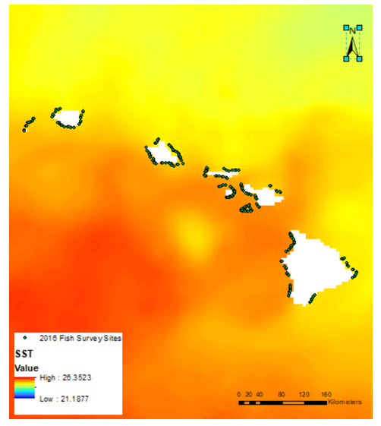
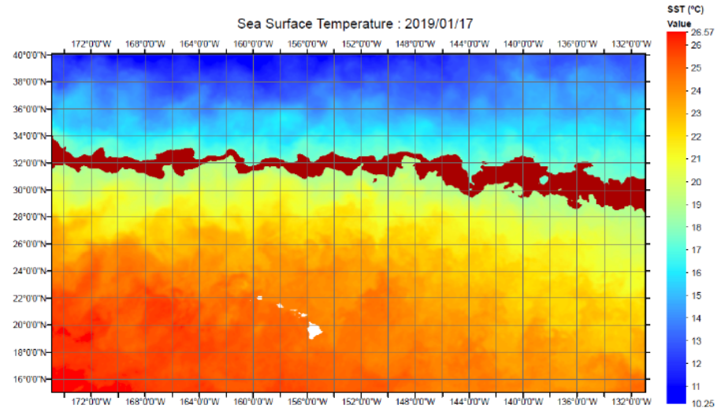
ArcGIS – Tutorial 1
Download data from ERDDAP
Import data into ArcGIS using the Make NetCDF raster layer tool.
Enable time on the layer to visualize data for different time steps
Create maps
Extract SST values at survey locations
Calculate statistics within a shapefile
Classify SST data to create a TurtleWatch map
https://umd.instructure.com/courses/1332077/pages/arcgis-tutorial-1?module_item_id=11289608
Notes:
ERDDAP is designed to make data access easier. There are a lot of different data sources out there, which gives rise to a plethora of different file formats and different methods for accessing and downloading data. Each institution that distributes data tends to favor a specific service and procedure, so if you need data from several sources, it can be a real headache to familiarize yourself will all of them, and then to figure out how to convert the data into a format you can use. ERDDAP works as a middleman, pulling data from a variety of different sources, and then distributing data in a wide variety of formats, as both data and graphs.
You now don’t have to learn how to use new protocols and formats, all you have to do is go to an ERDDAP webpage, select data you are interested in, and download it in your preferred format. ERDDAP is a RESTful service, which means that the entire data request is defined by a URL, which allows you to interact with ERDDAP from within your preferred software without having to go to the website. This is especially useful if you need to routinely download data and don’t want to make many different requests manually.

Slide 43
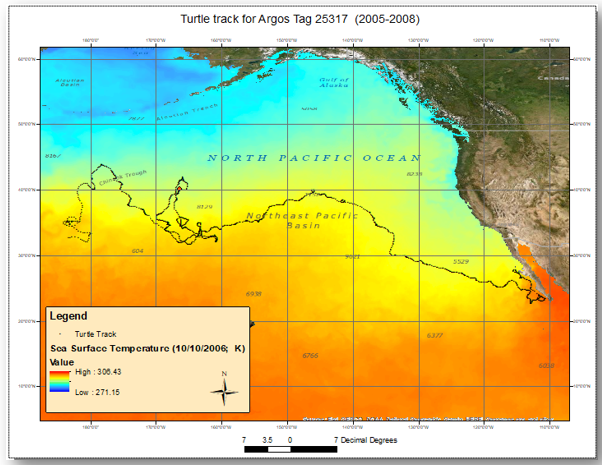
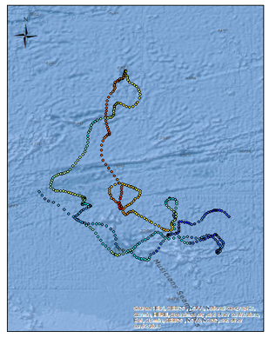
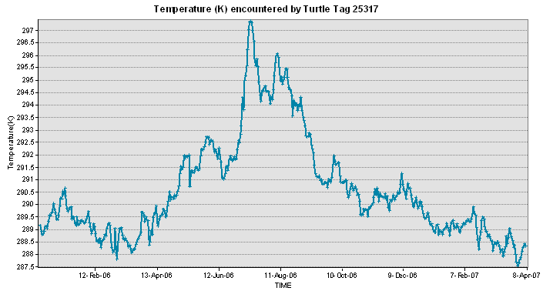
ArcGIS – Tutorial 2
Learn various methods to download and import data into ArcGIS
Plot the turtle track on top of SST data
Match SST data at each location (date and lat/lon) along the track for a portion of the track
Create graphs of extracted temperature along the track
Create movie of turtle movements in comparison with TurtleWatch SST range.
https://umd.instructure.com/courses/1332077/pages/arcgis-tutorial-2?module_item_id=11289609
Notes:
ERDDAP is designed to make data access easier. There are a lot of different data sources out there, which gives rise to a plethora of different file formats and different methods for accessing and downloading data. Each institution that distributes data tends to favor a specific service and procedure, so if you need data from several sources, it can be a real headache to familiarize yourself will all of them, and then to figure out how to convert the data into a format you can use. ERDDAP works as a middleman, pulling data from a variety of different sources, and then distributing data in a wide variety of formats, as both data and graphs.
You now don’t have to learn how to use new protocols and formats, all you have to do is go to an ERDDAP webpage, select data you are interested in, and download it in your preferred format. ERDDAP is a RESTful service, which means that the entire data request is defined by a URL, which allows you to interact with ERDDAP from within your preferred software without having to go to the website. This is especially useful if you need to routinely download data and don’t want to make many different requests manually.

Slide 44
Slido
How did you find the amount of material in yesterday’s module?
Do you have any feedback on the tutorials? Is there anything else you want to learn that is not covered by the tutorials?
Are there satellite products you need that you couldn't get from CoastWatch?
What satellite products do you need that you couldn't find on CoastWatch?
How are you feeling about tomorrow's presentations?
slido.com #SatCourse0422

Slide 45
Tomorrow’s presentations - 1 slide, 2 mins max.
Your slide should be in widescreen format and include the following information:
Your name
Your affiliation
A short description of your project
One or two images (map, time series, histogram, cute picture) that you were able to make over the course of the week in relation with your project
What specific satellite product(s) you used
What software you used
Cool picture of relevant animals or technology etc. involved in your project (optional)
If applicable: challenges, data products that you wish were available (satellite-related), need unmet by current data/services offerings.
2. Submit slide:
Send your slide to Melanie.Abecassis@NOAA.gov by Friday 9am HST

Slide 46
Tomorrow’s presentations – 10am -12pm HST
We probably won’t need 2 hours, but if you need to leave early, email Melanie so I can “schedule” you for the beginning.

Slide 47
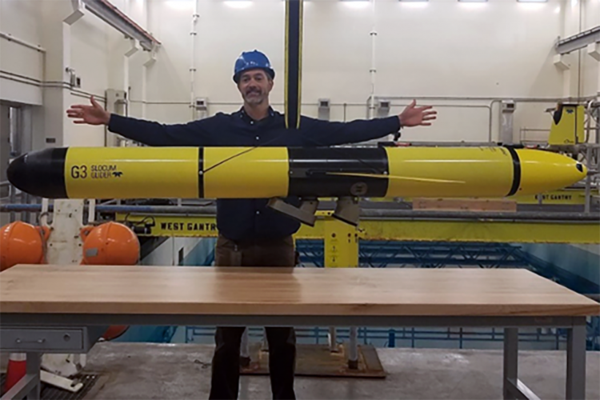
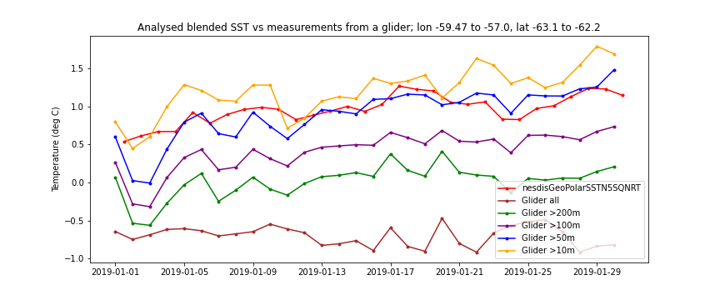
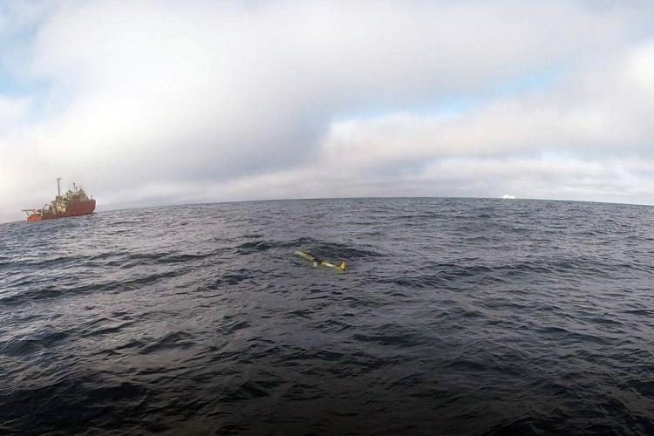
Sam Woodman, NOAA/SWFSC/AERD
Original project idea: explore how to ingest satellite data to improve situational awareness for our glider piloting.
Outcome: Use Python notebook to compare SST (NOAA Geo-Polar Blended Global Level 4) measurements with temperature measurements form AERD’s AMLR01 glider in Jan 2019

Slide 48
Exploring Marine Heatwaves and Eddies in the Northeast US
Rachel Wegener
University of Maryland, College Park
I looked at how warm water coincided with 1) sea surface height anomalies and 2) an eddy tracking product. I focused on the Northeast US from October 2016-March 2017, when a known marine heatwave was occurring. The goal was to assess if the movement of warm water was related to warm core eddies.
Datasets
NOAA Cora Reef Watch - SST Anomaly (5km)
Coastwatch Sea Level Anomaly (0.25º)
AVISO Eddy Tracking META3.1
Software
ERDDAP – data download
Panoply – initial visualization
Python – data processing and analysis

Slide 49
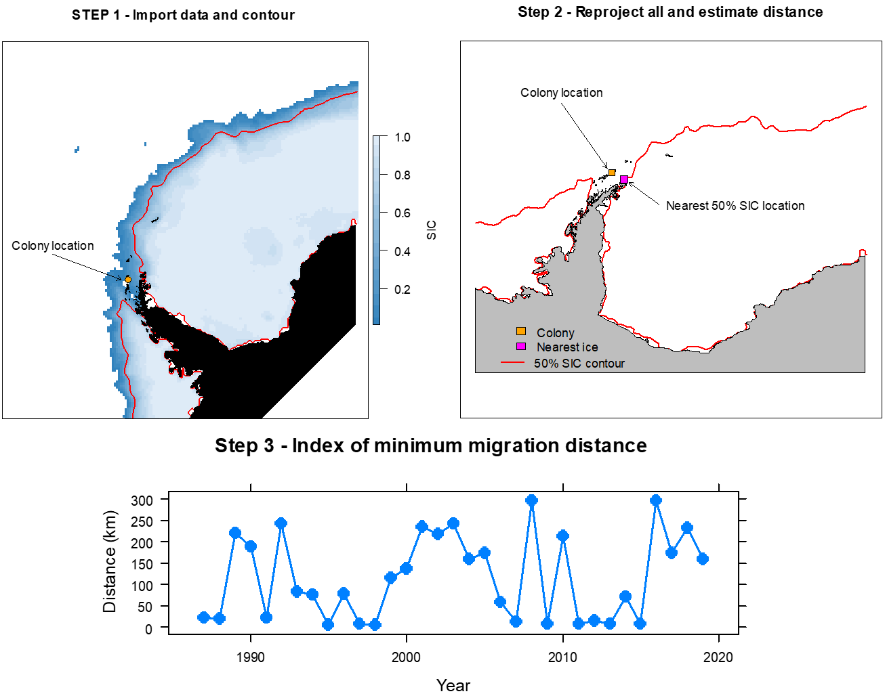
Jefferson Hinke – AERD/SFWSC
CoastWatch Satellite Course 3-7 May 2021
My project assessed the distance from a penguin breeding colony to the nearest location with a sea ice concentration (SIC) >=50% in September. Adélie penguins usually spend the winter in pack ice with SIC ≥50%.
In September, birds migrate from the ice to their colony. The travel distance from winter habitats to breeding sites may impact their reproductive success.
I estimated the annual minimum migration distance using NSIDC SIC data with 25km resolution available monthly from 1985-2019.
The pseudo code to do this is
Import a sector of SIC data: 90W to 0W and north of 90S
Estimate location of 50% SIC contour
Estimate distance from colony to nearest 50% contour position (blocking potential locations that require traversing mountain ranges).
Progress toward the index is illustrated in Steps 1 and 2 with data from September 2019. An index for all years is presented in Step 3.

