Slide 1
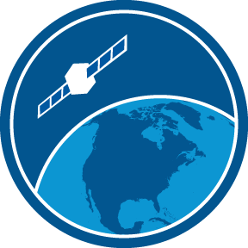
Satellite Sea Ice Data
Jennifer Sevadjian, Cara Wilson, Dale Robinson
NOAA CoastWatch Virtual Satellite Course
May 3-7, 2021
Versioning
-Sevadjian & Robinson, May 2021, Apr 2020, Apr 2019
-Robinson, 2018
Notes:
This is the presentation on satellite sea ice data as part of the virtual NOAA CoastWatch virtual satellite course.

Slide 2
Outline
Introduction
Background | Challenges associated with sea ice data
Finding/choosing a dataset
Where to get data? | What products are available?
Projections
Working with multiple projections
Workflow integration
Integrating sea ice data
Notes:
In this presentation I will provide an overview of satellite sea ice data, and discuss some challenges associated with working with sea ice data. I will cover some considerations to keep in mind when choosing a dataset, how to access data through CoastWatch and our partners, and highlight some available resources to help address the challenges associated with integrating sea ice data into research projects.

Slide 3
Who needs sea ice data and why?
Using sea ice data is unique to polar and subpolar applications
Many data providers do not carry sea ice data
Important for multiple applications
Fisheries management, safety at sea, navigation, transportation, tourism, and recreation
Polar regions are very inaccessible
Using satellites to monitor sea ice is important due to inaccessibility of these regions
Notes:
Using sea ice data is unique to polar and subpolar applications. Many satellite data providers do not carry sea ice data. In addition to research, sea ice data is important for multiple applications including fisheries management, safety at sea, navigation, transportation, tourism, and recreation. Because the Polar regions are very inaccessible, using satellites to monitor sea ice is important because other measurements are simply not possible.

Slide 4
There are challenges associated with using sea ice data
How can I find the data? Where can I get it?
There are many data providers: NSIDC¹ , NIC², ESA³ Copernicus, NCEI⁴
Issues: products made for limited user base, limited data formats, limited access
How do I choose a data product?
What are the differences among products?
There are many map projections.
Usually not the projection I use.
How do I integrate the data into my workflow?
¹NSIDC - National Snow and Ice Data Center
²NIC - National Ice Center
³ESA – European Space Agency
⁴NCEI - National Centers for Environmental Information
Notes:
When faced with integrating sea ice data into a project there are several challenges that are common. First it can be a challenge to know where to get the data because sea ice data may not be available where you would typically look for environmental or satellite data. There are many data providers including NSIDC¹ , NIC², EUMETSAT, and NCEI⁴. It is often not clear which data provider to go to and what the differences may be among the data they provide. Each data product typically geared toward a specific user base with data formats and access methods that are suited for that user community. This can limit the broad use of products because it takes effort to dig into each of the products and determine these details. There are many map projections used in sea ice data products. This can make it difficult to preview and test out multiple products.

Slide 5
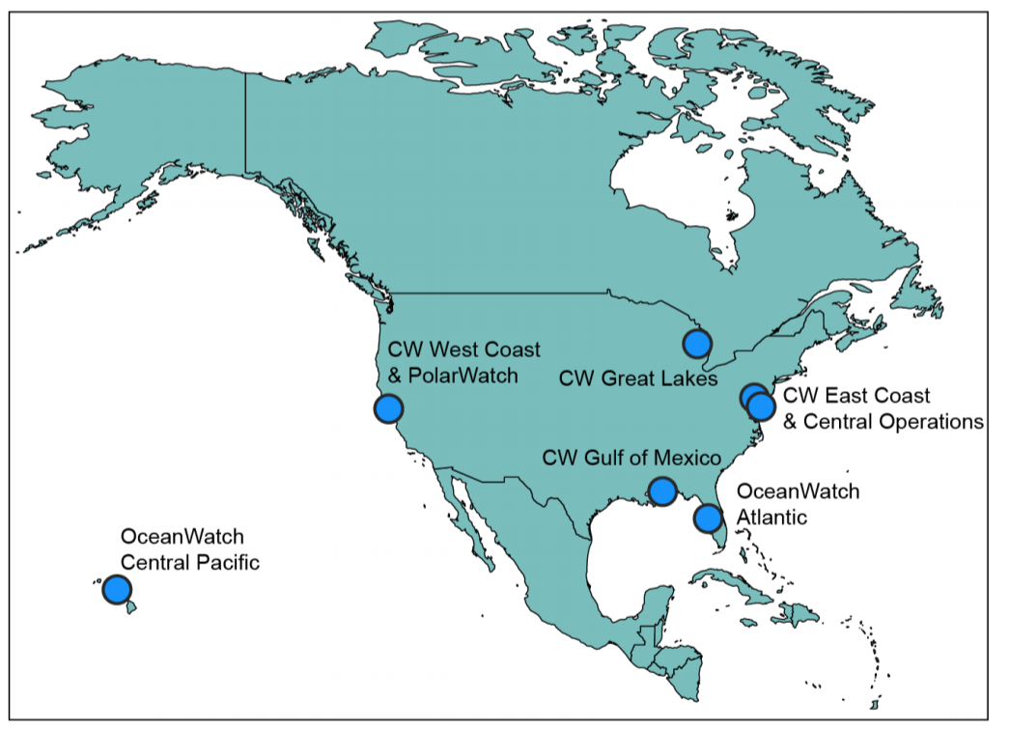
Where to get data: Introduction to PolarWatch/CoastWatch
PolarWatch is a NOAA CoastWatch Node
value added provider that collaborates with key data providers and users:
CoastWatch Central, NSIDC¹, NIC², NMFS³, NESDIS⁴
facilitate discovery and access to satellite data covering polar and subpolar regions.
¹NSIDC - National Snow and Ice Data Center
²NIC - National Ice Center
³NCEI - National Centers for Environmental Information
⁴NESDIS - National Environmental Satellite, Data, and Information Service
Notes:
Recognizing these barriers to satellite sea ice data usage, PolarWatch addresses these challenges with the goal of encouraging broad use and integration of polar satellite data into research and management projects. PolarWatch is a NOAA CoastWatch Node that collaborates with key data providers and users. We work closely with CoastWatch Central, the national snow and ice data center, the national ice center, NOAA fisheries and NESDIS to facilitate discovery and access to satellite data covering polar and subpolar regions.

Slide 6
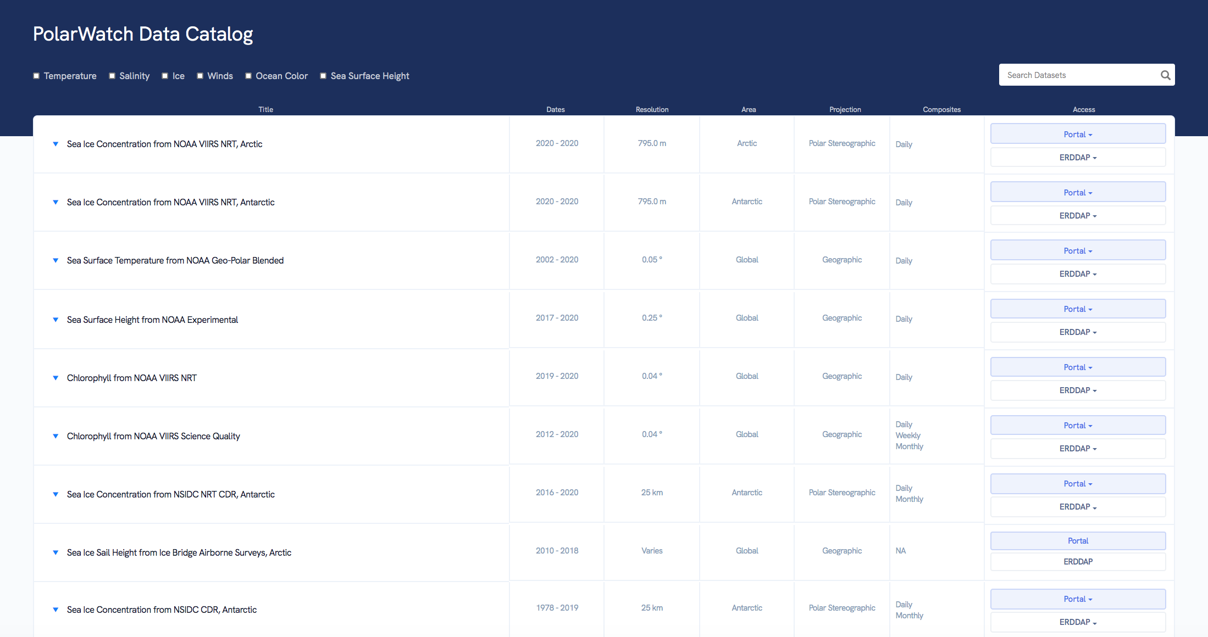
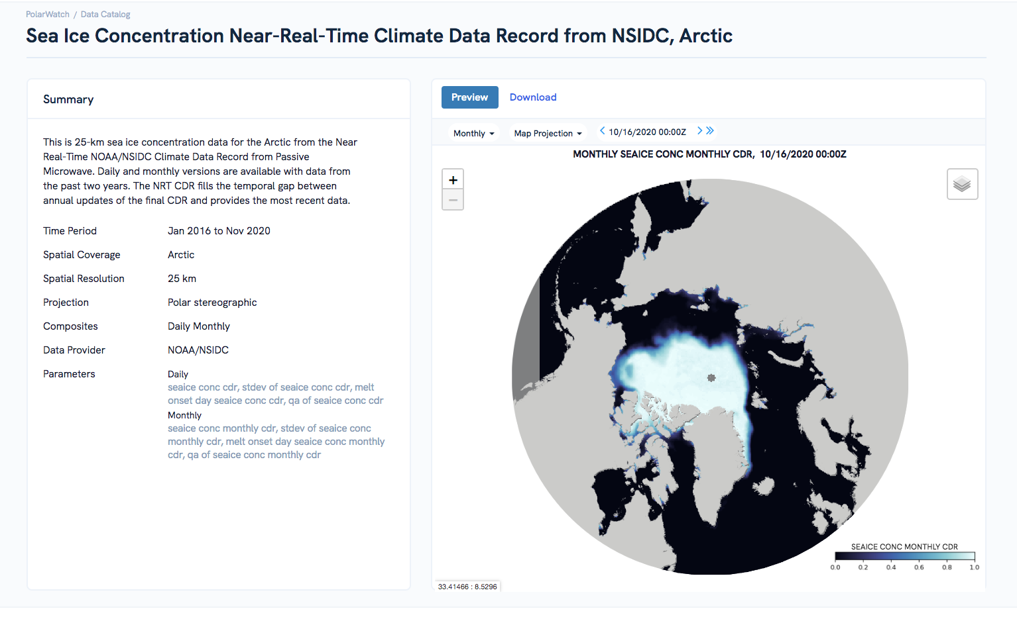
Where to get data: PolarWatch
PolarWatch provides access to near real-time and historical satellite observations including:
Sea ice, water temperature, ocean color, salinity and winds
PolarWatch addresses the challenges of integrating sea ice data:
Making data available in common formats with easy access
Curating quality datasets,
Making it easier to quickly determine differences between datasets,
Previews of data before downloading
Notes:
To address the challenges of integrating sea ice data, PolarWatch: provides consistent access to near real-time and historical satellite observations from multiple parameters including: Sea ice, water temperature, ocean color, salinity and winds we provide a curated collection of quality datasets from multiple data providers all data are available in common formats with easy open access. The PolarWatch data catalog makes it easier to determine differences between datasets at a glance. And Each dataset can be previewed online on an interactive polar map before downloading.

Slide 7
Satellite Sea Ice Datasets
There are many available datasets, we will cover some highlighted products
Reach out to us with any questions about data sets
PolarWatch User Support
Jennifer.sevadjian@noaa.gov
Some things to consider when choosing a dataset:
Intended use
Coverage
Resolution
Gaps, interpolation
Timeliness
Reliability
Notes:
Next I will cover some of the sea ice products that are available through CoastWatch, PolarWatch, our partners, and datasets that are relevant to fisheries science and management. Please reach out with any questions about datasets. There is often more than one viable option and it is not always readily apparent which is the best dataset to use. You can email me at jennifer dot sevadjian at noaa dot gov. Or if you know you are interested in datasets from NSDIC you can reach out directly to their excellent user services support, their email is nsidc at nsidc dot org. I will be providing a brief overview of the most common types of data available for sea ice measured by satellite. I will focus on Level 3 and 4 data which are gridded, georeferenced and cloud masked datasets. I will focus on highlighting datasets most relevant to course participants and provide links to where you can learn more and to where you can access the data.

Slide 8
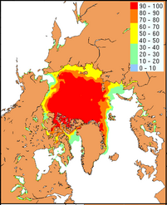
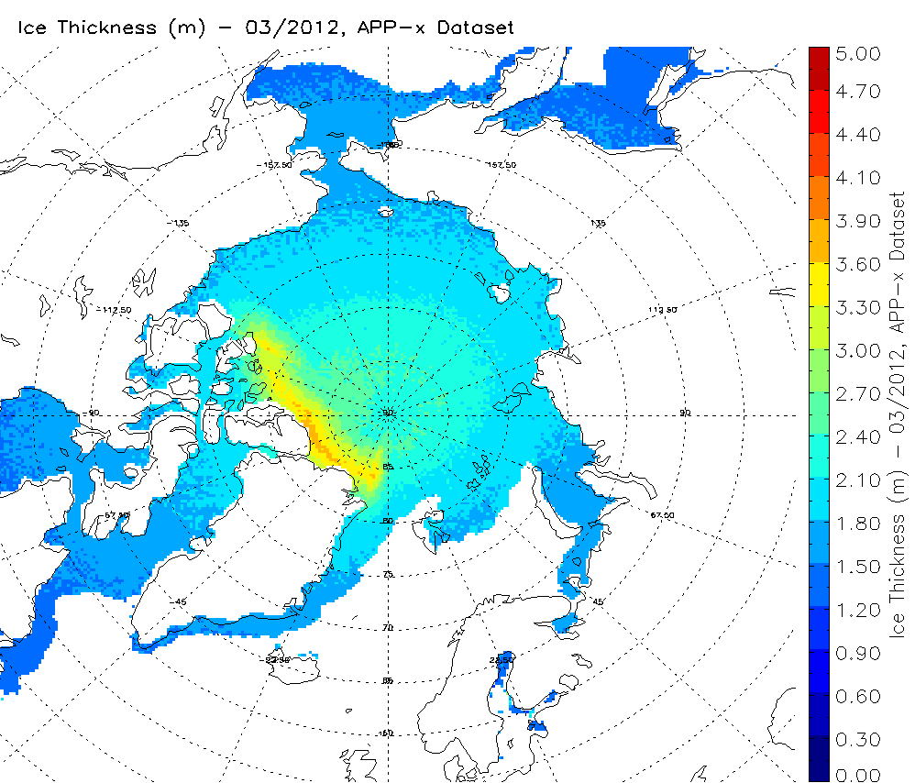
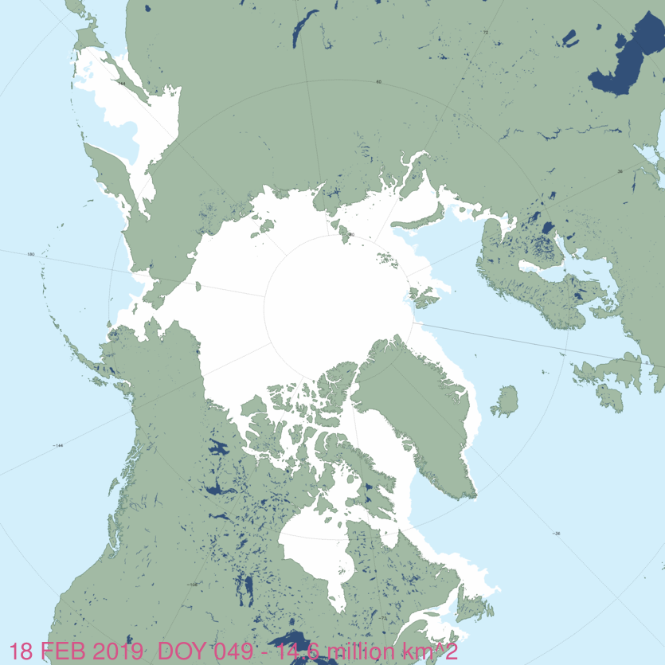
Datasets: Sea Ice Properties
Many sea ice properties can be monitored by satellites
Sea Ice Concentration
Sea Ice Thickness
Ice Type/Age
Ice Edge
Notes:
Let’s start with a rough overview of the properties of sea ice that can be measured by satellite. One or more of these properties may be relevant to your research area. Concentration provides the percentage of a grid cell that contains sea ice. Sea ice thickness is the vertical height of the sea ice. Ice type refers to first year ice or older multi-year ice which are important distinctions in some research areas. Ice edge products focus on providing the most accurate defining line between sea ice and its surroundings.

Slide 9
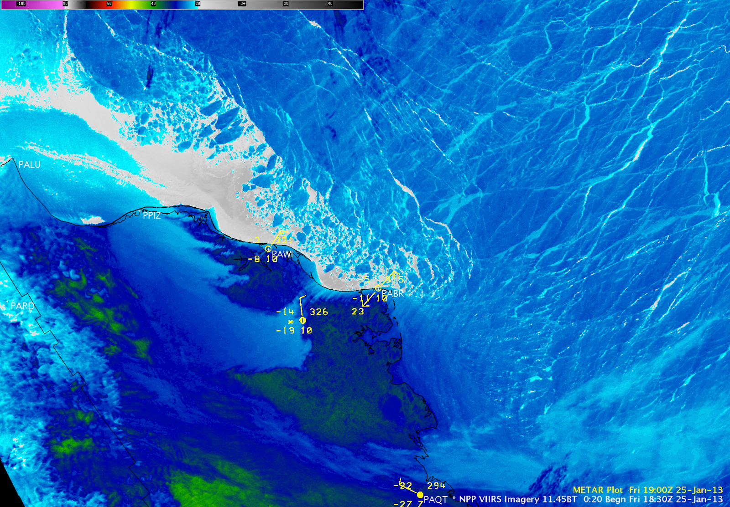
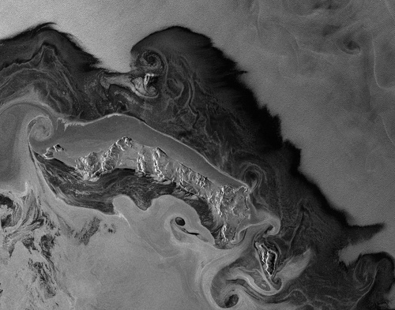
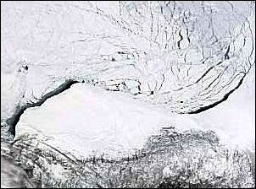
Datasets: Satelite Sensors
Many different satellite sensors can measure sea ice
Infrared
Microwave
(Passive and Active)
Visible
VIIRS Infrared Image
Active Microwave SAR Image
MODIS Visible Image
Notes:
These properties can be measured by a variety of satellite sensors, including infrared, microwave and visible sensors.
Visible sensors can collect data only during the day when there is light. Infrared sensors do not need light so they can provide data both day and night. This is important in polar regions where there is complete darkness for long periods. Both Visible and IR sensors do not “see through clouds”, but microwave sensors can. This is also very relevant in the polar regions where there is often cloud cover. The trade-off is that microwave sensors have a large footprint and so a much coarser resolution than IR. Depending on the needs of your project you may want to include data from multiple sensors. For example, researchers will often use infrared data as their number one choice, but if there are gaps in the high-res infrared data they will fall back to lower-resolution passive microwave to fill in the gaps. There are even some level 4 sea ice products that do work for you by incorporating data from multiple sensors to provide a “best of” dataset with the most coverage. I will provide an overview of some of the available datasets and how to access them next.

Slide 10
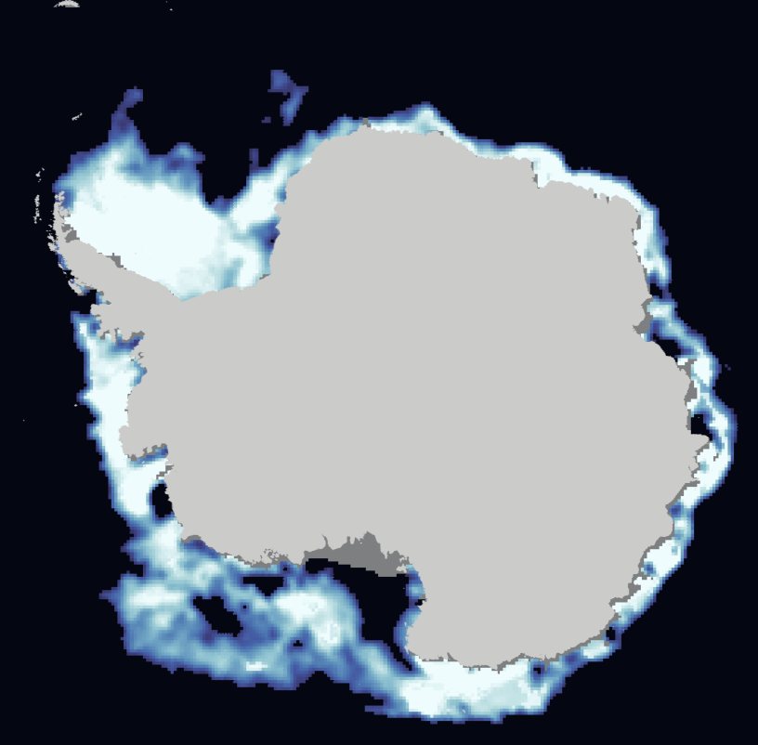
NOAA/NSIDC Ice Concentration Climate Data Record Products
Coverage: Arctic and Antarctic
Long Time Series: 1978 – present
Spatial Resolution: 25km
Temporal Resolution : Daily, Monthly
NSIDC: Download and Information:
https://nsidc.org/data/g10016
PolarWatch: View and ERDDAP Download : https://polarwatch.noaa.gov/catalog/?ice=y&searchFor=NSIDC%20CDR
Notes:
I will start with sea ice concentration products which are some of our most commonly requested products. There are a number of products available, here I will highlight a handful. If you are looking for a long-time series the NOAA/NSIDC Climate Data Record is a product with coverage in both the Arctic and Antarctic that goes back to 1978. This data comes from microwave sensors so it doesn’t have spatial gaps and it has a resolution of 25km. These data are provided by the national snow and ice data center and are available for preview, subsetting and download in a variety of formats through PolarWatch services. There are other sea ice concentration datasets that have higher resolution but don’t go as far back in time. I’ll cover some of those next.

Slide 11
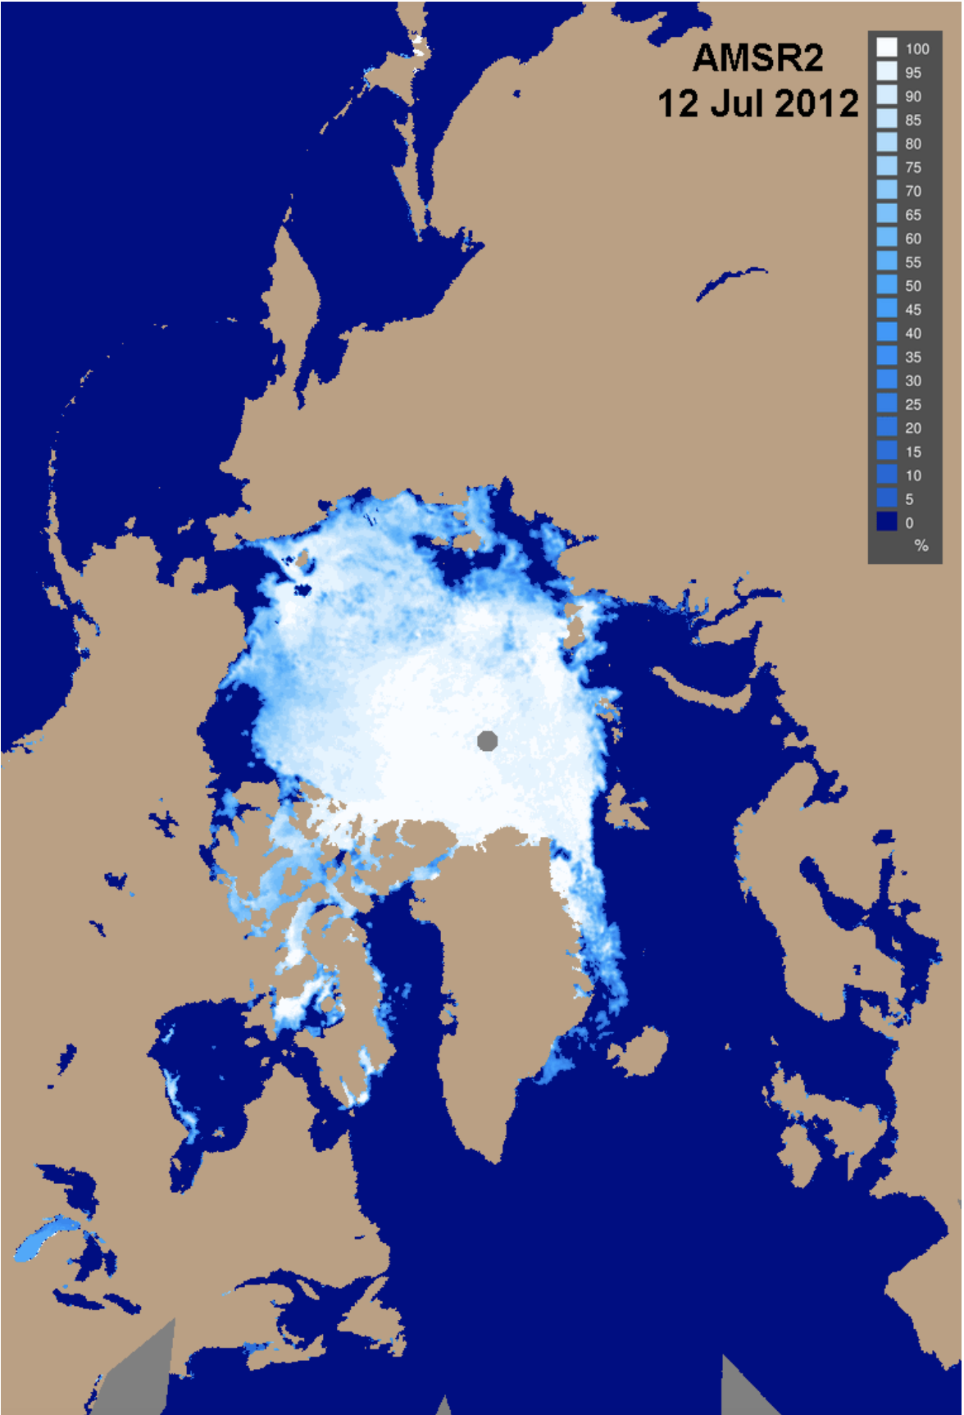
AMSR-2 and AMSR-E Ice Concentration Products
Newest, highest resolution microwave sensor data
Coverage : Arctic
Time Series: 1978 – present
Spatial Resolution: 10km
Temporal Resolution : Daily, Monthly
NSIDC: Download and Information:
https://nsidc.org/data/amsre_amsr2
PolarWatch: View and ERDDAP Download https://coastwatch.noaa.gov/cw/satellite-data-products/sea-ice/amsr2-sea-ice-concentration.html
Notes:
You can get gap-free higher-resolution satellite sea ice concentration data from the AMSR2 satellite sensor. This data goes back to 2012 and has a resolution of about 10-12 kilometers. Some datasets merge AMSR2 data with earlier AMSRE data for a continuous record back to 2002. You can learn more about the AMSR2 data on the NSIDC website and on the CoastWatch website. CoastWatch and PolarWath are currently working on distributing AMSR2 data as level 3 gridded products. We anticipate these will be added to the PolarWatch portal in the next few months. There are a number of different products and it can be difficult to discern the differences between them. Reach out to me if you are interested in using AMSR data and I can help you determine the best one for your needs.

Slide 12
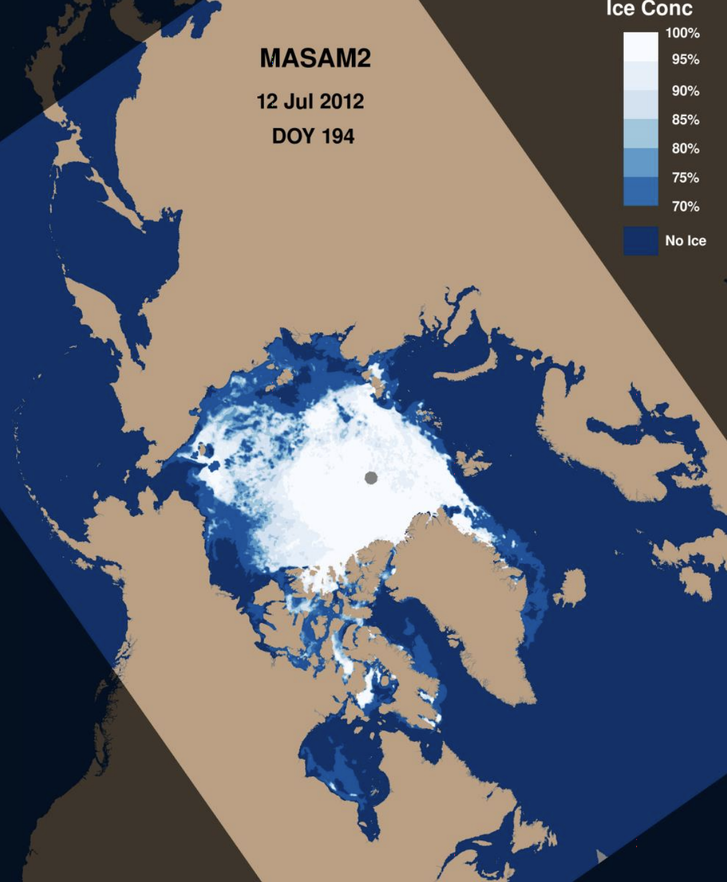
NSIDC MASAM2 Ice Concentration Products
Adds the value of MASIE reliable ice edge
Coverage : Arctic
Time Series: 2012 – present
Spatial Resolution: 4km
Temporal Resolution: Daily
NSIDC: Download and Information:
https://nsidc.org/data/g10005
Notes:
An interesting product that incorporates the AMSR2 data is the NSIDC MASAM2 product. This product is only available for the Arctic. By combining the AMSR2 microwave data with the higher resolution national ice center IMS product, MASAM2 can provide a more accurate picture of what is happening at the edges of the ice which may be of particular interest and benefit to researchers in fisheries.

Slide 13
VIIRS High Resolution Infrared Ice Products
Coverage : Arctic
Time Series: 1978 – present
Spatial Resolution: 750m
Temporal Resolution : Daily, 4-day
Measurements:
Ice concentration
Ice thickness
Ice surface temperature
PolarWatch Catalog VIIRS Ice Datasets
https://polarwatch.noaa.gov/catalog/?ice=y&searchFor=viirs+ice
Notes:
Sea Ice concentration data from infrared sensors can provide much higher resolution data than the microwave datasets I just mentioned - but it does not see through clouds, so spatial coverage is less reliable. The latest data infrared sea ice data from CoastWatch are 750m resolution products from VIIRS and there are daily and 4-day composites for both the Arctic and Antarctic. Currently this data is served through CoastWatch as a near-real-time dataset with a rolling archive of the most recent 3-weeks. If gap-free coverage is needed, this VIIRS dataset could be complemented with AMSR2 to provide microwave coverage where IR is unavailable. The VIIRS sea ice data have recently been published to the Polar Watch portal and are available for online preview and data access.

Slide 14
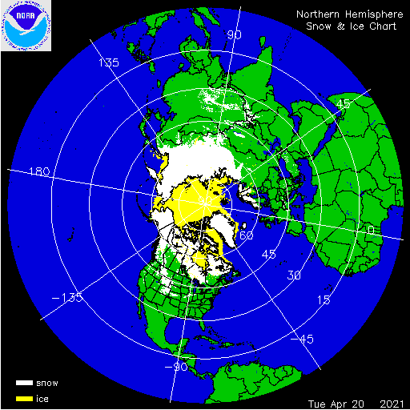
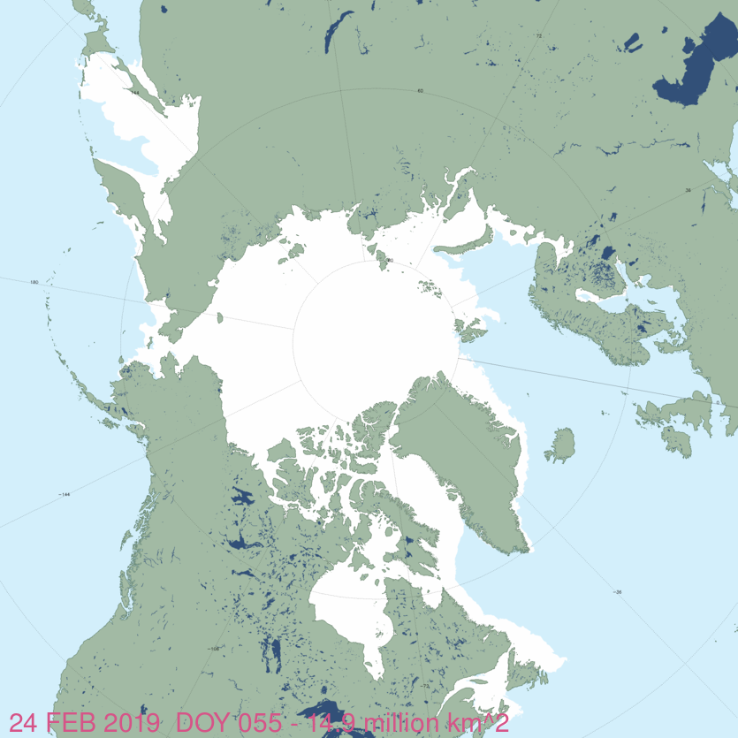
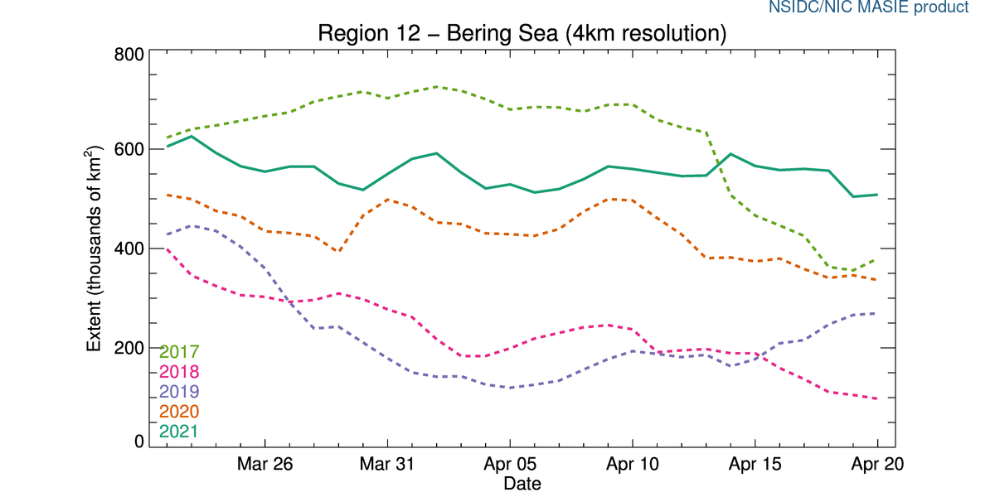
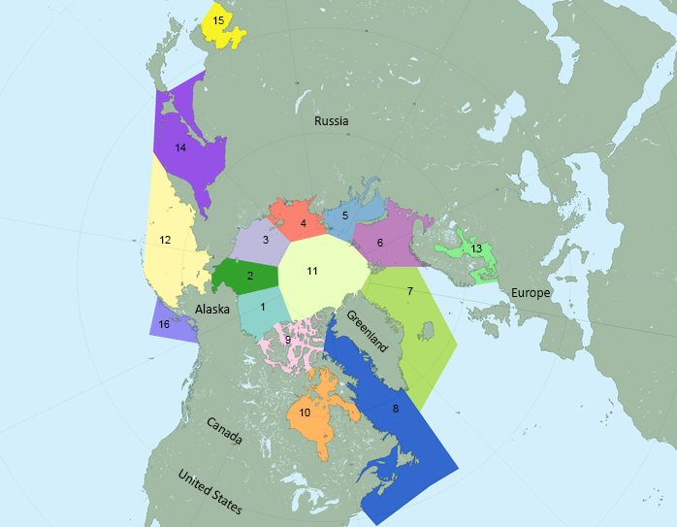
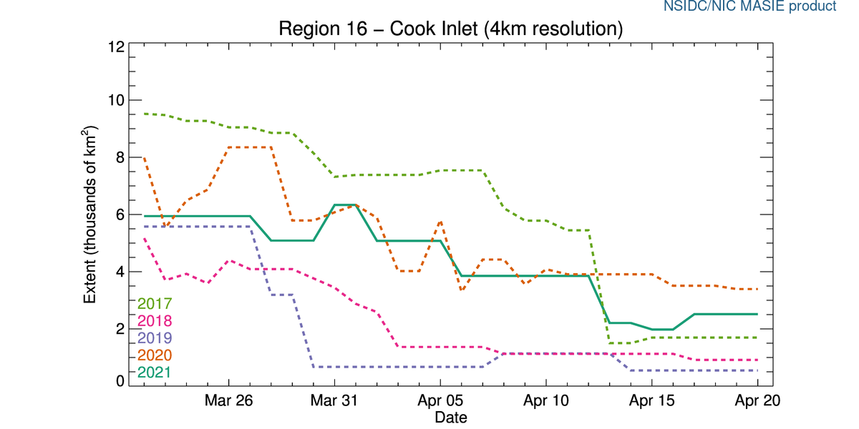
Ice Edge Products
IMS
MASIE - NH
NIC IMS
Highly accurate maps of extent of snow and ice coverage
Integrates multiple sensors, manually created daily by analyst
Shape file, image, geotiff, kml, grib2
Arctic, Daily
https://usicecenter.gov/Products/ImsHome
Dates Available
25km: since 1997
4km: since 2004
1km: since 2014
MASIE - Regions
MASIE – Time-Series
NSIDC MASIE
IMS product sea ice in additional data formats/products.
Regional products - GeoTIFFs, .pngs and time series plots
Arctic, Daily
https://nsidc.org/data/masie
Dates Available
1km – since 2014
4km – since 2006
Both IMS and MASIE are coming soon to the PolarWatch portal
NSIDC User Services: nsidc@nsidc.org
Notes:
I mentioned the IMS daily ice edge analysis product earlier when I was talking about the MASAM2 product. The IMS product is made by the national ice center and provides a highly accurate daily sea ice edge for the Arctic. For the Southern ocean, the national ice center makes a number of other ice edge graphical products. In cases where the ice edge is important it can often be useful to compare a satellite image to an analysts interpretation of the ice edge. The analysts makes the edge based on all the best imagery from numerous satellites and other data so this ice edge product is respected among the community. As I mentioned, the ice edge products are incorporated into higher level satellite data products and models. NSIDC’s MASIE product is an example of a level-4 dataset based on NIC IMS ice data. The MASIE product provides statistics on ice area by region and includes time-series charts showing changes over time. PolarWatch is currently working with the NIC to integrate the IMS data and NSIDC to integrate the MASIE data . Both of those projects are nearing completion. For now, you can access the data through the NIC and NSIDC directly.
This should be noted on the slide as well.

Slide 15
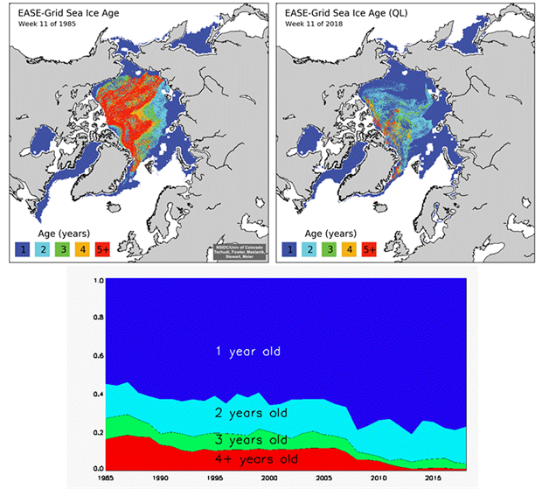
Datasets: Ice Type (Age) Products
Categories of ice: no ice, first year ice , multi-year ice
EASE-Grid Sea Ice Age, Version 3
https://nsidc.org/data/nsidc-0611
1984 to Present
Arctic Coverage (North of 48.4º)
12.5-km resolution
Weekly
OSI-SAF EUMETSAT IceType Product
http://osisaf.met.no/p/ice/edge_type_long_description.html
2005 to present
Arctic
10-km resolution
Daily
Notes:
Ice type products specify how old the ice is with designations of first-year ice or multi-year ice. This helps to discern where ice is melting and growing each year and can be useful in long-time-series studies. The NSIDC sea ice age product goes back to 1984 and is a weekly product. EUMETSAT offers a similar product that goes back to 2005 but is produced daily. These data are not currently available through PolarWatch, you can access them through NSIDC or EUMETSAT. Please let us know if you are interested in this type of product. We need to know there is an interest in the data before we can justify integrating it into PolarWatch.

Slide 16
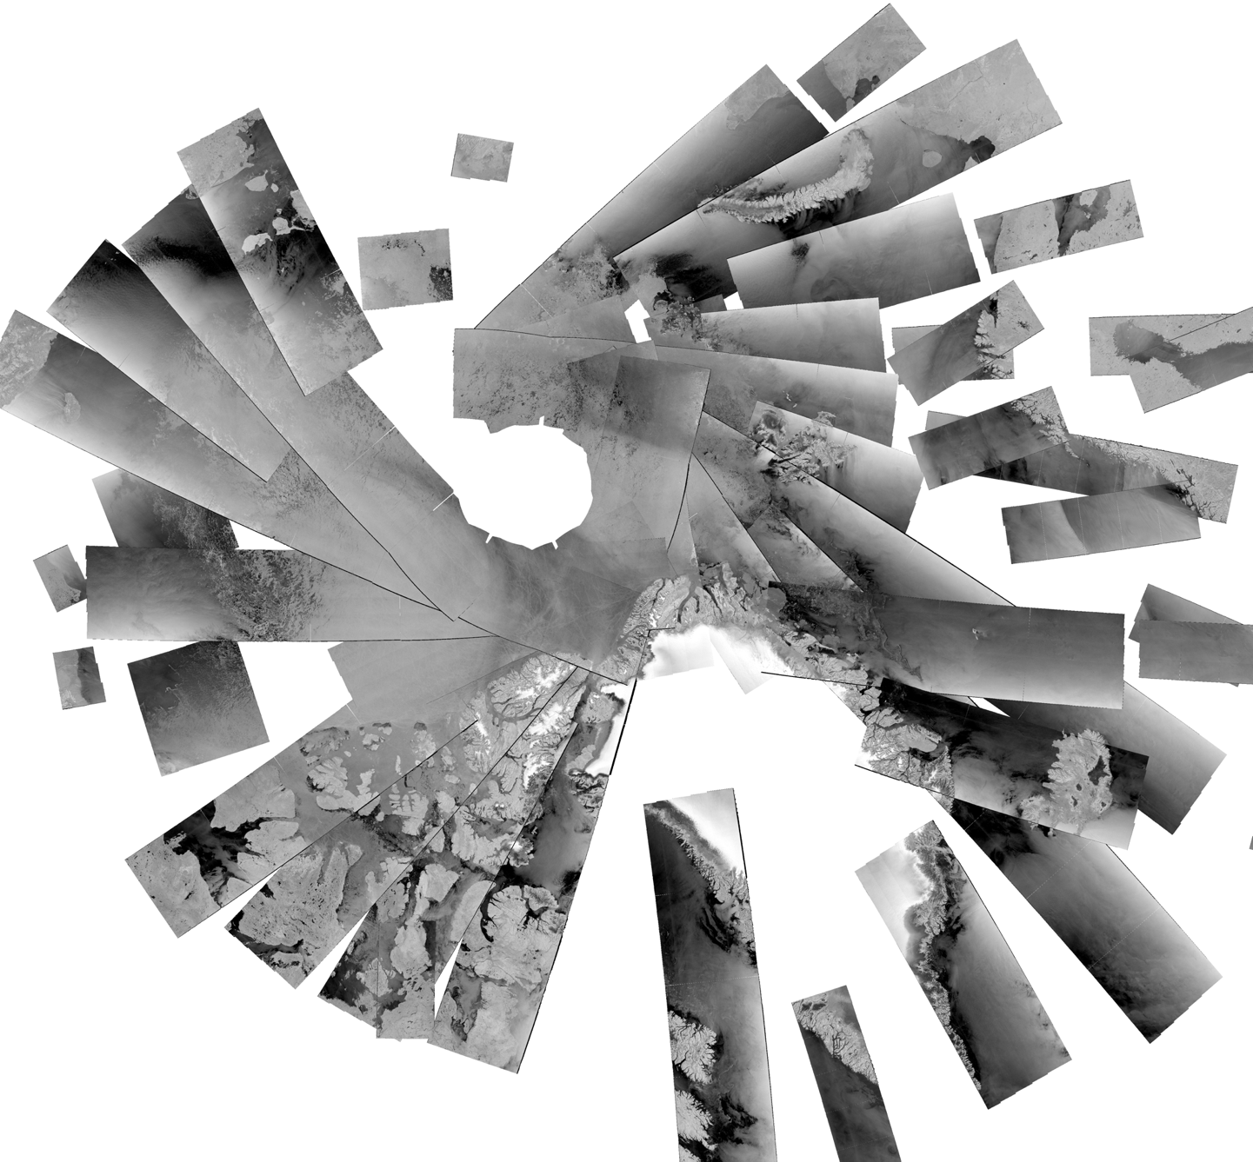
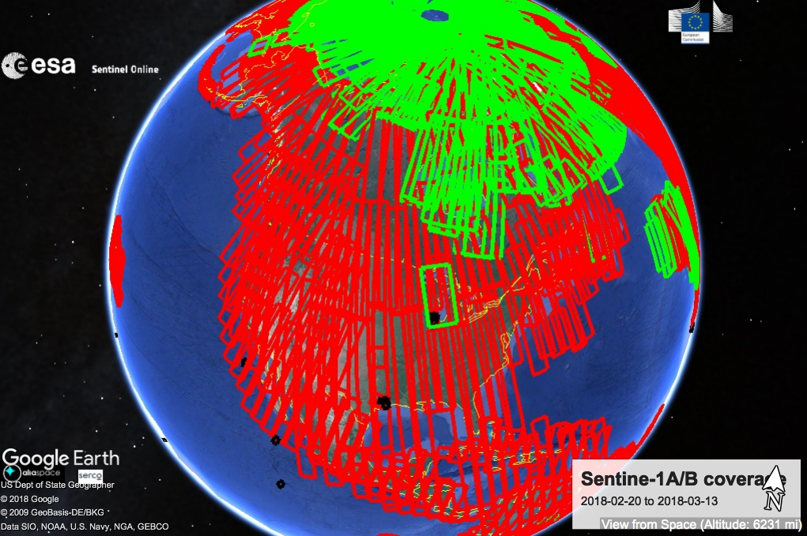
Datasets: SAR Imagery Overview
Active Microwave Remote Sensing
Coverage Example for the Arctic
24 hours
Coverage: Arctic and Antarctic
Resolution: 1m to 100m resolution
Small footprint but frequent satellite passes in high latitudes. Level 2 data.
High-resolution images can be used for detailed information. Not good for long time-series work due to inconsistent coverage
3 weeks
Notes:
At the far end of the resolution spectrum is SAR imagery. The resolution can be less than a meter , so this is very high resolution imagery that can be used for ice feature detection. The trade-offs are that SAR doesn’t see through clouds and because of the high resolution the coverage area is much smaller than other sensors. CoastWatch has SAR data for both the Arctic and Antarctic. The graphic on the top right represents the coverage over one day and the graphic on the bottom right depicts the coverage over a 3 week span.

Slide 17
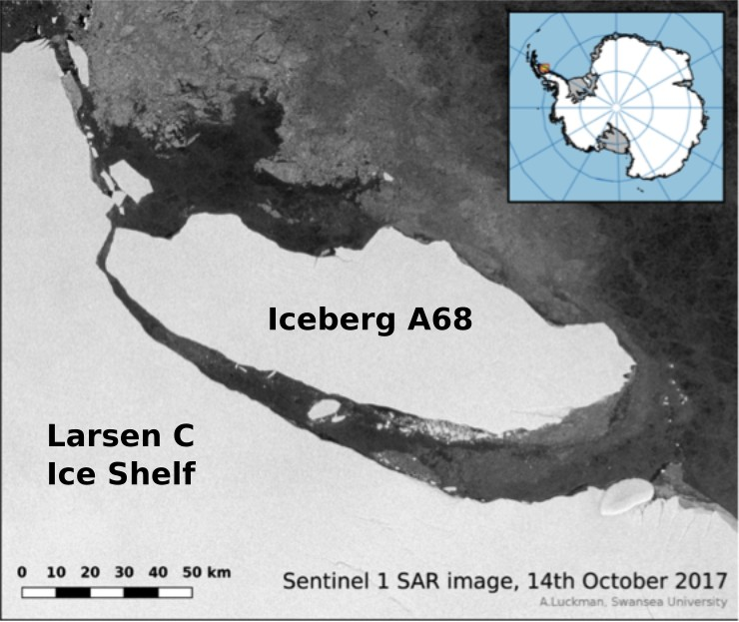
Datasets: SAR Imagery Products
Sentinel 1A/B, Sentinel 2, RadarSat
Find and download NRT images with PolarView
https://www.polarview.aq/arctic
CoastWatch SAR data landing page
https://coastwatch.noaa.gov/cw/satellite-data-products/...
More products are coming through CoastWatch.
Break up of the Larson Ice Shelf. A68 sets sail from Larsen C. Sentinel 1 SAR image [Credit: Adrian Luckman, Swansea University].
Notes:
It is a longer-term project to integrate these data into PolarWatch because of the challenges associated with the high-resolution and data structure. Near Real Time SAR imagery can easily be viewed and downloaded in PolarView online. You can also find SAR imagery by date/location search on the CoastWatch website. If you have an area and time of interest you can search through the images and see if there are any without clouds and a clear image of your area. In addition to SAR imagery products there are a number of other SAR products - SAR winds are available through CoastWatch and a Sea Ice Motion product is in development.

Slide 18
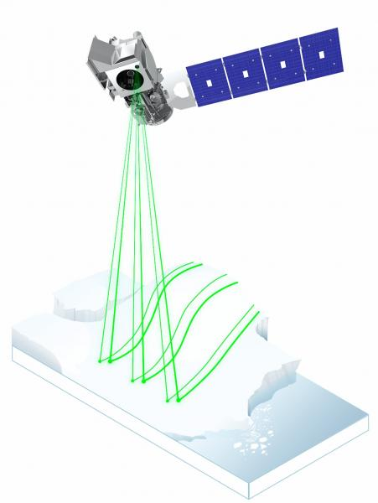
Datasets: ICESAT-2 launched Sep 2018
Level 3 data now available
High-resolution laser altimetry data products
Small footprint, coverage area
Sea ice thickness, freeboard, land ice height, land and canopy elevation, sea surface height.
NSIDC: Download and Information:
https://nsidc.org/data/icesat-2
Image courtesy NASA.
Notes:
There is new ice data from the ICESAT-2 satellite that was launched in 2018. This satellite focuses on high resolution, small footprint data collection. It is geared towards getting a 3D picture of sea ice and provides products like sea ice thickness, and freeboard. Level 3 products are now available through NSIDC.

Slide 19
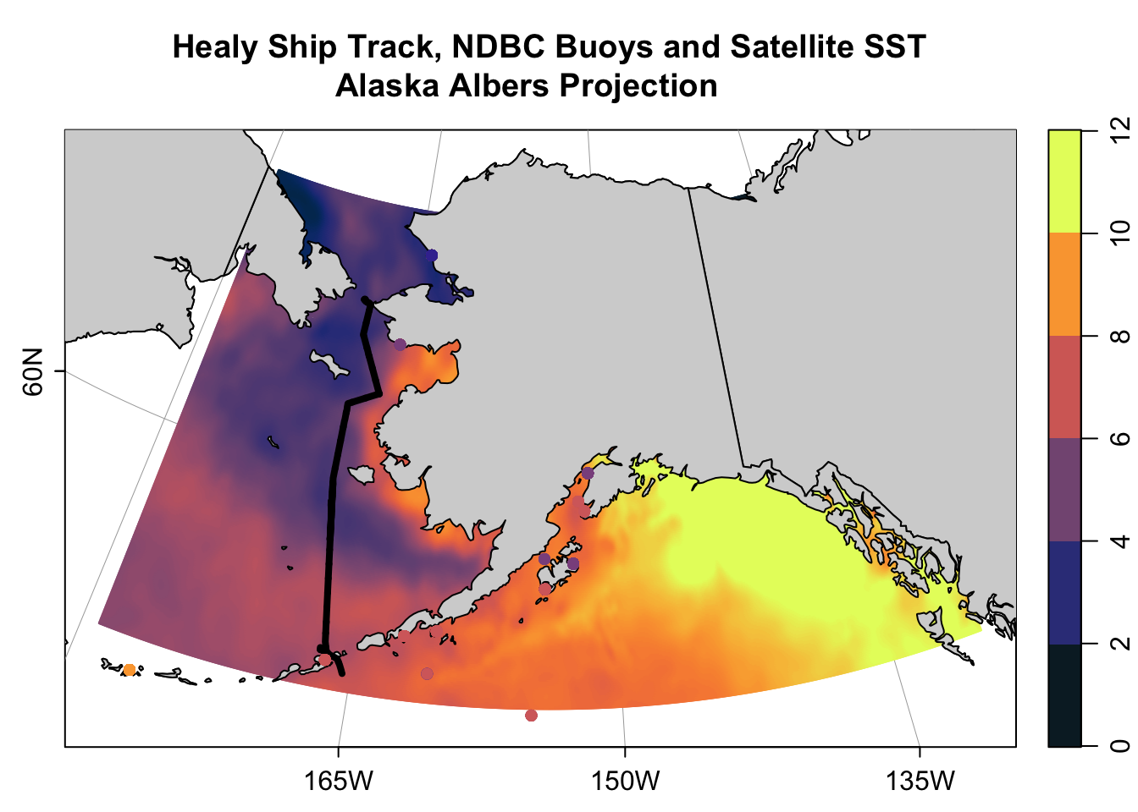
Polar Projections
Data products in the polar regions are produced in a number of projections.
There are reasons for multiple projections including intended use and spatial domain.
Open source software can convert between projections and plot data using projections.
Be aware of the implications with reprojecting
PolarWatch provides code examples for working with projected data in python and R.
https://dale-robinson.gitbook.io/coastwatch-satellite-course-may-2021/tutorials/r-tutorial/chapter-7-reprojecting-satellite-and-buoy-data
Notes:
Those are some datasets available for sea ice and where you can access the data. As you start looking into the datasets more closely, you will see they are offered in a number of different projections. Data products for the polar regions are produced in a number of projections because they have different intended uses or spatial domains. This presents another challenge to working with sea ice datasets. You will likely need to convert data between projections to integrate it with your existing data. This can be a hassle because to test a dataset in your workflow you’ll have to become intimately familiar with its format and projection just to view it and test bringing it into your routines. It is also important to be aware of the implications of reprojecting data. PolarWatch is working to alleviate some of the challenges of working with projected data by providing the online map previews of data and providing training resources for working with projected data in open source software like R and Python. We currently share examples of accessing data in different projections, converting from one projection to another, plotting projected data, integrating data of different projections. These tutorials and code examples are available online as jupyter notebooks. Two examples are included as part of this course and are available in the course r code gitbook. These and more examples are available online in the PolarWatch code gallery. We are actively expanding these examples, please let us know if you would like to see additional examples or if you have an example that you would like to add to the gallery.

Slide 20
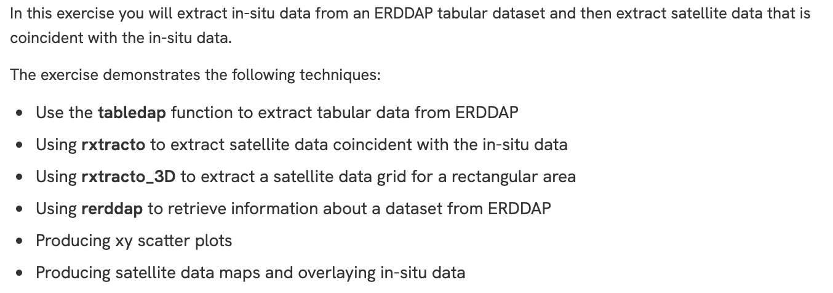
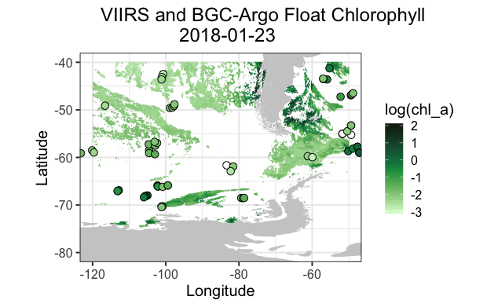
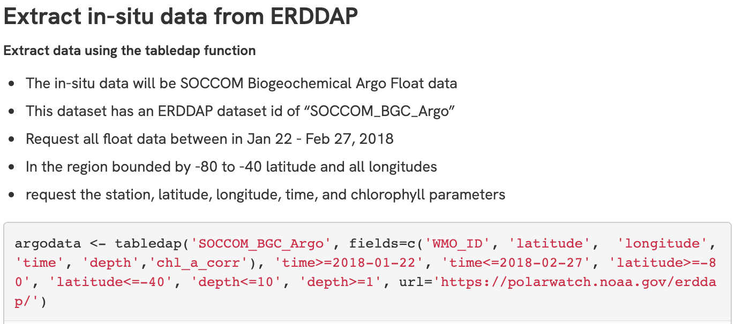
PolarWatch helps with workflow integration
Matchup Satellite and Argo Float Data - R Script
Customized access: Subset, reformat, file type
Routine data access with the workflow: R, Python, Matlab
Convert projections
Matchup field data to satellite data
PolarWatch code gallery Code example scripts in R and Python
https://polarwatch.noaa.gov/tools-training/code-gallery/argo-matchup
Notes:
In addition to the integration challenges related to projections there are a number of other things that can make integrating sea ice data difficult. Sea ice data may be in an unfamiliar format designed for a different user community. Datasets that are integrated into PolarWatch are available in a variety of formats and they can also be subset before downloading. So if you are working in a specific region like the gulf of Alaska you can download only the portion that you need, you don’t have to download the whole northern hemisphere. The polarwatch erddap data server also provides API access all datasets for integration and routine data access with R, Python, Matlab. Software tools and examples for matching up field data to satellite data. PolarWatch code gallery has code example scripts in R and Python demonstrating how to access data, make matchups and work with data in different projections.

Slide 21
Support and Training
PolarWatch
Jenn Sevadjian, Operations Manager jennifer.sevadjian@noaa.gov
Cara Wilson, Node Manager
cara.wilson@noaa.gov
Dale Robinson, Deputy Manager
dale.robinson@noaa.gov
NSIDC User Services
nsidc@nsidc.org
Additional PolarWatch Training Resources
Jupyter Notebook R Tutorial
Reprojecting Gridded and Tabular Data
Jupyter Notebook R Tutorial
Mapping Projected Datasets
View more tutorials in the PolarWatch code gallery.
Notes:
If you are interested in learning more about accessing and using sea ice data, we have a few additional training resources that are part of this coastwatch course. These cover accessing using the PolarWatch website, accessing data from the Polarwatch erddap and accessing sea ice data using R and the PolarWatch ERDDAP API. Those materials are available online. You can check out the polarwatch code gallery for more examples of working with data from PolarWatch including both R and Python. Please reach out to us if you have any questions.

