Slide 1

Intro to Harmful Algal Blooms
NOAA CoastWatch Satellite Course
Last Updated: 12/19/2023
coastwatch.info@noaa.gov
Notes:
Welcome to the online course on oceanographic satellite data products, produced by NOAA’s CoastWatch Program. This optional Intro to Harmful Algal Blooms module is designed as a precursor to the Harmful Algal Blooms satellite module and may be helpful for those not super familiar with these blooms. My name is Betty Staugler, and I am Sea Grant’s liaison to NOAA’s CoastWatch Program.

Slide 2
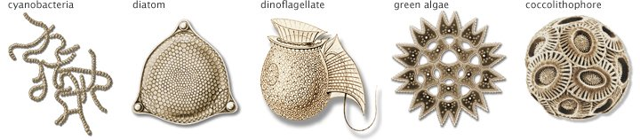
Algae
Algae are simple photosynthetic plant-like organisms (non embryophyta)
Like all plants, algae have chlorophyll
Algae form the base of the food web in aquatic ecosystems
Notes:
We can’t talk about Harmful algal blooms without briefly discussing algae. What unites all plants (and algae) is chlorophyll and the ability to photosynthesize. This chlorophyll is also important in the use of ocean color satellites. Algae are aquatic, plant-like organisms that encompass a variety of simple structures, from single-celled phytoplankton floating in the water, to large seaweeds (also called macroalgae) often but not always attached to the ocean floor. Algae can be found residing in oceans, lakes, rivers, ponds and even in snow, anywhere on Earth. Despite being simple organisms, the definition of algae can be quite confusing for several reasons. For instance, cyanobacteria photosynthesize but they are not true algae, many algae are motile by flagella or other means, some algae are not photosynthetic, and some can eat other organisms. In the next few slides, I’ll discuss a few classic types of algal organisms.

Slide 3
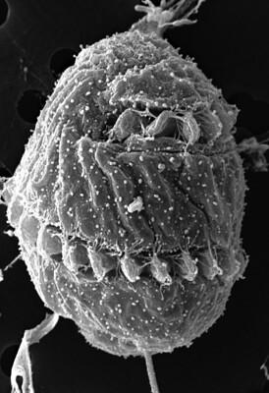
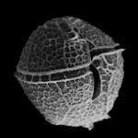
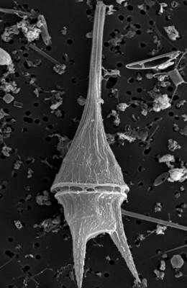
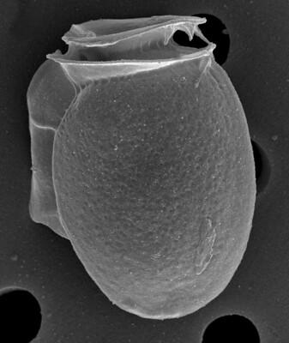
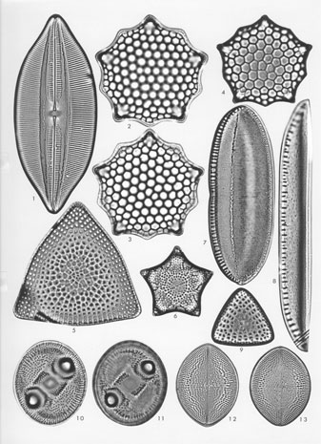
Dinoflagellates & Diatoms
Dinoflagellates
Neither plant nor animal - unicellular protists
  They are planktonic
  They are small
  They are motile
Some are toxic (e.g., K. brevis)
Some are bioluminescent
Diatoms
Live in houses made of glass (rigid structure)
  Heavy compared to dinoflagellates
Blooms linked to upwelling, nutrient runoff, and/or freshwater discharges
Some marine blooms are toxic; Freshwater not toxic but can still cause problems
3
FWC
USGS
Diagrammatic view of Various Diatoms
NOAA CoastWatch Satellite Class http://coastwatch.noaa.gov
Notes:
Dinoflagellates and diatoms are two types of algae that are most prevalent in saltwater but may be found in all aquatic environments. Dinoflagellates are neither plant nor animal. They have a cell wall composed of cellulose and are characterized by two whip-like flagella that are used for locomotion – typically to move up and down in the water column where they can take advantage of sunlight and nutrient sources. Although capable of movement, dinoflagellates cannot propel themselves against the current or wind. Diatoms are enshrined in a transparent silica cell wall, frequently referred to as a “house of glass”. Their structure is rigid and made of interlocking parts. Although diatoms do have means for locomotion, they are heavy and without currents, tend to sink to the seafloor.

Slide 4
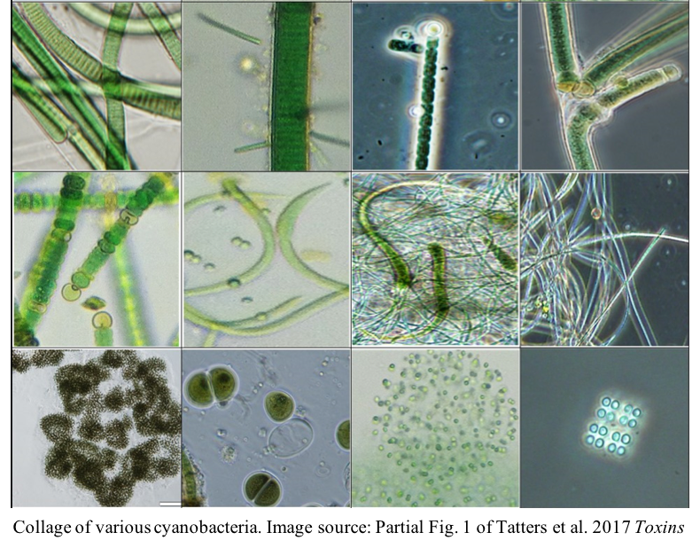
Cyanobacteria
Cyanobacteria are true bacteria, but have chlorophyll-a like algae
Structurally the cyanobacteria are bacteria-like, but functionally they are algae-like
Therefore, they are typically considered to be part of the algae community and are often called blue-green algae
Occur in both freshwater and marine systems
Some toxic
Notes:
Cyanobacteria, also called blue-green algae, are found throughout the world in a variety of environments but dominate in freshwater systems. They are true bacteria but because they also contain chlorophyll-a, they are typically considered part of the algal community. Cyanobacteria morphology varies from small colonies of cells to elaborate filamentous forms that may branch.

Slide 5
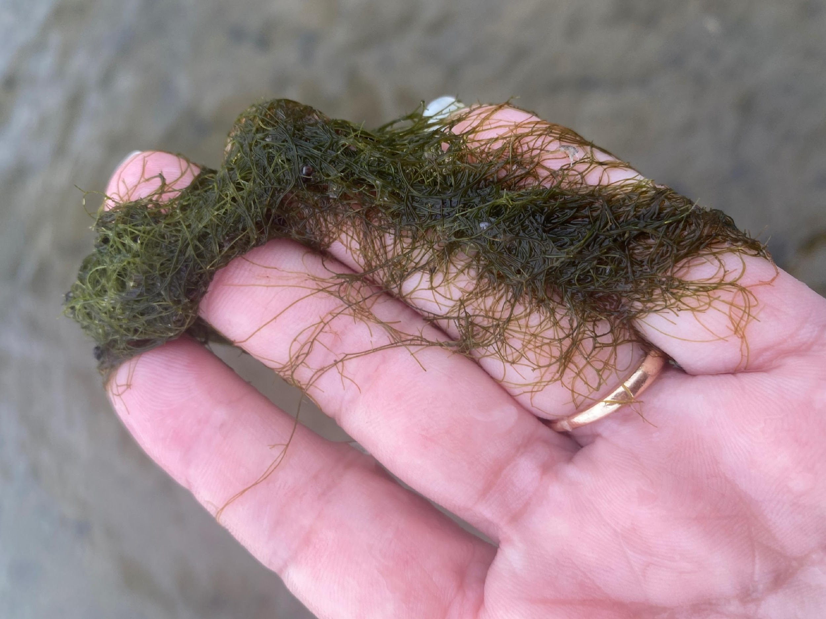
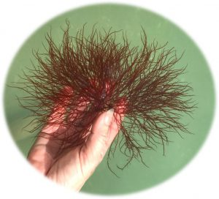
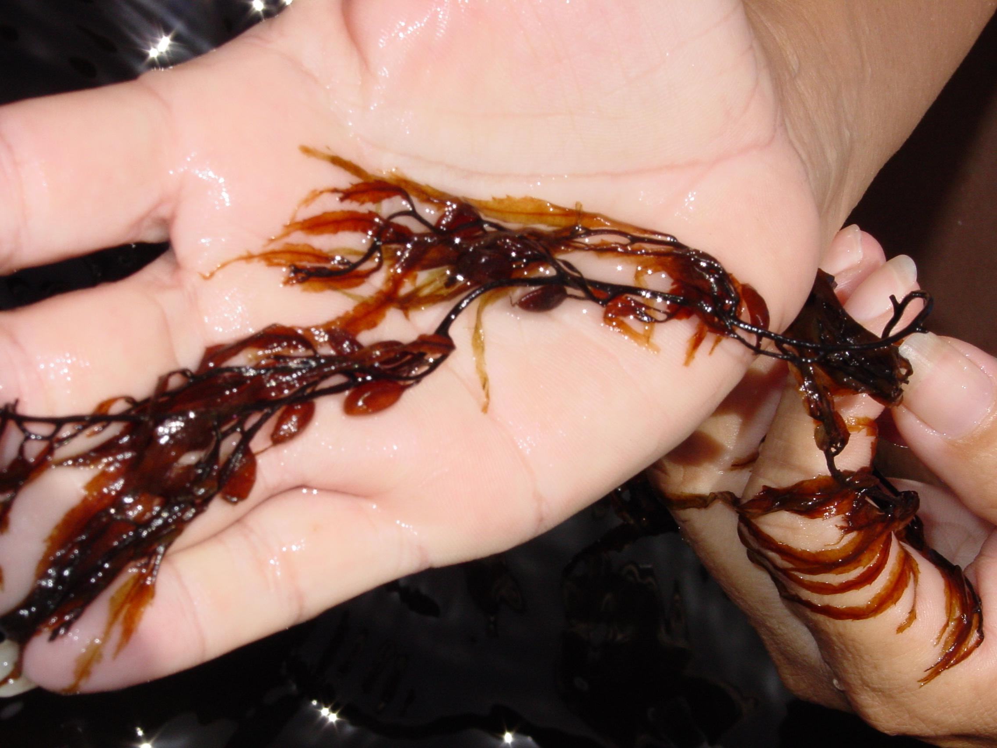
Macroalgae
Green
Red
Macroalgae is a collective term used for seaweeds and other benthic marine algae that are generally visible to the naked eye
Wide range of forms
Generally classified by photosynthetic pigment
Images: Betty Staugler, FSG
Brown
Notes:
Macroalgae, commonly called seaweeds, are marine algae that can be seen with the naked eye. Most of them are classified as benthic and fasten themselves to the seabed, but planktonic forms of Sargassum, which seasonally wash up on beaches around the Caribbean and Gulf of Mexico, are notable exceptions. Macroalgae are classified into three major groups by dominant photosynthetic pigment: green algae (Chlorophyta), red algae (Rhodophyta), and brown algae (Phaeophyta).

Slide 6
Factors that influence algal blooms
Bloom stage:
  Initiation
  Growth
  Maintenance
  Decline
Time
Sunlight
Nutrients
M
CELL COUNT
  Water clarity
  Upwelling
  Circulation patterns
  Hydrology
  Temperature
  Salinity
  Climate and Weather
  Biological Community Interactions
G
D
I
TIME
Notes:
A bloom is defined as the rapid increase or accumulation in the population of algae in an aquatic system. Some algal blooms discolor the water (e.g., red tides) while others can be invisible. And some algal blooms can be harmful although most are not. There are generally four stages of an algal bloom. Bloom initiation occurs under the right combination of sunlight and nutrients for cell division. Initiation generally occurs during the warm summer season or when water temperatures are warmer than usual. Blooms often occur in calm back bay or stagnant waters where they have ample time for cells to accumulate. During the growth stage, algae is taking advantage of available nutrients, however other physical and biological conditions such as sunlight, temperature, and salinity all play a role. Once a bloom occurs, it can expand or stay present essentially until it runs out of nutrients. Decline can be simple as a change in water circulation that disperse the algae away from nutrient sources, or it could happen due to cooler temperatures or salinities that are outside of range for the organism. Understanding the factors that influence the bloom stages of different algal species is an important component of satellite applications.

Slide 7
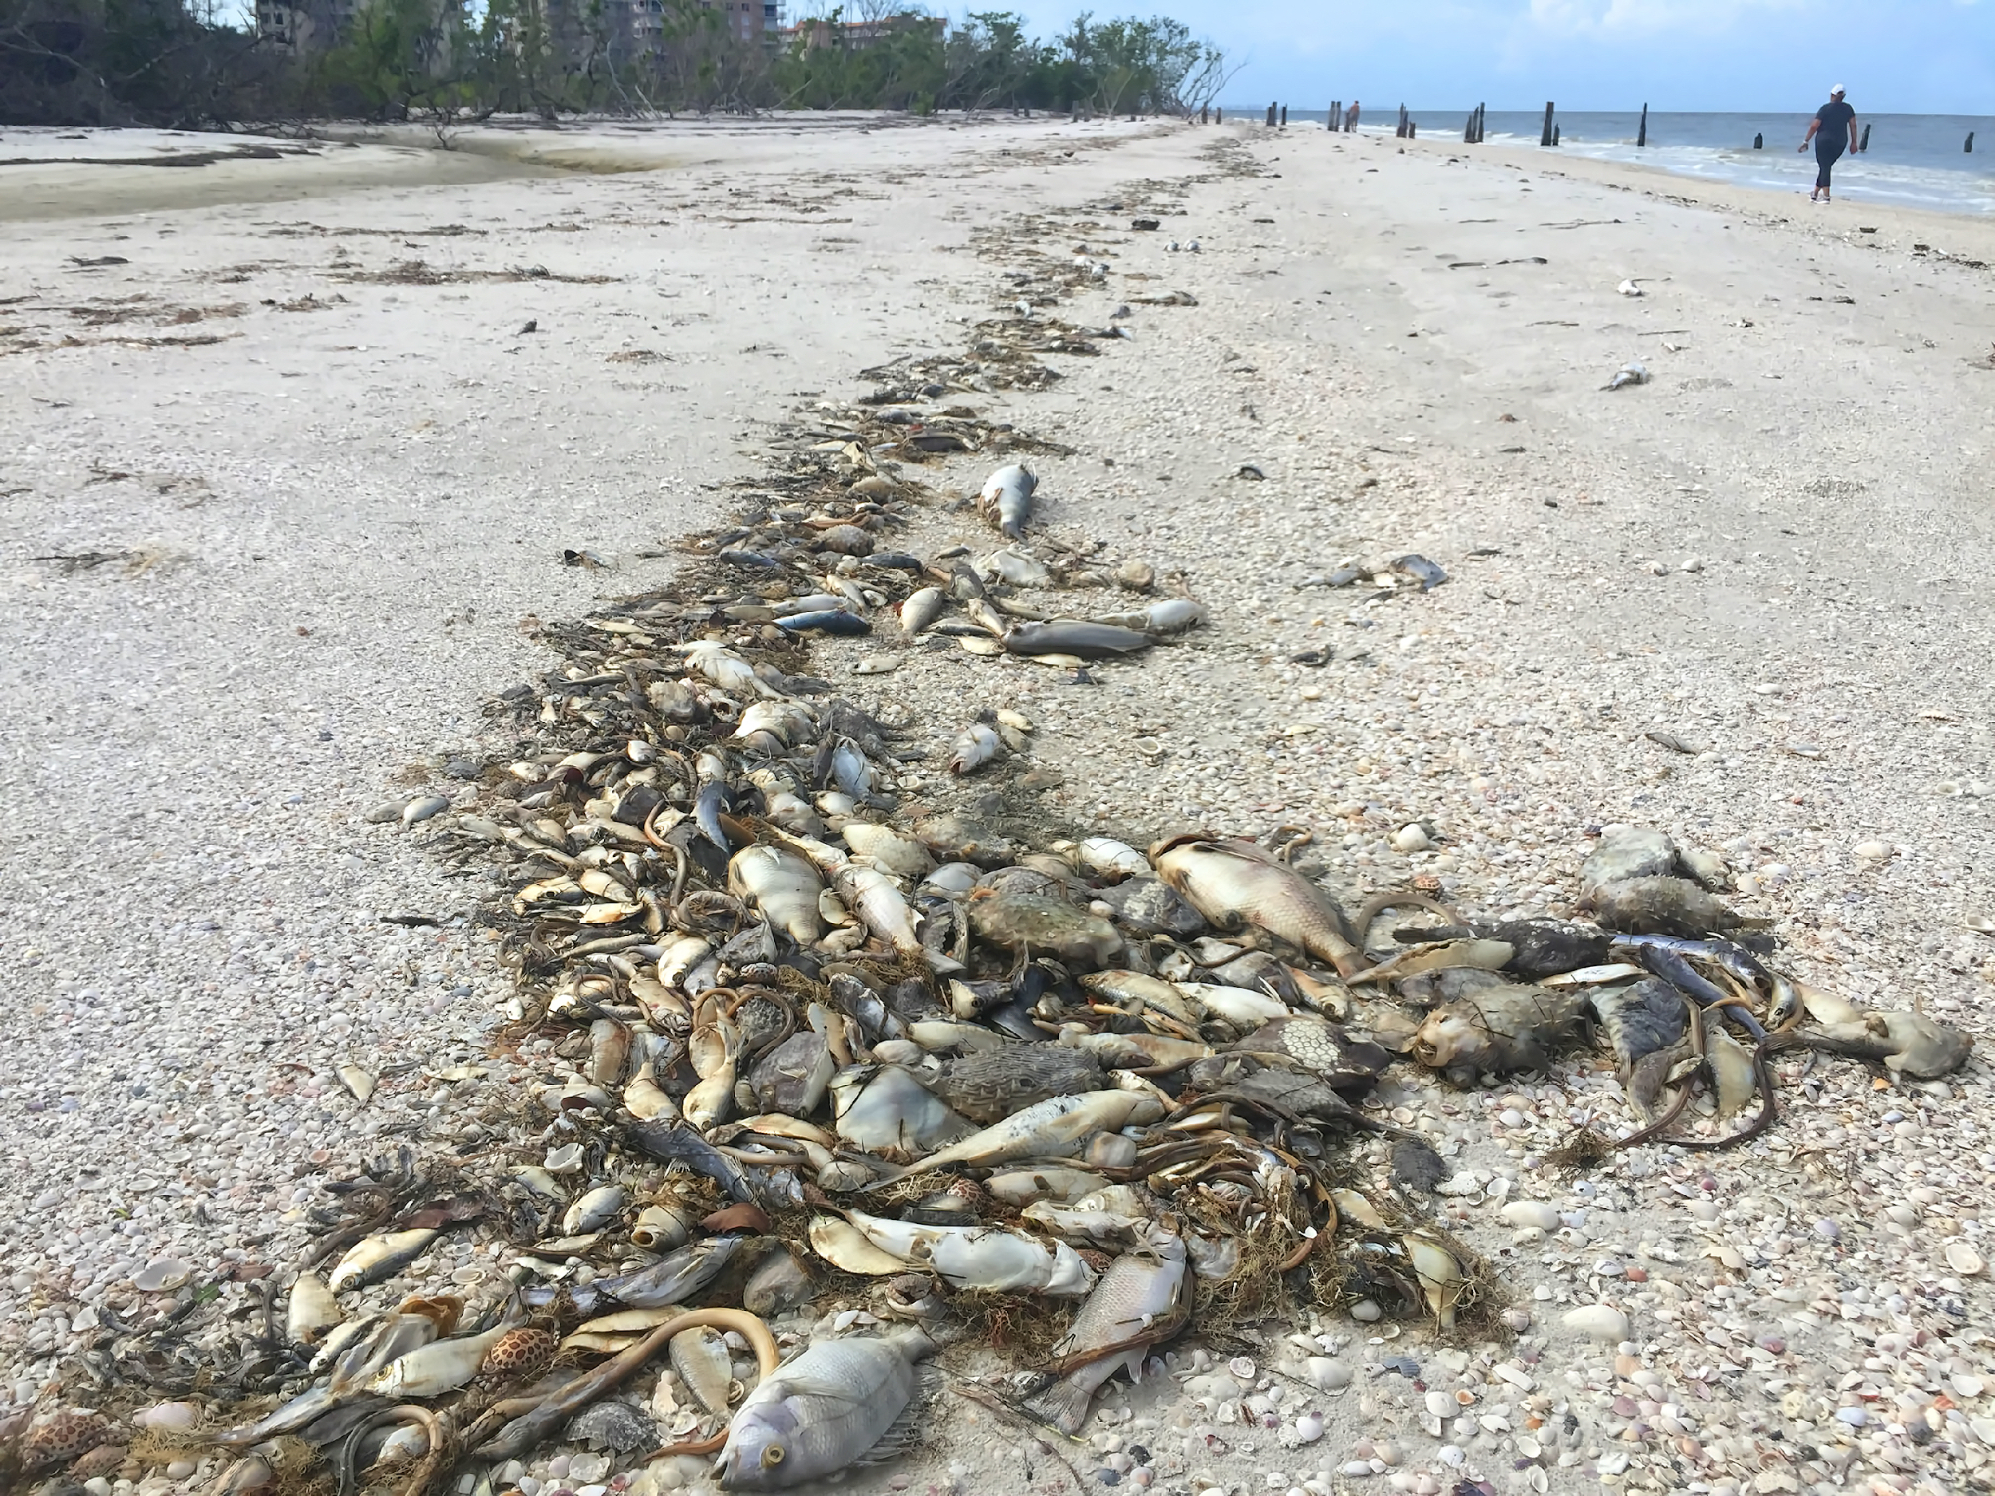
Some algae are harmful
Toxicity - Some HABs are
always toxic (NSP, PSP)
sometimes toxic (CFP, ASP)
never toxic
  Toxicity is not the only way HABs cause harm
Harm to people & pets (Public Health Concerns)
  Toxicity
  Allergy
Harm to wildlife & environments (Ecological Concerns)
  Hypoxia
  Food-web disruption
Economic harm
  Loss of recreational revenue
  Impacts to aquaculture
  Cleanup costs
  Health care costs
  Drinking water treatment expense
K. Brevis fish kill Jillian Cain Photography-Shutterstock
Ft Myers, FL date UKN
“The salient criterion to use in defining whether a “harmful” species is in bloom and the distinctive feature of such blooms lie not in the level of abundance, but whether its occurrence has harmful consequences. “ -Ted Smayda, 1997 L&O
Notes:
While most algal blooms are not harmful, some do negatively affect fish and humans, as well as other animals like birds and marine mammals. These are known as Harmful Algal Blooms (HABs). Some algae are harmful because they produce toxins. Toxic concerns for humans include shellfish toxicity, skin and respiratory irritation, and contamination of drinking water. Aquatic and non-aquatic animals alike can also be affected by these toxins, and toxic effects may increase through successive trophic levels. Algae may also be harmful when dense blooms clog the gills of fish and invertebrates or result in hypoxic or anoxic conditions due to respiration and decay. HABs often have negative economic consequences. Health care costs due to toxin exposure, beach clean-up activities following fish kills, and losses in tourism revenues are some of the economic impacts associated with HABs. As we’ll see in the next module, satellites can detect most blooms, but there is not a strong correlation between bloom biomass and toxicity. Most HABs vary toxicity based on environmental conditions. As a result, satellite cannot be used to determine toxicity.

Slide 8
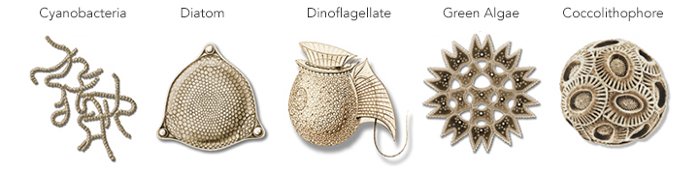
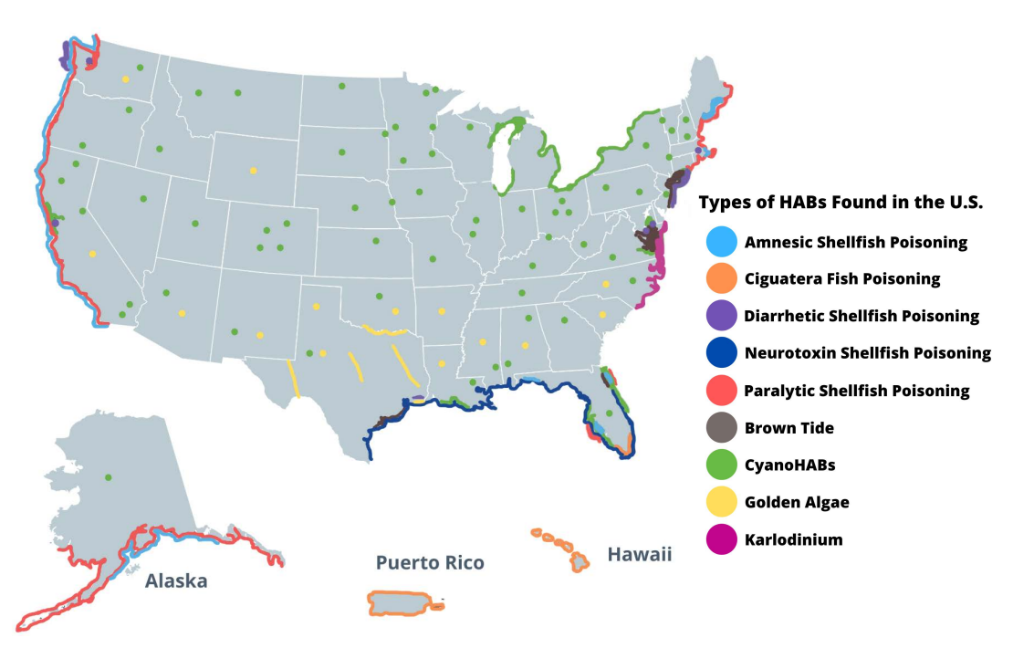
Harmful Algal Blooms
Macroalgae/Sargassum sp.
Source: NOAA 2021
NOAA CoastWatch Satellite Class http://coastwatch.noaa.gov
Notes:
What you’re looking at is a bird’s eye view of where HABs occur across the coastal US. The colors represents different functional groups…each having different effects on people, animals, ecosystems and the economy. Within these functional groups, we may have multiple species with unique bloom drivers, toxicities, and impacts. As you can see from the image, HABs have been reported in every U. S. state. Dinoflagellates and diatoms, are the most common HAB species in marine and brackish waters, including estuaries and many are responsible for the fish and shellfish poisoning syndromes you see listed. Cyanobacterial HABs, are more prevalent, but not exclusive to freshwater lakes and rivers. Because harmful species tend to occur under particular environmental conditions, ocean color satellites can often be used to separate different types of algae. Additionally, algae size, morphology, density, pigment type, external structure and the presence or absence of gas vacuoles are also important.

Slide 9
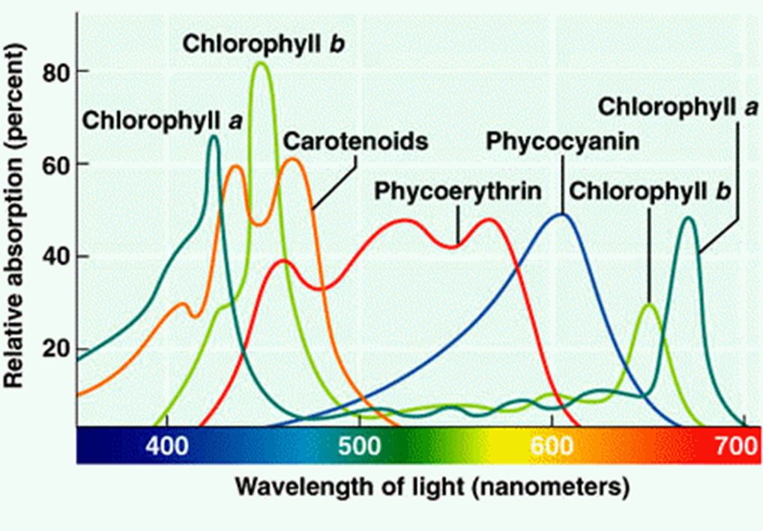
Photosynthetic Plant Pigments
Chlorophyll a – unites all plants
  Chla_{b – f}
Accessory pigments
  Carotenoids - found in nearly every phytoplankton species, and absorbs blue and green, and appears yellow, orange and/or red.
  Phycoerythrin appears red because between it and Chla, all of the blue and green are absorbed, and can be found in red algae and marine cyanobacteria.
  Phycocyanin absorbs yellow to red light and is responsible for cyanobacteria’s common name – blue-green algae.
Source: Simply.science
NOAA CoastWatch Satellite Class http://coastwatch.noaa.gov
Notes:
For instance, as previously mentioned, all plants, including algae contain Chlorophyll. Accessory pigments are compounds that can harvest light at wavelengths that chlorophyll can’t absorb well. This light energy is transferred to chlorophyll molecules for use in photosynthesis. One of these accessory pigments is phycocyanin, which absorbs yellow/red light and appears blue and green to us. It is responsible for cyanobacteria’s common name blue-green algae. The color in which different algae (both macro or micro) appear to us, and to a satellite depends on the pigments they contain and at which wavelength these pigments reflect or absorb. Satellite however are much more sensitive to color changes than the human eye.

Slide 10
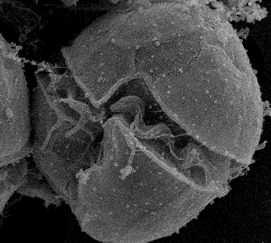
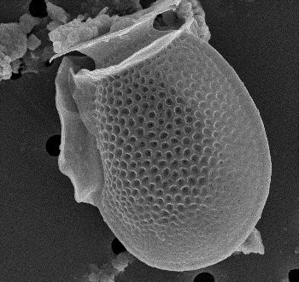
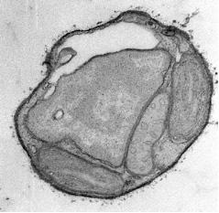
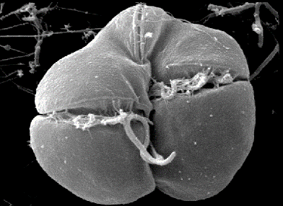
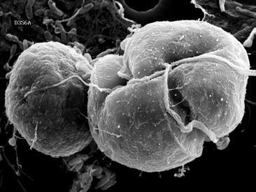
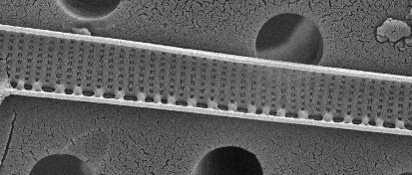
Marine HABs
FWC images unless otherwise indicated
Roger Anderson, Columbia University
Vince Lovko, MML
VIMS Image
Alexandrium spp. | Karenia brevis | Dinophysis spp. | Karlodinium veneficum | Pseudo-nitzschia spp. | Aureococcus anophagefferens & Aureoumbra lagunensis
Dinoflagellate | Dinoflagellate | Dinoflagellate | Dinoflagellate | Diatom | Pelagophyte (Picoplankton)
PSP – (saxitoxin) | NSP – (brevetoxin) Toxins aerosolize | DSP (Okadaic acid, dinophysiotoxin) | Causes fish kills Karlotoxins - (ichthyotoxin) | ASP – (Domoic acid) | Harmful to shellfish & submerged habitats
Gulf of Maine, New England, Pacific West Coast, Alaska | Gulf of Mexico | Maine, Oregon, California | Mid-Atlantic | Pacific West Coast, Alaska | Long Island Sound, Chesapeake Bay, Texas, Florida
Notes:
Now let’s take a look at some important Marine HAB forming organisms. On the bottom of this slide the arrows indicate blooms that discolor the water based on the pigments just discussed. This discoloration is what can be seen with ocean color satellites. Starting with the first four organisms (left to right), there are several types of neurotoxins produced by dinoflagellates. These chemicals may affect nerve action by interfering with the movement of ions across cell membranes, thus affecting muscle activity. The toxin saxitoxin, produced by some Alexandrium species accumulates in shellfish. Eating contaminated shellfish causes paralytic shellfish poisoning (PSP). Another toxin that accumulates in shellfish is brevetoxin, produced by the dinoflagellate Karenia brevis. Brevetoxin is unique in that it becomes aerosolized when the dinoflagellates end up in the surf zone. Aerosolized toxins may blow onto a beach leading to respiratory irritation in humans. A toxin produced by the dinoflagellate Dinophysis causes diarrhetic shellfish poisoning (DSP), which results in digestive upset but is not fatal. And, the relatively unknown tiny but toxic dinoflagellate, Karlodinium veneficum, can produce dense blooms and fish-killing toxins called karlotoxins. Moving to the right on the table, amnesic shellfish poisoning results from the ingestion of shellfish containing domoic acid, which is produced by some diatom Pseudo nitzschia species. In addition to its effect on humans, elevated levels of domoic acid have been linked to neurologic illness and death in seabirds and sea lions. And then finally, Brown tides are caused by the very tiny but non-toxic picoplankton Aureococcus and Aureoumbra. Because they are so small, picoplankton form very dense blooms that completely shade bottom vegetation and often result in fish kills due to hypoxia, and starvation of shellfish.

Slide 11
CyanoHABs and Toxins
Source: Jennifer Grahamn, USGS
Hepatotoxins
Neurotoxins
Dermatoxins
3
 | CYL | MC | ANA | SAX
Dolichospermum (formerly Anabaena) | x | x | x | x | x
Aphanizomenon | x | ? | x | x | x
Microcystis |  | x |  |  | x
Planktothrix |  | x | x | x | x
Dolichospermum
Aphanizomenon
Microcystis
Planktothrix
Photos: USGS
NOAA CoastWatch Satellite Class http://coastwatch.noaa.gov
Notes:
Unlike the diatom and dinoflagellate species we just looked at, cyanoHAB species tend to produce a suite of toxins, and these toxins can be produced simultaneously. CyanoHAB toxins are diverse, but they generally fall into three categories (Hepatotoxins, Neurotoxins, and Dermotoxins). There is also variability within individual toxin. For instance, there are nearly 300 known variants of the Hepatotoxin microcystin and they range from highly toxic to non toxic. Here we are looking at a few planktonic cyanobacteria genera and their associated toxins.
Cylindrospermopsin, microcystin – Hepatotoxins = toxic chemical that damages the liver
anatoxin, saxitoxin – Neurotoxins - Neurotoxins = toxins that are destructive to nerve tissue
Dermatoxins = damage to the skin

Slide 12
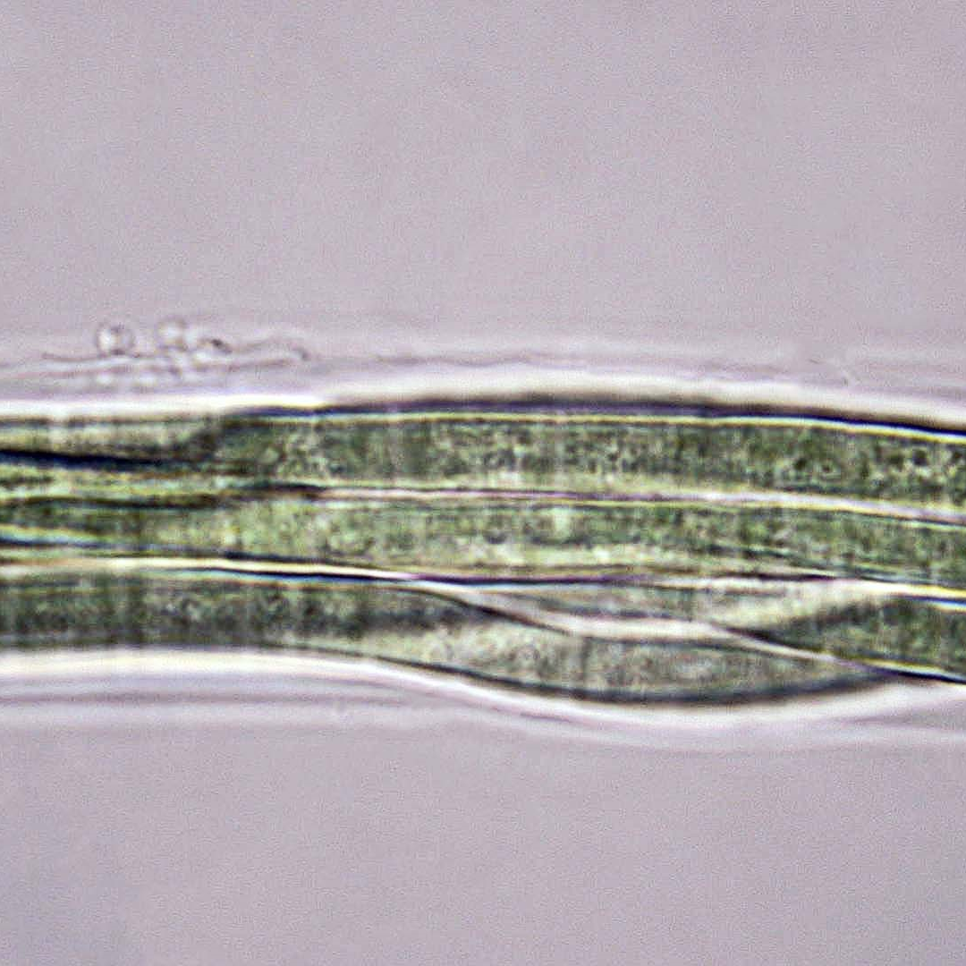
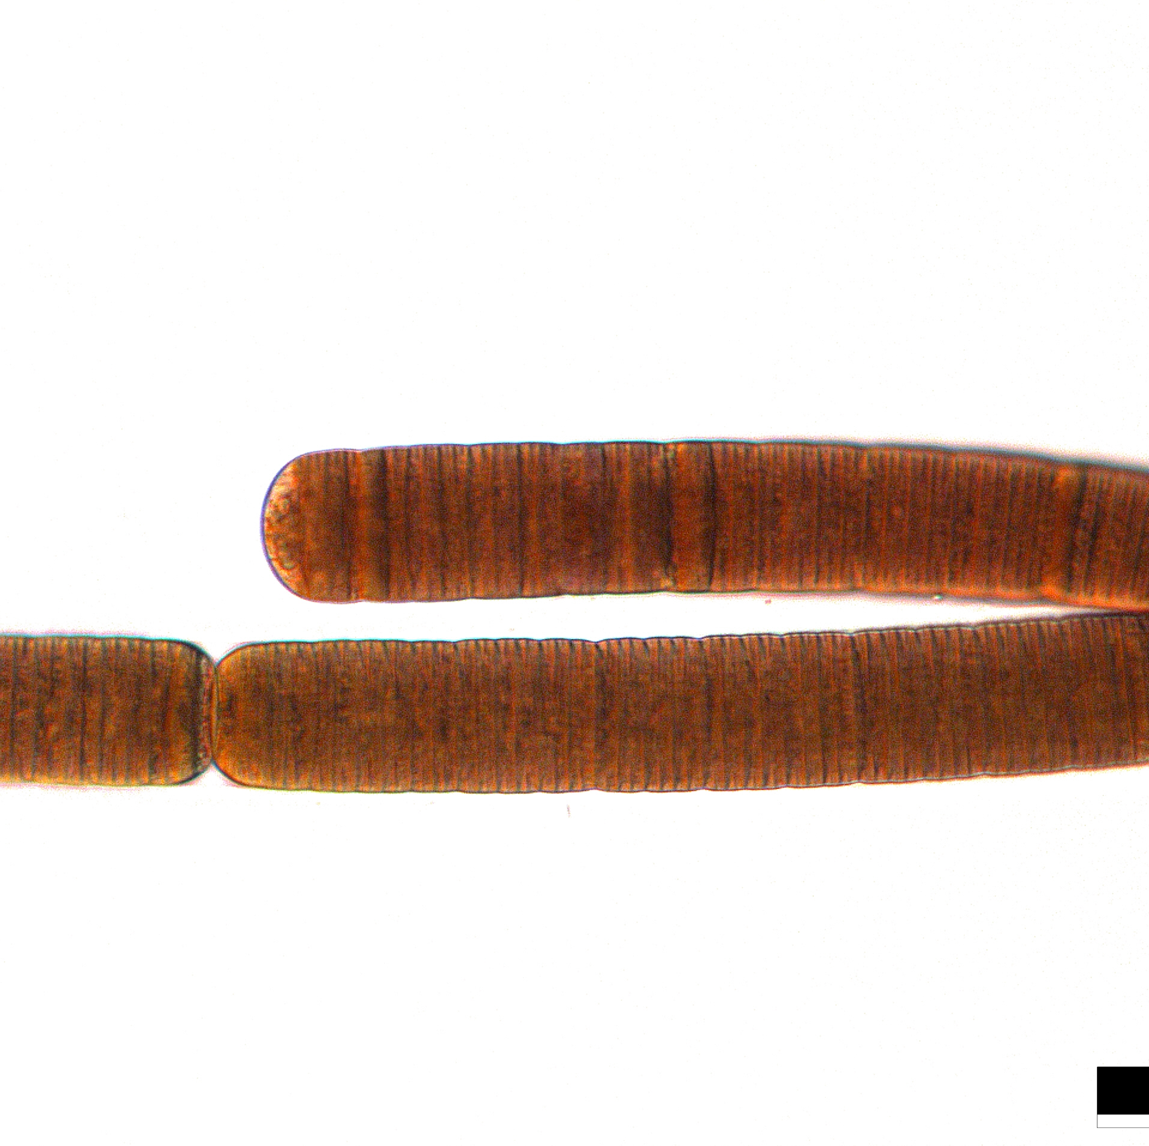
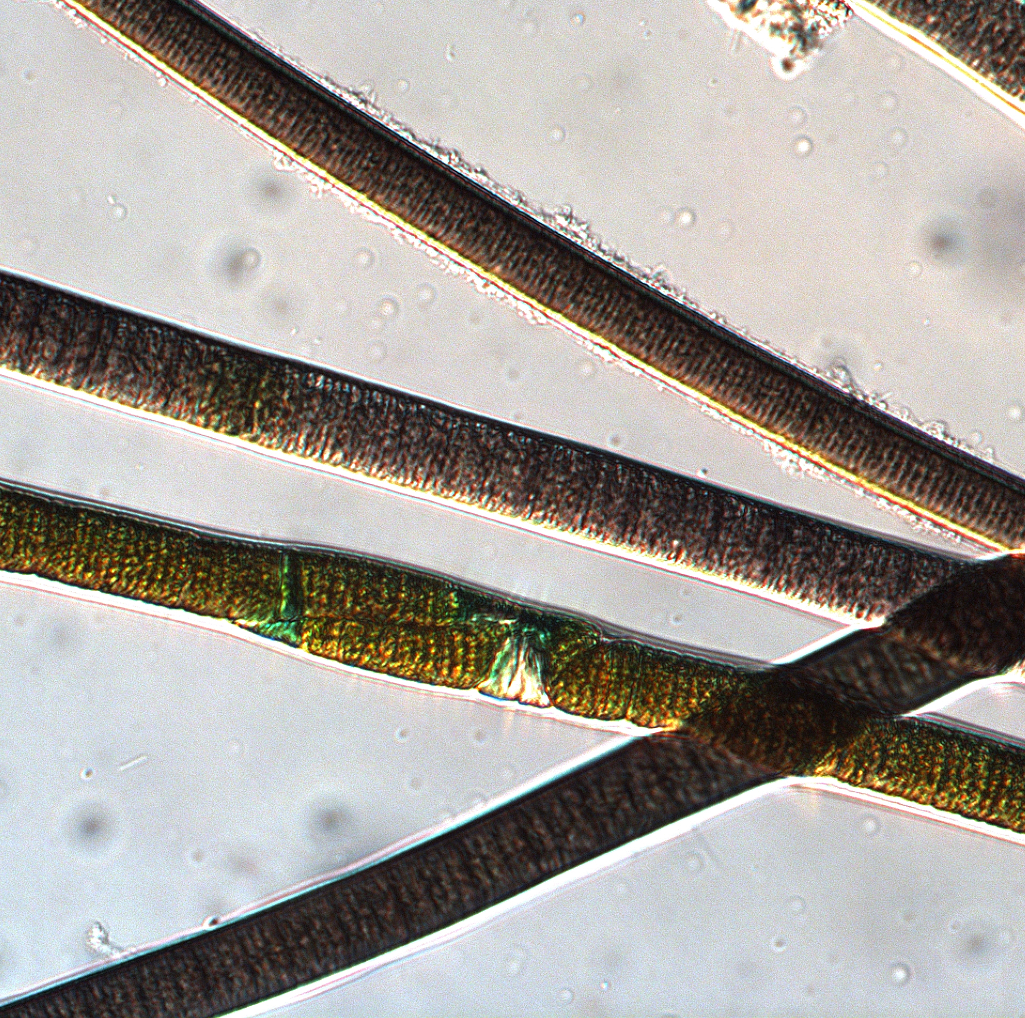
Benthic CyanoHABs and Toxins
Source and Photos: David Berthold, UF
Hepatotoxins
Neurotoxins
Dermatoxins
3
Freshwater | CYL | MC | ANA | SAX
Microseira (=Lyngbya), Microcoleus (=Phormidium), Iningainema, Scytonema | x | x |  | x | x
Saltwater | CYL | MC | ANA | SAX
Sirenicapillaria, Okeania, Dapis |  | x | x | x | x
Microcoleus
Iningainema
Dapis
Sirenicapillaria
NOAA CoastWatch Satellite Class http://coastwatch.noaa.gov
Notes:
Benthic cyanoHABs are characterized as growing on the bottom in the littoral zone and exist across the fresh to saltwater continuum. Like the planktonic cyanoHABs we saw in the previous slide, benthic cyanos are known to produce a suite of toxins, some of which are novel and still being identified.
Cylindrospermopsin, microcystin – Hepatotoxins = toxic chemical that damages the liver
anatoxin, saxitoxin – Neurotoxins - Neurotoxins = toxins that are destructive to nerve tissue
Dermatoxins = damage to the skin

Slide 13
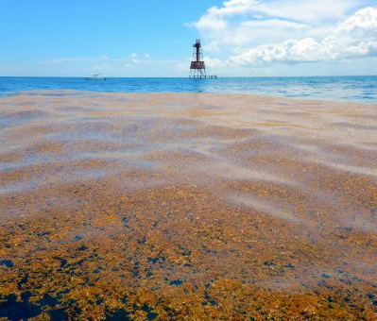
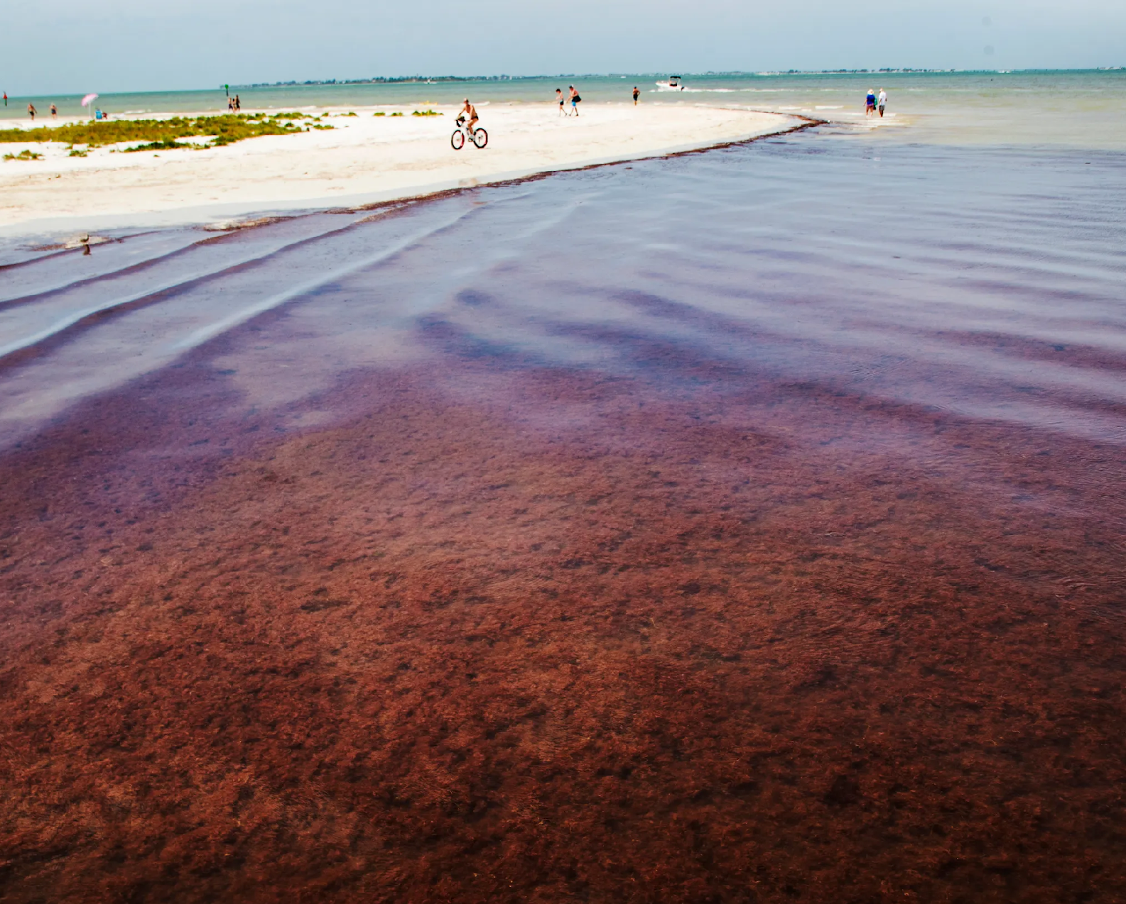
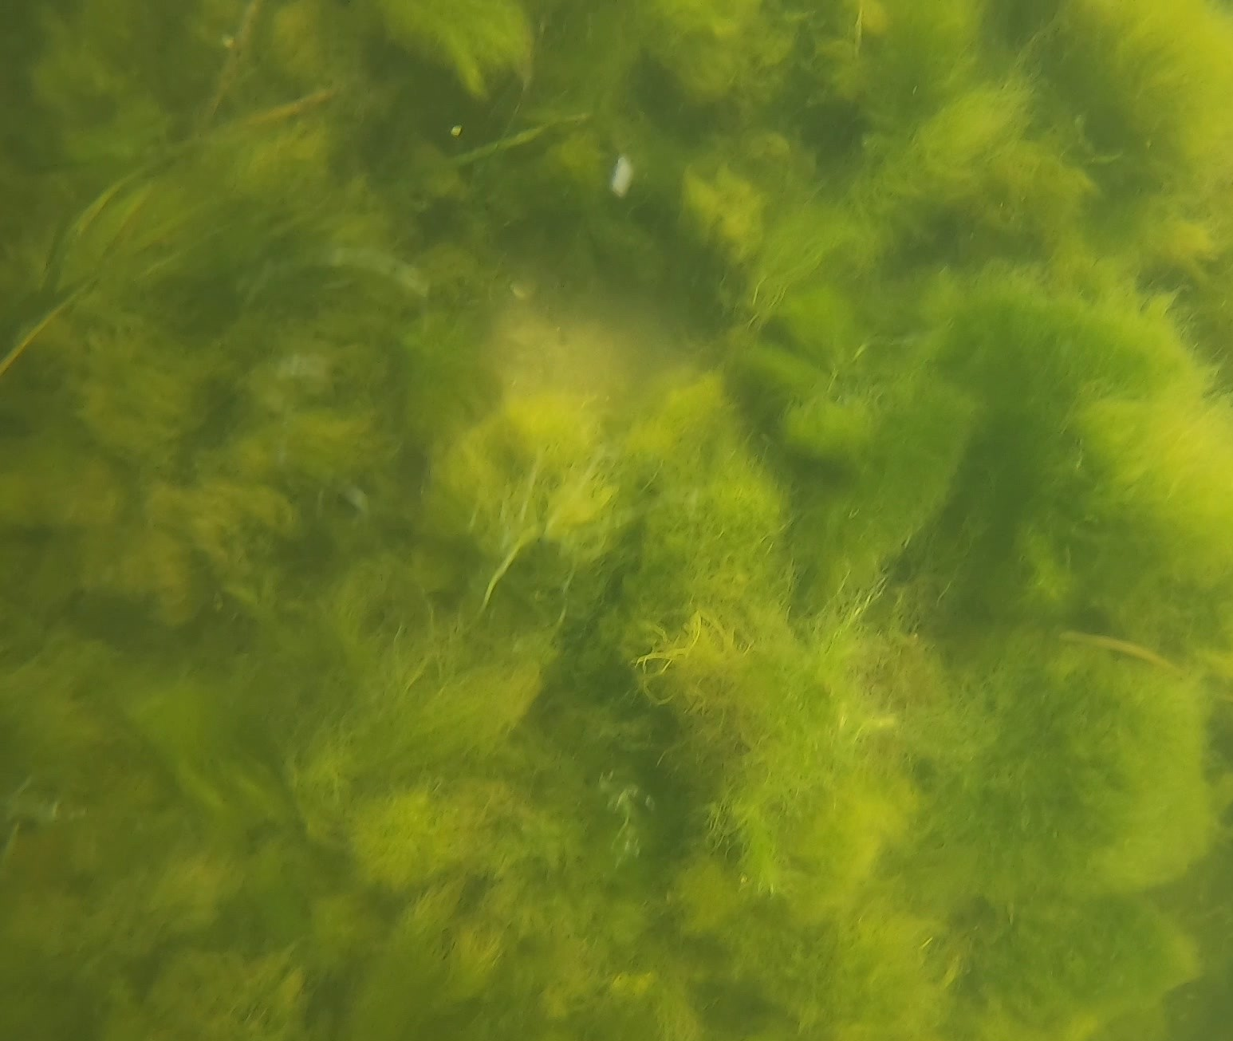
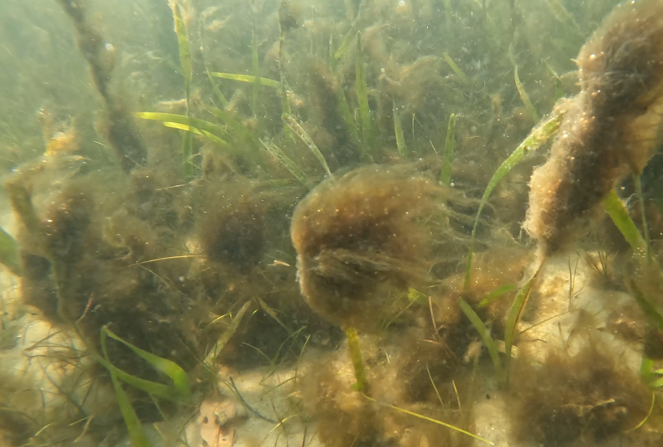
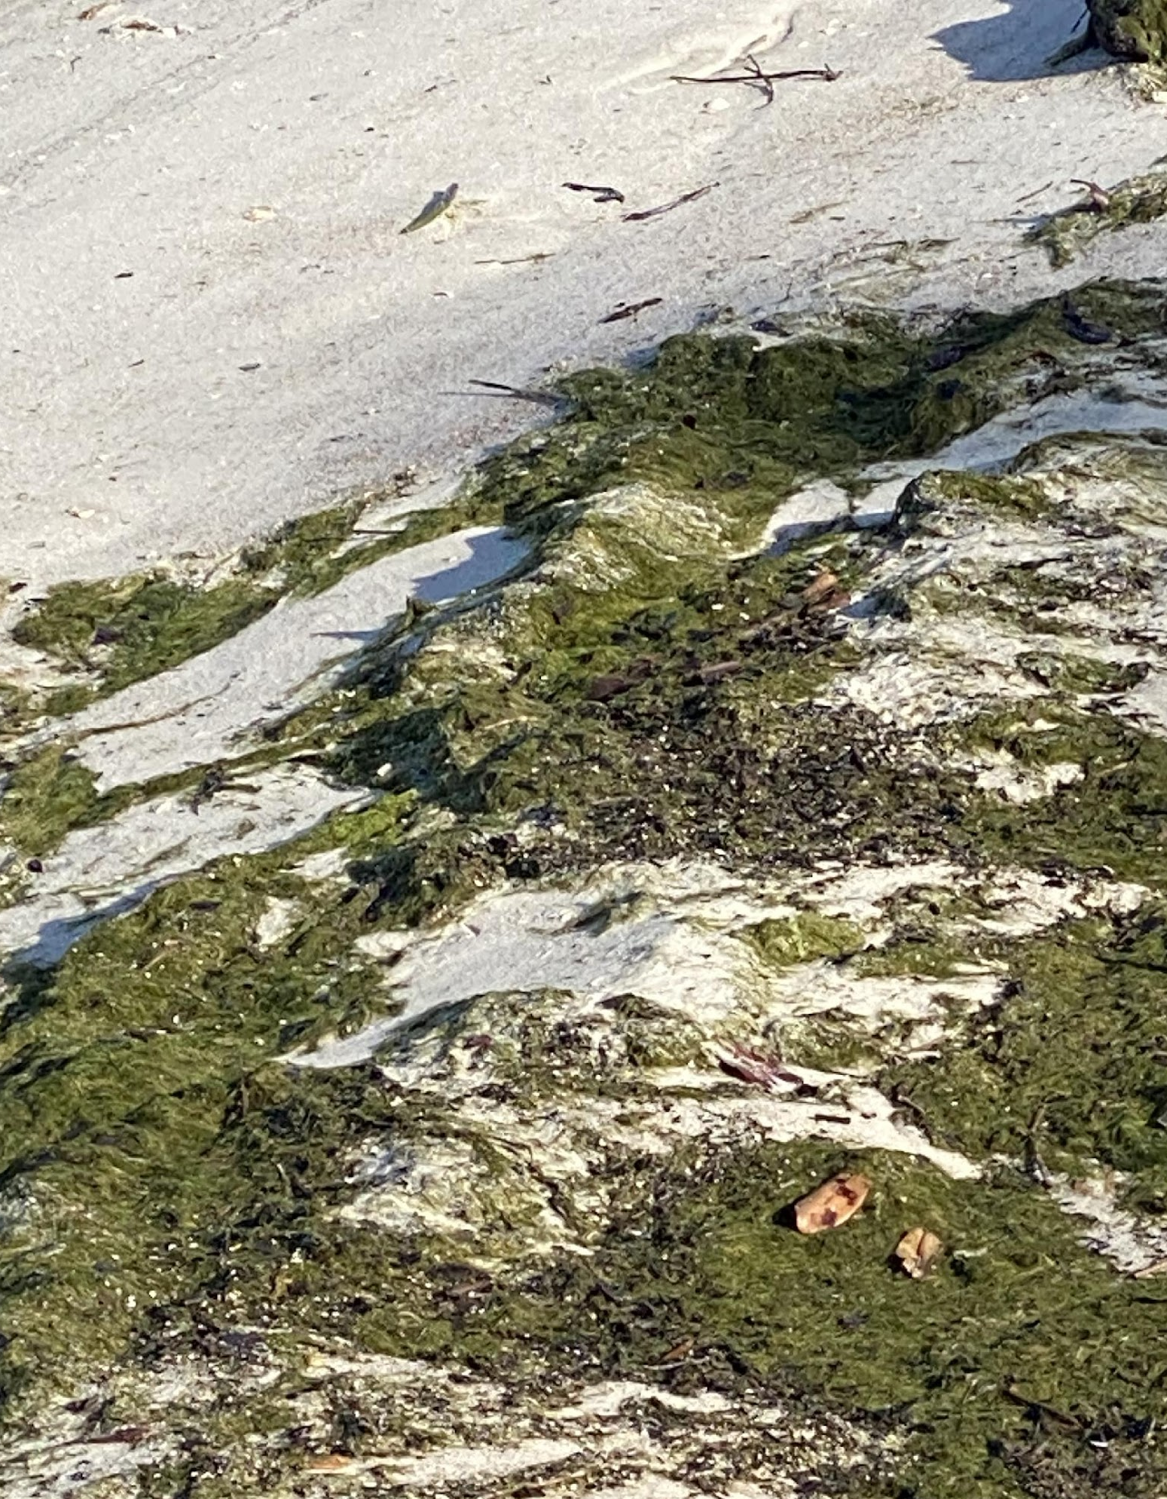
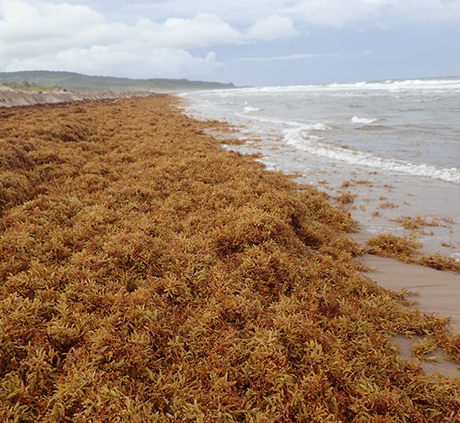
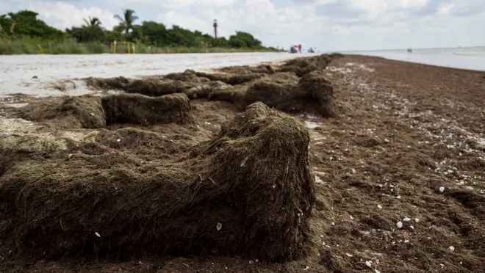
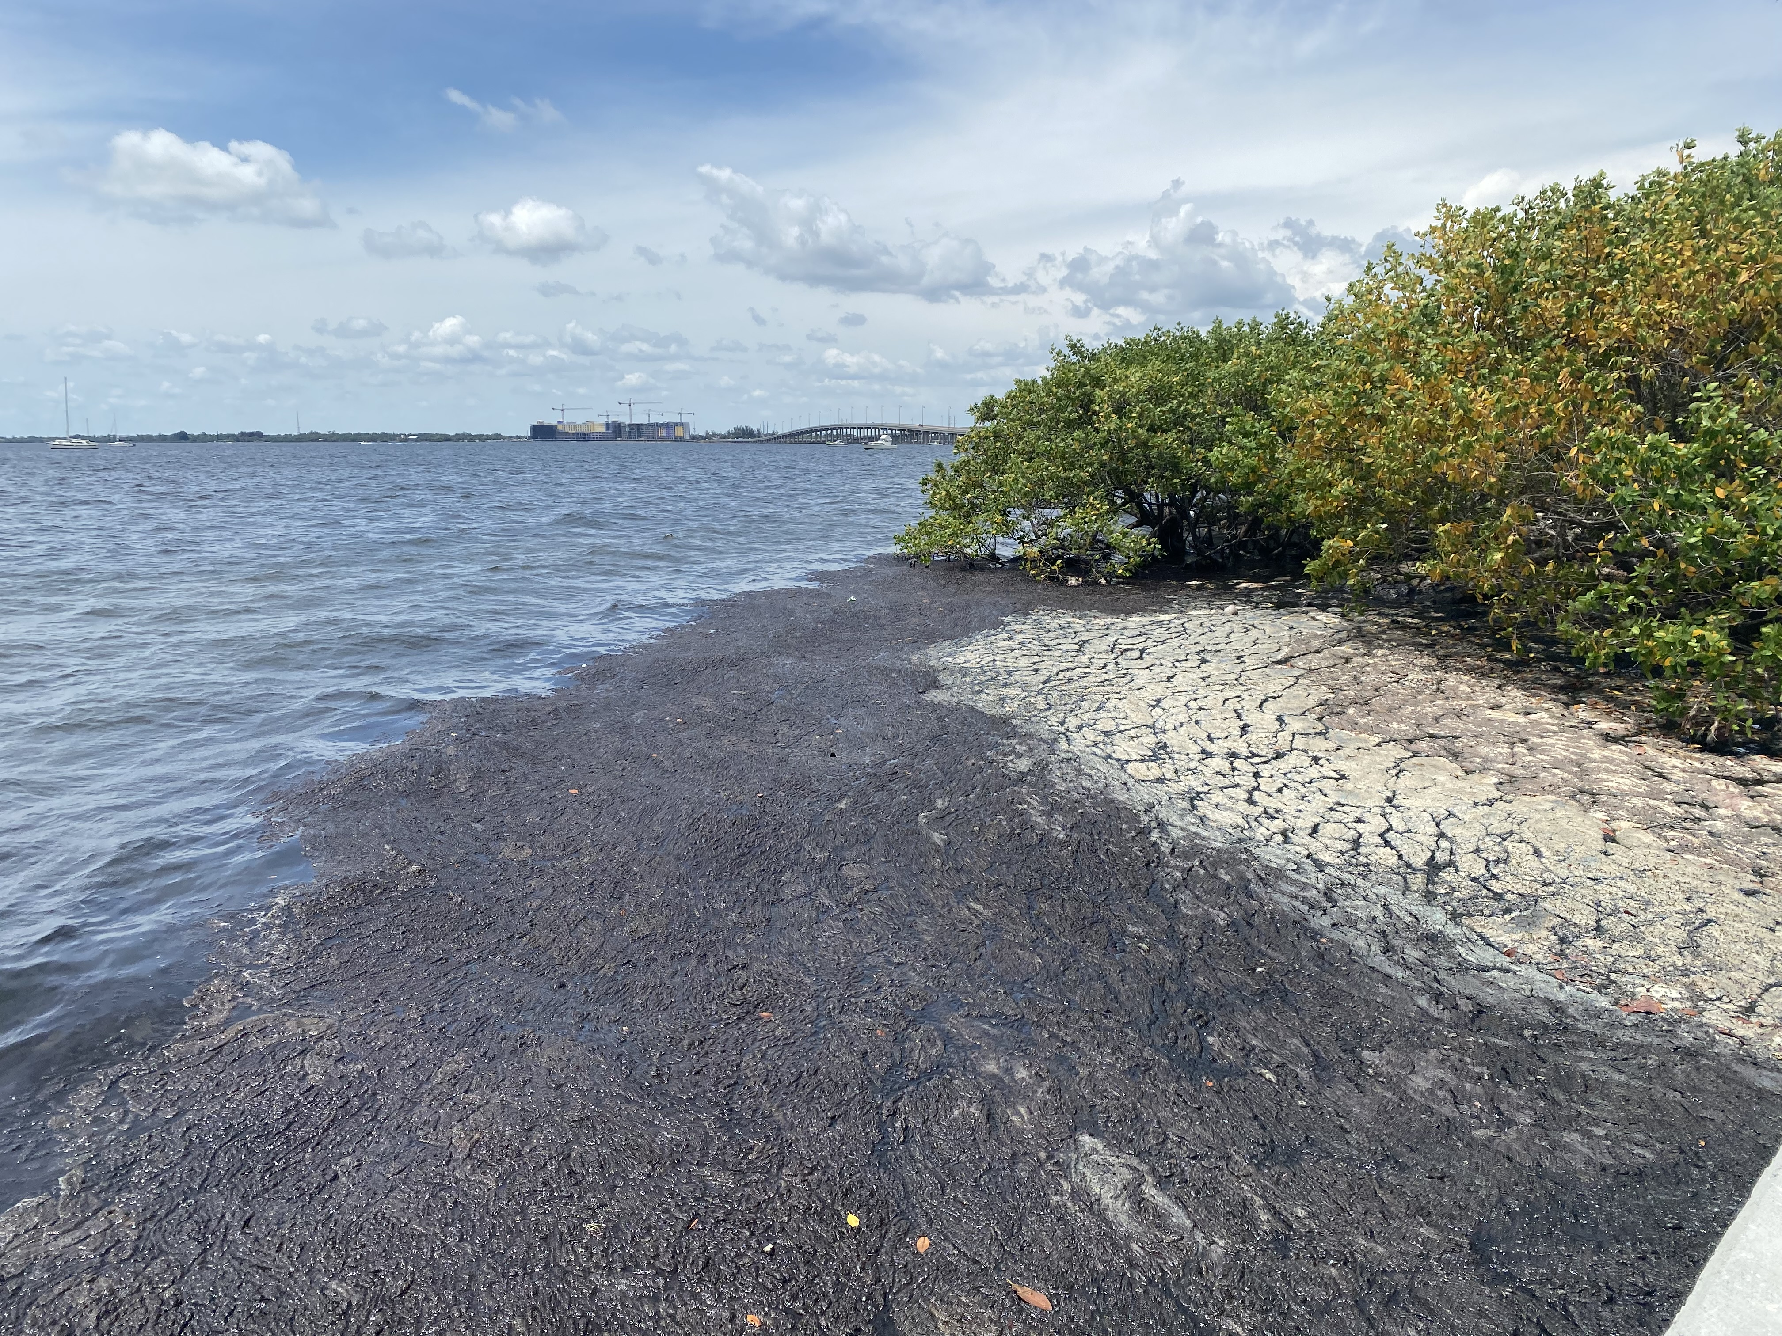
Macroalgae & Benthic Cyanobacteria
D. Berthold image
Sargassum sp.
Red drift algae
Green algae
Benthic cyanobacteria
Notes:
Although we often don’t think of macroalgae as being harmful, you can see here that under the right conditions they can form dense proliferations. In the water, these proliferations can shade submerged vegetation and cause hypoxic conditions. And when they pile up onshore, they can release noxious gases as they decompose. Benthic cyanobacteria, as seen in the photos on the right can also form dense proliferations and have similar consequenses when they pile up along shore. Benthic cyanobacteria proliferations occur in fresh and saltwater environments and as previously mentioned, may produce toxins.

Slide 14
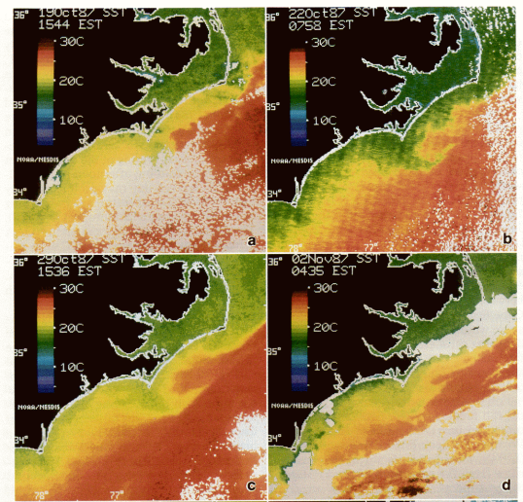
HAB detection using satellite
1987-1988
48 people sickened
$48.8 million economic loss to NC coastal economy
Tester et at., 1991
https://www.nesdis.noaa.gov/news/satellites-see-red-blue-and-green-monitoring-harmful-algal-blooms-space
Notes:
The use of satellites to track harmful algal blooms is a relatively young field, tracing back to the fall of 1987 when scientists used NOAA satellite data to track a bloom of Karenia brevis-- the algal species responsible for “Florida red tide”-- off the coast of North Carolina. The use of sea surface temperature satellite remote sensing data provided strong evidence that the bloom resulted from the transport of cells from the Gulf of Mexico to the coastal waters near Cape Lookout. According to a group of NOAA scientists who wrote about the episode in an article for Harmful Algae News, the North Carolina bloom “illustrated the need for near real-time satellite data and gave birth to NOAA’s CoastWatch Program.” (Source: NESDIS) Today, most harmful algal bloom monitoring using satellites rely on those carrying ocean color instruments.

Slide 15
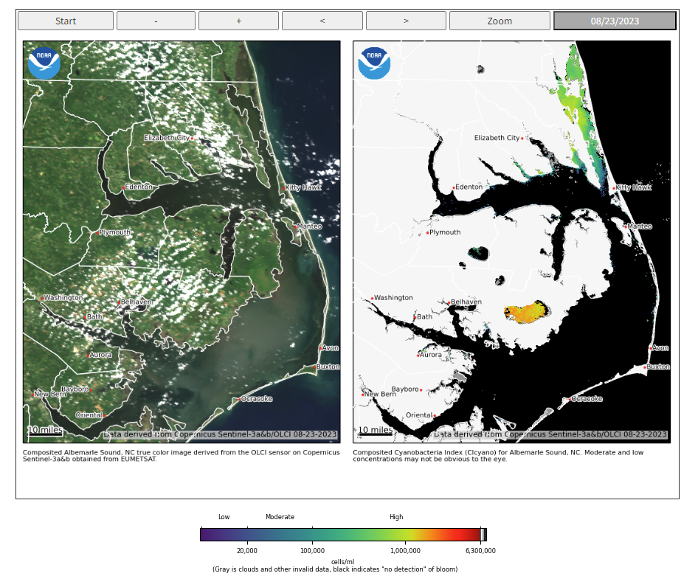
HAB detection using satellite
Albemarle Sound, North Carolina, August 23, 2023
https://coastalscience.noaa.gov/science-areas/habs/hab-monitoring-system/
Notes:
In the next HABs module, we will explore how satellites are used to detect and monitor harmful algal blooms. In addition, we will look at examples of satellite use in HAB forecasting.

